Slide 1
RELIGIOUS
FREEDOM
Jack Gibbs
775-2005
Jason Bertoldie
777-2151

Slide 2
Terms and Definitions
Religious freedom:
  The right to observe the tenets of your respective religion or to observe no religion at all
Religious accommodation:
  Allowances for individual expressions of sincerely held beliefs
    Conscience
    Moral principles
    Religious beliefs
  CAVEAT:
    Allowances are not made if they will adversely impact military readiness, unit cohesion, standards or discipline
    For ease of reference this caveat will be referred to as the ‘adverse impact caveat’
Chaplain Corps:
  Personnel that advise and assist leadership in making religious accommodation requests (IAW DoDI 1300.17)

Slide 3
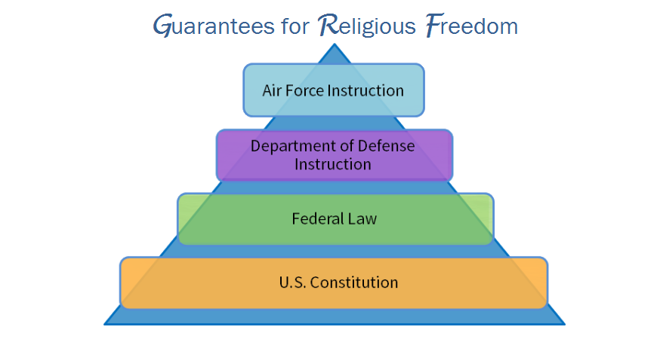
Protection of Religious Freedom
Guidance…
  The U.S. Constitution is the guarantor of religious freedom
  Federal law provides specific rules to protect that freedom
  The DoD & the Air Force use legally informed instructions to:
    Ensure mission success
    Protect the religious freedom of all Airmen

Slide 4

The First Amendment
Part 1 of the 1st Amendment
The Establishment Clause
  Prohibits Congress from:
    Establishing a national religion
    Making laws that favor one religion over another
    Preferring religion over irreligion

Slide 5
The First Amendment (cont’d)
Part 2 of the 1st Amendment
  Congress may not make laws restricting religious freedom
Interpreting the 1st Amendment clauses
  As citizens, Airmen have religious freedom BUT…
  As agents of the government, Airmen may not:
    Coerce subordinates toward a religion
    Improperly restrain individuals from practicing a religion
Airmen may practice their faith or no faith
The Air Force does not officially endorse a religion

Slide 6
The NDAA of FY2014
National Defense Authorization Act (NDAA)
Codifies the protection of Rights of Conscience
NDAA 2 main areas:
  Accommodations are granted IAW the adverse impact caveat
  Disciplinary or Administrative Action:
    Is not precluded for conduct prohibited by the UCMJ
      Chapter 47 of Title 10, United States Code

Slide 7
Accommodations
Religious accommodations generally fall into five major areas:
  Worship Practices
  Dietary Practices
  Medical Practices
  Religious Apparel
  Personal Appearance and Grooming

Slide 8
Accommodations (cont’d)
Designated leaders should consult the chaplain and legal regarding all religious accommodation requests
  Accommodation requests are approved IAW the adverse impact caveat

