Slide 1

New Employee Orientation
Introduction to Resilience Training

Slide 2
What do you think of when you hear the word resilience?
?
Notes:
Facilitated Discussion:
Ask participants:
What do you think of when you hear the word resilience?
Write these responses on a whiteboard or writing pad, if available.
Note to trainer:
If participants are quiet, give them time and let there be some silence until participants provide some responses. It is important to give them a chance to respond and set the tone that the training will require participation.
2

Slide 3
What is resilience?
The ability to:
  Successfully adapt and recover after stress or a challenge
  Continue to perform well in the face of change or stress
Having a sense of wellbeing and a personal mission or purpose
“Being mentally ready”
Meredith et al, 2011; Jensen & Fraser, 2005
Notes:
Note to Trainer:
Be sure to also cover what resilience is not-–it is a larger construct than just bouncing back from adversity, or being happy. It also isn’t a personality trait—meaning, you are either resilient or you are not. People can be more or less resilient depending on the situation they are in.
Instructions to Participants:
Resilience is the ability to adapt and recover after adversity or stress. It is also the ability to maintain performance when facing change.
Resilience is recovering from both major and minor stressors. Research suggests that it is the day-to-day stressors that can actually compromise our performance even more so than major stressful events.
Resilience is also larger than just dealing with stress. Resilient people also have a strong sense of wellbeing and purpose. They feel connected to a personal mission or sense of purpose.
Resilient people also have resources that help them when needed—whether those are friends or family members who can provide support, or the ability to draw on their strengths when needed.
Resilience is not:
Only focused on trauma or adversity (e.g., “bouncing back” in the face of trauma)
Being happy
Something either you have or you don’t. You can be professional resilient but feel less resilient in your personal relationships. Or, you can go through some times in your life where you feel less resilient than other periods.
It is also not just a social activity.

Slide 4
Do you think you are very resilient?
?
Notes:
Facilitated Discussion:
Ask participants:
Do you think you are very resilient?
4

Slide 5
Why Resilience Matters
Increases in:
Decreases in:
Navigating change, adapting, and recovering after stressors
Performance under pressure
Communication & teamwork
Leadership
Decision-making and ability to generate ideas
Sleep
Immune functioning
Stress symptoms
Disengagement
Burnout
Cynicism & pessimism
Blood pressure
Notes:
Instructions to Participants
Resilient people also experience less problematic issues. They are less likely to be affected by stress symptoms, disengagement, and burnout. They are also less likely to be cynical or pessimistic.
And they have lower blood pressure than non-resilient people.
The benefits of resilience are clear and well-supported by science.

Slide 6
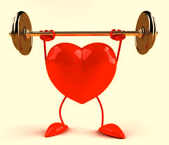

Why resilience training?
Allows you to train your mind, just as we train our bodies with PT.
Provides a set of tools designed to help your personal and professional performance.
Notes:
Instructions to Participants:
Why does the Air Force have resilience training? To stay physically fit, we train our bodies with physical training. Your mind is also like a muscle, and the skills you have to help it perform better, the stronger it becomes. Learning and using resilience skills is like training for your mind.
And, just like an effective physical training program that includes different skills to accomplish different goals—cardio, strength training, good nutrition—resilience training includes multiple tools designed to help you be mentally prepared and improve your personal and professional performance.

Slide 7
Good News
You can learn to be more resilient
No matter where you start, there is always room for growth
Performance and Resilience
Notes:
Instructions to Participants
The good news is that resilience can be learned. Our goal is to shift the resilience and performance curve for everyone. No matter where you start (or how well you perform), there is always room for growth.

Slide 8
Resilience Training Overview
Module 1: Values and Strengths
  Gratitude: Look for the Good
  Values-Based Goals: What do you stand for?
  Bring Your Strengths
Module 2: Resilient Thinking
  Reframe
  Balance Your Thinking
  Celebrate Good News
Module 3: Focus and Attention
  Mindfulness: Be Present
  Physical Resilience

Slide 9
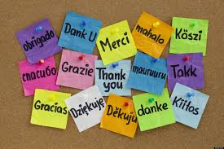
Gratitude:
Look for the Good
Notes:
Gratitude: Look for the Good: (8 minutes)
Background (1-2 minutes)
Definition of Gratitude (2 minutes)
Negativity bias and Benefits of Positive Emotions (2-3 minutes)

Slide 10

How Does Gratitude Help?
Builds optimism and positive emotions by paying attention to good things.
Helps you cope with daily hassles and stress.
Improves social relationships.
Notes:
Instructions to Participants:
The goal of this skill is to help people build optimism and positive emotions.
A regular gratitude practice can help you deal with those daily stressors, as well as more significant adversity in your life.
Appreciating things in your life and focusing on the positive can help you adjust and move forward after stressful events.
Researchers have found that expressing gratitude can strengthen social relationships.

Slide 11
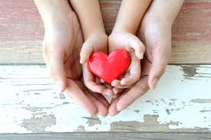
What Is Gratitude?
A sense of wonder, thankfulness, and appreciation for life.
Looking for the good helps us focus on what went right.
Emmons, 2007
Notes:
Instructions to Participants:
Gratitude is a sense of wonder, thankfulness, and appreciation for life.
While we often focus on things that went wrong, cultivating gratitude is a tool that allows you to think about what went right. By actively looking for the good things in our life, we boost positive emotions.
Resilient people don't have fewer negative emotions. Instead, they feel more positive emotions, which allows them to rebound from stress and adversity more easily.

Slide 12

Negativity Bias
We are more likely to pay attention and remember negative things than positive things.
Negative emotions trigger:
  Flight
  Fight
  Freeze
Baumeister, 2001; Rozin & Royzman, 2001
Notes:
Instructions to Participants:
We have a natural “negativity bias.”
We are hard-wired to focus on negative events and emotions.
We are more likely to remember negative things than positive things. We process negative information more quickly than positive information.
We work harder to avoid a bad mood than experience a good one
Paying attention to those negative events (and danger) helped us to survive and trigger our fight, flight, or freeze instincts. But, that negativity bias may not serve us as productively any more.

Slide 13
Positive Emotions Can Help Us Focus And Be More Creative
Gratitude and other positive emotions help us:
  Counteract the negativity bias
  Discover and develop new skills
  Improve our performance
Broaden and Build Theory, Fredrickson & Joiner, 2002
Notes:
Instructions to Participants:
Positive emotions are the “fuel” for resilience. They can help us find meaning in our daily experiences, which in turn, builds more positive emotions. Psychologist Barb Fredrickson calls this the “upward spiral.”
Looking for good things helps us counteract our negativity bias.
Experiencing gratitude and other positive emotions make us more likely to discover and develop new skills, and be more creative. Positive emotions help us refocus our attention on good things and helps us perform better.

Slide 14
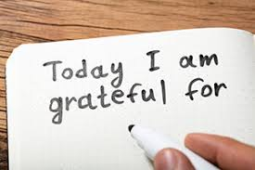
Skill: Gratitude
Gratitude builds optimism & positive emotions, helps you cope with stress, & improves relationships.
  Develop a regular (daily or weekly) gratitude practice that:
    Includes 1-3 things that you are are grateful for
    Includes a REFLECTION ON WHY you are grateful
Notes:
A great way to cultivate gratitude and, in order to counter the negative bias and generate more positive emotions, create a regular practice in which you are reflecting on the things for which you are grateful.
Start a daily practice where you write down what went well or what you are grateful for.
Think about something that happened in the past 24 hours. It might be a good event that happened to you, a goal you achieved, or an something that someone did for you.
Reflect on what you are grateful for.
Think about why it went well or how you or others in your life contributed to the good thing.
These reflection questions are key to ensuring you get the benefits of this skill. Reflecting on the good thing helps make the exercise more meaningful and creates more positive emotions.

Slide 15
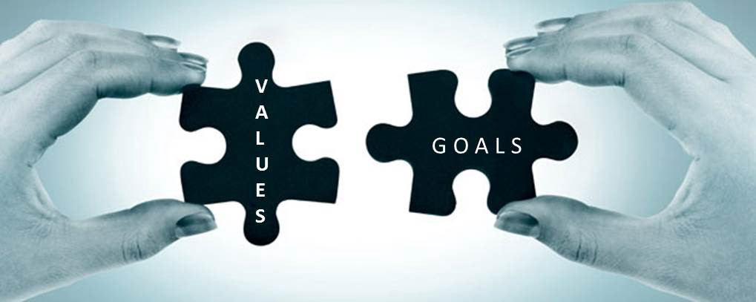
Values Based Goals
Notes:
Values-Based Goals: (11 minutes)
Background (3 minutes)
Set-up Best Version of You (2-3 minutes)
Best Version Activity and Facilitated Debrief (5 minutes)

Slide 16
How Does Values Based Goals Help You?
Goals that are values-based are those that are meaningful to you. They:
  Provide a sense of purpose and meaning
  Ensure you are pursuing YOUR goals, not the expectations of others
  Help us prioritize what is important
(Ryan & Deci, 2000)
Notes:
Instructions to Participants:
Research has shown that intentionally living your values provides us with a sense of purpose and a feeling that life has meaning. Values Based Goals also gives you insight about yourself and your values and enables you to consistently act on your values.
Values Based Goals provide a boost of positive emotions and encourage an orientation to the future--optimism.
Studies have shown that it is important to set goals based on your values rather than pursue goals you think others want. Working towards the goals of others can undermine the sense of accomplishment you get from reaching those goals, and can make the process less meaningful. Choose goals that you can own not the goals that you think you should do.
Intentionally living your values means you have prioritized what is most important to you.
16

Slide 17
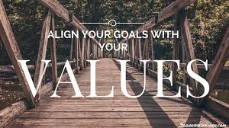
Values Review
Best Version Of You
Review Values on the next slide –what values do you want to be most known for?
Imagine the BEST VERSION of you.
3. Write out what the best version of
you looks like
on a sticky note
Notes:
Instructions to Participants:
For the first activity I want you to think about the best version of you, lets start with your values
Step 1 – Review Values on the next slide – Pick out 3 that you think best defines you.
Step 2 – Now, using these values, think about and write out what the best version of you looks like (give them 4 min)
Notes to Facilitator:
If you haven’t seen the video of the One Sentence described please view it on your own before teaching this activity.
Examples from Daniel Pink:
https://www.danpink.com/2010/10/whats-your-sentence-the-movie/
New One Sentence videos from around the world - https://www.youtube.com/watch?v=xjBmnfI4Tn4
Original video - https://www.youtube.com/watch?v=8wGTXc-j7-c&spfreload=10
Transition – you have probably had some supervisors who you till talk about today… What do you say about them? Ask 2-4 people to share, repeat and rephrase if necessary using the starter He/She was…
Take about 2 min to get examples
Examples: “He never stopped trying to figure things out” “She hoped that others could learn from the mistakes she made, and felt it was her mission in life to help others achieve.” “He helped solve problems. Big and small” “she handled life’s problems with energy and vigor, doing nothing half heartedly”

Slide 18
Values
Adventure
Challenge
Collaboration
Commitment
Community
Courage
Curiosity
Creativity
Discipline
Discovery
Efficiency
Enthusiasm
Environment
Equality
Excellence
Fairness
Faith/Religion
Family
Freedom
Friendship
Fun
Generosity
Gratitude
Happiness
Hard Work
Harmony
Health
Helping Others/Compassion
Honesty
Humor
Independence
Innovation
Integrity
Interdependence
Leadership
Love
Loyalty
Meaningful Work
Mindfulness
Openness
Personal Growth
Problem Solving
Reliability
Resourcefulness
Self-Reliance
Simplicity/Thrift
Strength
Tradition
Trust
Willingness
Wisdom

Slide 19
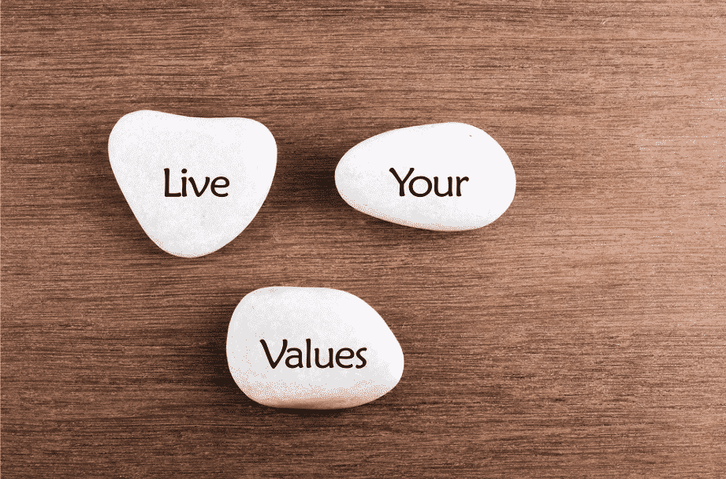
Skill Review: Values Based Goals
Values Based Goals helps us find opportunities to live our values.
  Define your values (what you stand for).
  Live Your Values by remembering The Best Version of You!!

Slide 20
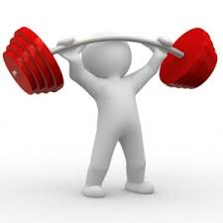
Bring Your Strengths
Notes:
Bring Your Strengths: (5 Minutes)
Background (1-2 Minutes)
Define BYS (1-2 Minutes)
Review, Questions and Wrap-up: (1-2 Minutes)
http://www.viacharacter.org

Slide 21
How Does Bring Your Strengths Help You?
Improves engagement and purpose
Energizes you and boosts mission performance
Builds meaning and wellbeing
Leaders who recognize strengths in others improve individual and team performance
(Harter, Schmidt, & Hayes, 2002; Peterson et al, 2009; Stefansson, 2007; CLC, 2002)
Notes:
Instructions to Participants:
Many of us focus on what is wrong with us, or how we need to improve. We don’t spend enough time focusing on our strengths, and what is right about us.
But research has shown that bringing our strengths to the table improves our performance. It helps us stay more engaged in what we do, and brings a sense of meaning and purpose.
People using their strengths have a stronger sense of well-being and experience less stress. They are more energized in the task.
Using strengths in your job is associated with a range of health and performance benefits. Compared to those who do not use their strengths, employees who use their strengths at work:
Were more engaged
Were more satisfied
Had lower turnover
Leaders who recognize and the strengths of people on their team improve both individual and team performance.
21

Slide 22

What Are Your Signature Strengths?
They are those that you own, celebrate, and exercise frequently.
“Being the best you”.
To Find Your Signature Strengths Go To:
http://www.viacharacter.org
Notes:
Instructions to Participants:
Signature Strengths are those that you feel ownership over, celebrate using, and exercise frequently.
Many people report feeling a sense of authenticity and excitement when using their Signature Strengths.
Using your Signature Strengths is “being your best you”.
The VIA survey is a great, free way to find out what your strengths are – encourage your family members (teens/college age and older)..

Slide 23
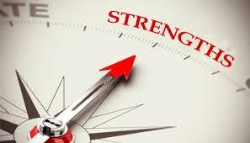
This skill improves engagement and builds meaning.
  Identify your strengths
  Find new ways to develop and to use your strengths
  Understand how your strengths can contribute to your unit’s mission

Slide 24

ReFrame
Notes:
ReFrame: (7 Minutes)
Background (1-2 minutes)
Reframe reaction example (2-3 minutes)
Review, Questions and Wrap-up: (1-2 Minutes)

Slide 25
How Does Reframe Help You?
Be aware that your thoughts about an event drive how you react
Understand the difference between your thoughts and your emotional/physical reactions
ReFrame helps you:
  Improve your performance
  Act based on your values
  Strengthen relationships
Control How You React
Notes:
Instructions to Participants:
This skill is an important foundation for the skills we will learn throughout resilience training.
The goal of Re-Frame is to help you:
Identify how your thoughts about an event contributes to your reactions—how you think about something drives how you react to it
Understand the difference between your thoughts, emotional reactions, and physical reactions.
Doing these things helps you improve your performance, act based on your values, and strengthen your relationships.
Ultimately, using ReFrame will help you control how you react.

Slide 26
Myth: Event→Reaction
Emotional
Reactions
Event
Physical
Reactions/Behavior
Adapted from Ellis, 1962; 1991
Notes:
Instructions to Participants:
People often think that if something happens to them (an event), they have an automatic physical or emotional reaction.
An emotional reaction is how you feel about the event and a physical reaction is how you act (or a physiological reaction). For example, if someone bumps your hand when you are holding a drink, you may have an immediate reaction emotional reaction of annoyance or anger, and a physical reaction of glaring at the person or shoving the person.
Quick & Simple Activity for Participants:
Option 1: If you have an emotional reaction to a driver cutting you off on the interstate please stand up? Those sitting down do you have a physical reaction?
Option 2: If you have a physical reaction to a notice that their will be mandatory meeting before you can go home for the day – please stand up? Those sitting down do you have a emotional reaction?
Option 3: If you have both an emotional and physical reaction to your significant other/boss/kid’s teachers saying we need to talk – please stand up? Those sitting down – why no reaction?

Slide 27
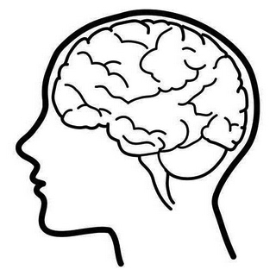
Reality: Event→Thoughts→Reaction
What you think
about that event
Emotional
Reactions
Event
Physical
Reactions/Behavior
Events aren’t positive or negative…only our thoughts about them are!
Adapted from Ellis, 1962; 1991
Notes:
Instructions to Participants:
In reality, there is a critical period where we interpret the event—meaning how we think about that event. Let’s walk through this process.
First, something happens to you: An event or a trigger. An event is anything that you may react to.
What you think about the event drives our emotional and physical reactions (what we feel and what we do). Not the event itself.
An event isn’t positive or negative—it is how you think about the event that makes it positive or negative. For example, some events may be positive to one person (like having a baby) or negative for another person.
Bottom line is that we don’t automatically react. Instead, we react based on how we think about the event. So, we can choose what thoughts we react to.
Because we don’t usually think about our reactions, let’s spend some time thinking about physical reactions and behaviors.
Provide your own example of an event to explain the reality.

Slide 28
Review: ReFrame
ReFrame helps identify your thoughts that drive your reactions ensuring them to be productive.
Objectively describe the event
Identify and differentiate between thoughts, emotional, and physical reactions
Determine if the reaction is helping or hurting your performance
Reframe your thoughts in a way that will help you be more productive

Slide 29
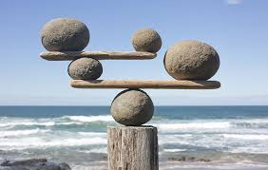
Balance Your Thinking
Notes:
Balance Your Thinking: ( 9-10 Minutes)
Background and Overview of Cognitive Traps (1-2 minutes)
Discussion of Cognitive Traps (4-5 minutes)
Balance Your Thinking Strategies (2-3 minutes)
Review, Questions and Wrap-up: (1-2 minutes)

Slide 30
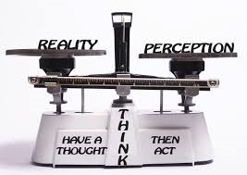
How Does Balance Your Thinking Help You?
Helps you see situations accurately and take action based on evidence.
Helps you respond in ways that align with your values and support your goals.
Helps you improve performance by reacting to facts and evidence.
Notes:
Instructions to Participants:
Balance Your Thinking is a skill that builds on ReFrame. Sometimes it might be enough for us to examine the connections between our thoughts and reactions, but other times we may need to ask more questions to ensure our thoughts are accurate.
Balance Your Thinking is a skill to ensure you perceive situations accurately, and help you react productively.
The skill also helps you respond in ways that align with your values and support your goals
Think of this skill as a way to look at a situation like a person on the outside looking in, seeing everything and evaluating based on evidence and facts, not a gut feeling or reactions.

Slide 31
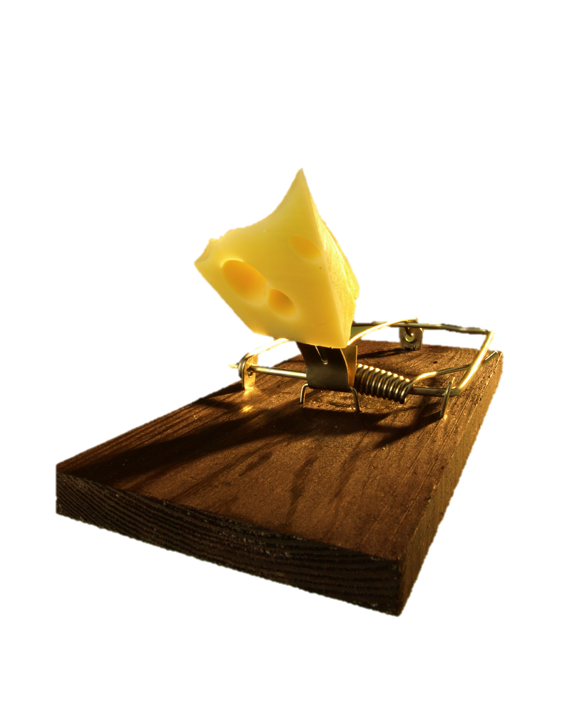
Cognitive Traps
Cognitive traps interfere with accuracy.
They often involve jumping to conclusions.
We all get stuck in them!
Beck, Seligman
Notes:
Instructions to Participants:
Our beliefs and thoughts can interfere with our ability to accurately assess a situation.
Sometimes we don’t fully consider all the evidence and we make inaccurate judgments about an event. We can focus on the wrong information, miss something valuable, or make assumptions.
The goal of Balance Your Thinking is to help you avoid these cognitive traps so that you can perceive situations accurately.
We’ll talk about a few cognitive traps that many people can relate to, but generally, these are just examples. The main goal of this skill is to make sure you can get out of the trap.

Slide 32
Examples of Common Cognitive Traps
All-or-nothing
Confirmation bias
Blaming others/Blaming yourself
Mind reading
Beck, 1995
Notes:
Instructions to Participants:
There are many different cognitive traps, but generally they are all a form of reacting when you don’t have all the information you need, or you aren’t fully considering everything. We will discuss each of these cognitive traps in greater detail, but this isn’t an exhaustive list, and they aren’t mutually exclusive. You can also be stuck in multiple traps at the same time.

Slide 33
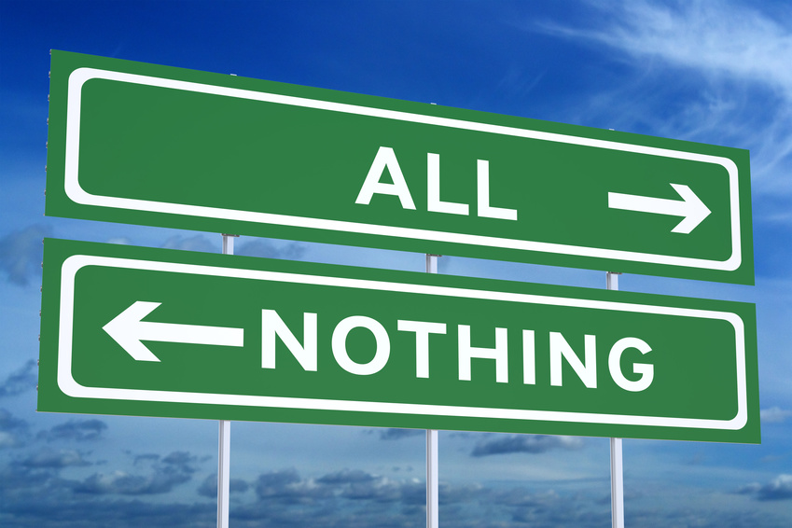
Looking at things in extreme ways
  Example: “Nothing ever works out for me”
  Everything…always…never
Beck, 1995
Notes:
Instructions to Participants:
One of the most common cognitive traps is all-or-nothing. All-or-nothing thoughts are characterized by absolute terms like always, never, and forever. It can also be thinking of something as only good or bad, perfect or terrible. Getting stuck in this cognitive trap can contribute to a sense of hopelessness. For example, ‘you ALWAYS leave the lights on” or ‘you NEVER remember your keys.’
Absolute thinking for example when we won’t try something because we think/know we won’t be perfect at it.
Few things are ever absolute, and there are generally grey areas. When we are stuck in this trap, we forget those grey areas.

Slide 34
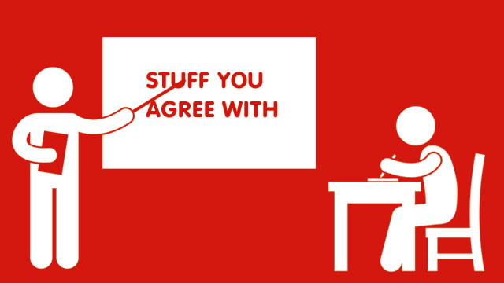
Confirmation Bias
We are attracted to information that supports what we already believe and ignore evidence that doesn’t fit.
Beck, 1995
Notes:
Instructions to Participants:
Confirmation bias is when we only find information that supports our existing opinion. We are attracted to information that confirms what we already believe. We search for or interpret information in a way that confirms our existing beliefs and thoughts. For example, if you believe that a co-worker is difficult to work with, you may only see him or her doing things that confirm that opinion—like being late or making a mistake. If you have a confirmation bias, you miss the positive things that co-worker may do, such as stay late to work on something, or help someone else.

Slide 35
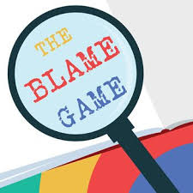
Blaming Others and Blaming Yourself
Blaming others: Only focus on other people as the cause of events
  “You Distracted Me”
Blaming Yourself: Ignoring the contributions of others
  “I missed the final free throw so it is my fault the team lost the game”
Beck, 1995
Notes:
Instructions to Participants:
Blaming others is when we focus only on other people as the source of your feelings or the cause of events. For example, “I couldn’t get to sleep early because my roommate kept me up watching movies.”
Blaming yourself is when we only think about yourself in a situation, and not seeing the contributions of others. For example, your supervisor is very quiet, and you assume he or she is upset about your performance. Instead, it may be that he or she may be thinking of something unrelated.

Slide 36
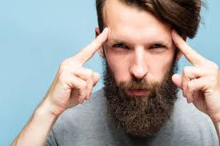
Mind Reading
Two forms:
  Assuming you know what the other person is thinking, or
Expecting another person to know what you are thinking
Beck, 1995
Notes:
Instructions to Participants:
“Mind reading” is something we’re all guilty of at some time or another. It can come in two different forms:
Assuming you know what the other person is thinking, or
Expecting another person to know what you are thinking.
How many of you live with or have lived with a mind reader?

Slide 37
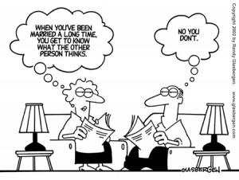
Notes:
Instructions to Participants:
One of the most common places this happens is in close relationships…
After so much time together, you start to assume you know what your best friend or spouse is thinking, and may expect him/her to know what you’re thinking.

Slide 38
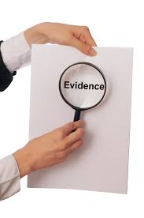
Strategy: Examine The Evidence
Examine the evidence:
  Is there any evidence to support this thought?
  Is there any evidence to challenge this thought?
  Am I missing any information?
Notes:
Instructions to Participants:
How can we avoid these cognitive traps? When you find yourself using unbalanced thinking, you can try three strategies to get out of it:
Let’s start by examining the evidence. Do you know everything you need to know? Is there any evidence to support what you think? Is there any evidence to challenge what you think? Am I missing information that would help me react more productively?
Note to Trainer:
Depending on timing, as you move through the strategies, you can ask participants to identify their own examples for each strategy.

Slide 39

Strategy: Check For A Double-Standard
  Check for a Double-standard:
  Would I judge other people as harshly if they did the same thing?
  Am I judging myself more harshly than I would judge someone else?
Notes:
Instructions to Participants:
For the second strategy, Check for a double-standard:
Would I judge other people harshly if they did the same thing?
Am I judging myself more harshly than I would judge someone else?
For example: You missed a foul shot and blame yourself for losing the game. If a team mate missed a foul shot, would you blame him/her for the entire loss?

Slide 40
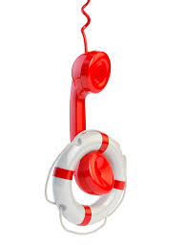
Strategy: Phone-a-friend Or Ask
  Phone-a-Friend or ask:
  - Find out if someone unbiased agrees with your thoughts
  - Ask the person(s) involved
Notes:
Instructions to Participants:
The third strategy is to get a second opinion--you can always phone a friend. Make sure you ask an unbiased friend who will be able to see the situation objectively. Find out if someone you trust agrees with your thoughts.
Ask the people involved so you can be more accurate about the situation.

Slide 41
Review: Balance Your Thinking
Balance Your Thinking helps you perceive situations accurately and take action based on evidence.
Determine if you are in a cognitive trap
Use the three strategies to Balance Your Thinking
    Examine the evidence
    Check for a Double-standard
    Phone-a-Friend or Ask
Revise your interpretation of the event if needed

Slide 42

Celebrate Good News
Notes:
Celebrate Good News: (6-7 Minutes)
Background (1-2 minutes)
Demonstrate Negative Strategies (1-2 Minutes)
Activity: Try Celebrating Good News and Debrief (4 minutes)
Review, Questions and Wrap-up: (1 minutes)

Slide 43

How Does Celebrating Good News Help You?
Builds, strengthens, and maintains important relationships.
Relationships are critical for resilience.
Notes:
Instructions to Participants:
This skill strengthens your relationships, which are critical for helping you be resilient.
We are often supportive to our friends and family members when they need our support in times of stress. We drop everything to be there when someone is struggling. But actually, how you respond to good news may actually be more important for strengthening relationships.
Celebrating Good News provides a boost of positive emotion for both you and the person you are supporting—and those positive conversations lay important groundwork for times when someone needs your support.
43

Slide 44
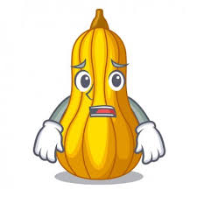
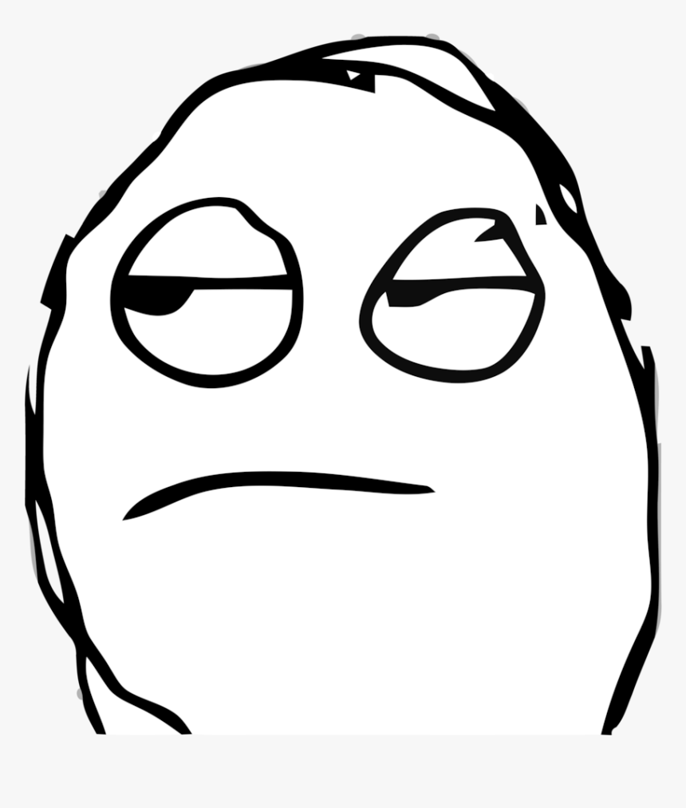
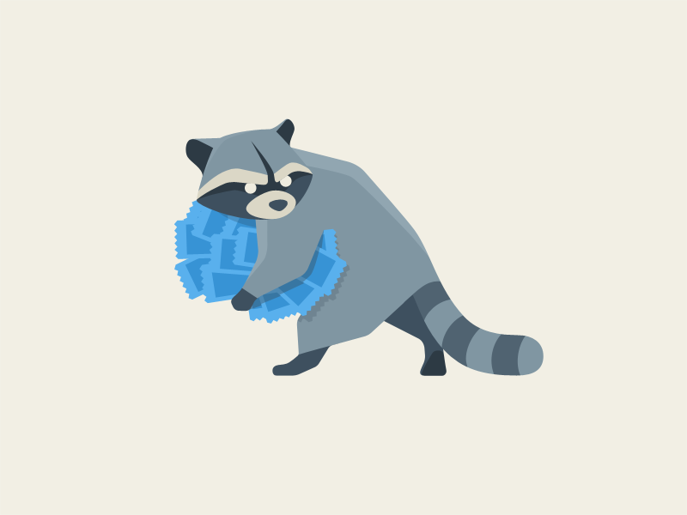
Responses That Deflate
Squash: Points out problems or provides negative feedback.
Steal: Focuses on him or her self; ignores the event.
Shut down: Responds with low energy; doesn’t care that much (or is distracted); “That’s nice”.
Notes:
44

Slide 45

Celebrate!
A better strategy:
  Ask questions
  Show enthusiastic support
  and interest
  Be authentic
  Be engaged and interested
Notes:
Celebrating the News is a better way to build the relationship. You can help the other person celebrate the moment by:
Asking questions, by seeking additional details about the event or asking why the event is meaningful
Expressing excitement and enthusiasm about the positive news
Being engaged and interested
Showing authentic interest and support
45

Slide 46
Key Points
It is not about the news….it’s about the person!
Help the other person savor the moment.
If you are concerned about the news, think conversation A, then conversation B.
Don’t celebrate something dangerous! Intervene if needed.
Provides a gateway conversation.
Notes:
Instructions to Participants:
There are several key points to remember about this skill
First, celebrate the news because you care about the person, not necessarily the news. For example, your friend may tell you that he received a care package from home. You may not care about what was in the care package, but you care about your friend.
Celebrating good news doesn't have to be time consuming. Asking a few questions doesn’t take much time.
Help the other person celebrate the moment and re-live their positive emotions.
If the news they share is dangerous, do NOT celebrate. It is okay to express your concern about something that may hurt the person. If the news isn’t dangerous, but you still have concerns, think about having Conversation A and then Conversation B. Conversation A celebrates the good news and builds positive emotions. Conversation B can be about your concerns.
Being there for someone when they share good news can be a gateway conversation in the relationship. If the person trusts you to celebrate good news with them, they may also trust you when they need to talk about something more difficult.
46

Slide 47

Turn to a partner and share good news.
Partners: Help them celebrate and savor the moment.
Notes:
Instructions to Participants:
Let’s try it in pairs now. Turn to your partner and share some good news.
4 Minutes.
47

Slide 48

Review: Celebrating Good News
Celebrating Good News builds, strengthens, and maintains relationships.
Celebrate good news by:
  Being authentic
  Asking questions
  Showing support

Slide 49
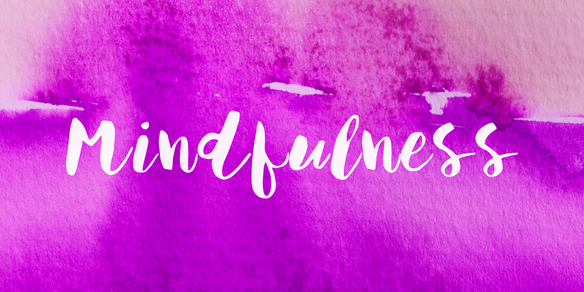
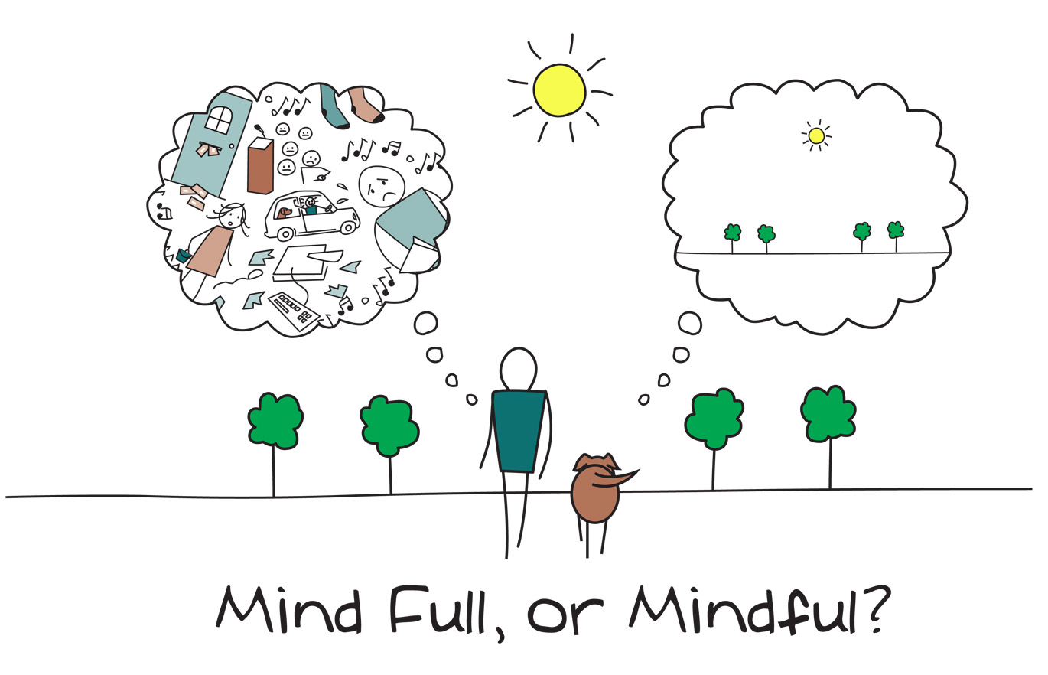
Notes:
Mindfulness: (5-6 Minutes)
Background (1-2 Minutes)
Mindfulness Practices (2-3 Minutes)
Review, Questions and Wrap-up: (1-2 Minutes)

Slide 50
How Does Mindfulness Help You?
Mindfulness helps you:
  Stay present and engaged
  Improve focus and the ability to concentrate on what is important
  Take action during stressful times
  Improve sleep and physical health
Notes:
Instructions to Participants:
Mindfulness can help us stay present, focused and engaged.
It helps us stay focused on what is important and allows you to accept challenges in order to take purposeful action.
Mindfulness is also helpful when you are facing stress and adversity. Sometimes we go through difficult things, and we can't always control what goes on around us. Rather than ignoring or avoiding difficult things or our negative emotions, mindfulness can help us work through those tough moments and focus on taking action.
Research has also demonstrated that mindfulness practices are linked to better quality sleep and physical health. Mindful people also feel better about the work they do and are happier with their lives.

Slide 51

What Is Mindfulness?
Paying attention, in the present, on purpose
Accepting the reality of the situation, understanding what you can control, and taking purposeful action
Helps you train your mind to control where your attention goes, rather than letting your mind control you
Notes:
Instructions to Participants:
Mindfulness is when you are focused on one thing—being present in the moment. You are paying full attention to that moment, and accepting the reality of the situation or how you are feeling.
Mindfulness is determining what you CAN control and take purposeful action.
Mindfulness helps us train our mind so that we can control what we pay attention to, rather than letting our minds control us.

Slide 52
Mindfulness In The Moment
Use mindfulness in the moment when your thoughts and emotions:
  Are getting in the way of your performance
  Keeping you from taking purposeful action
  Or you are avoiding dealing with a difficult situation
In those cases, mindfulness can help you determine what you CAN control and take purposeful action.
Notes:
Instructions to Participants:
Many of us are familiar with feeling overwhelmed or stressed out in a way that prevents us from being productive. You may feel like you want to yell at someone, throw your phone, or put your fist through a wall. It feels like our emotions have hijacked our thoughts
Or, we sometimes work to avoid difficult situations or thoughts you may be having. In those cases, we aren't able to take action because we keep trying to avoid focusing on the issue. For example, instead of taking purposeful action, you avoid having a difficult conversation with a family member or friend, or you procrastinate on completing something you need to do. Although those things may be important, you avoid thinking about them.
In both cases, we can use a mindfulness strategy—Mindfulness in the Moment--to help you get back to a place where you can think productively.

Slide 53
Review: Mindfulness
Mindfulness in the Moment
  When you feel overwhelmed with emotions:
  Pause
  Observe your thoughts and feelings without judging them
  Recognize what is most important
  Take action
Notes:
Review

Slide 54

Physical Resilience:
Strengthening Attention and Focus
Notes:
Physical Resilience: (35 minutes)
Background (2-3 minutes)
Discussion of relationship between physical and mental resilience (5 minutes)
How mental and physical resilience influence each other (4 minutes)
Making healthy choices and avoiding shortcuts (2-3 minutes)
Focus on sleep (5-10 minutes)
Strengthen Physical Resilience Activity set up and debrief (10 minutes)
Review, Questions and Wrap-up: (2-3 minutes)

Slide 55
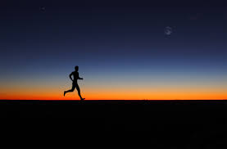
How Does Physical Resilience Help?
Strong physical resilience and wellbeing:
  Improves productivity
  Increases energy
  Sharpens focus and attention
  Enhances mood
Notes:
Instructions to Participants:
The goal of this skill is to help you strengthen your focus and attention by better understanding physical resilience.
A regular gratitude practice can help you deal with those daily stressors, as well as more significant adversity in your life.
Appreciating things in your life and focusing on the positive can help you adjust and move forward after stressful events.
Researchers have found that expressing gratitude can strengthen social relationships.

Slide 56
Reciprocal Relationship Between Physical And Emotional Resilience
Mental resilience
Physical resilience
Notes:
Instructions to Participants:
There is a reciprocal relationship between our emotional and physical well-being, meaning that how well you feel emotionally influence your physical well-being and vice versa.

Slide 57
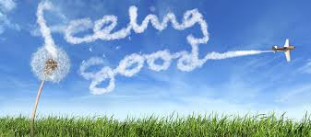
When you have stress under control, how do you feel physically?
When you have been exercising and taking care of yourself physically, how do you feel mentally?
Notes:
Facilitated Discussion:
Let’s talk about how physical and mental resilience may influence each other.
How do you think being mentally resilience might help your physical resilience?
(Note to MRT: The next two slides provide research-based links between emotional and physical resilience, but use this as an opportunity to get participants talking about the linkages in their own life.)
Possible responses:
When I have stress under control, I feel less physically tense and may have less pain in my shoulders or back. My heart rate is slower, feel more motivated to work out, better able to sleep, etc.
When I’ve been exercising and taking care of myself, I feel better able to handle stress, better focus and attention, etc.

Slide 58
DO YOU Want to???:
?
Improve your memory and overall performance?
Be able to learn more quickly and effectively?
Improve your mood?
Handle problems better?
Increase metabolism (how quickly you burn calories)?
Reduce risk for heart disease?
Perform better at sports?
Notes:
Instructions to Participants:
What if I told you there was something you could do to improve your memory and overall cognitive performance? Be able to learn more quickly and effectively? Improve your mood? Handle problems better? Increase your metabolism and lose weight more easily? Or reduce the risk for heart disease?
If that came in a pill form, would you take it?

Slide 59
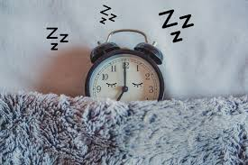
Get more sleep!
All that is possible if you are well-rested, yet:
  More than 80% of people report sleep problems at least once a week
  Centers for Disease Control has called sleep deprivation a public health crisis
Notes:
Instructions to Participants:
All that is possible if you get the amount of sleep you need. But, most people report having sleep issues at least once a week, and the Centers for Disease Control has called sleep deprivation a public health crisis.

Slide 60

Review: Physical Resilience
Physical resilience:
  Improves productivity and energy
  Sharpens focus and attention
  Enhances mood
Improve physical resilience by:
  Creating strong sleep habits
Notes:
Review

