Slide 1
WELCOME
Initial Wingman Intervention Training (I-WIT): Interpersonal Violence Prevention
Presented by:
Dave Haltom
Violence Prevention Integrator
Suicide Prevention Program Manager
75 ABW/CVB
Notes:
editable

Slide 2


Slide 3
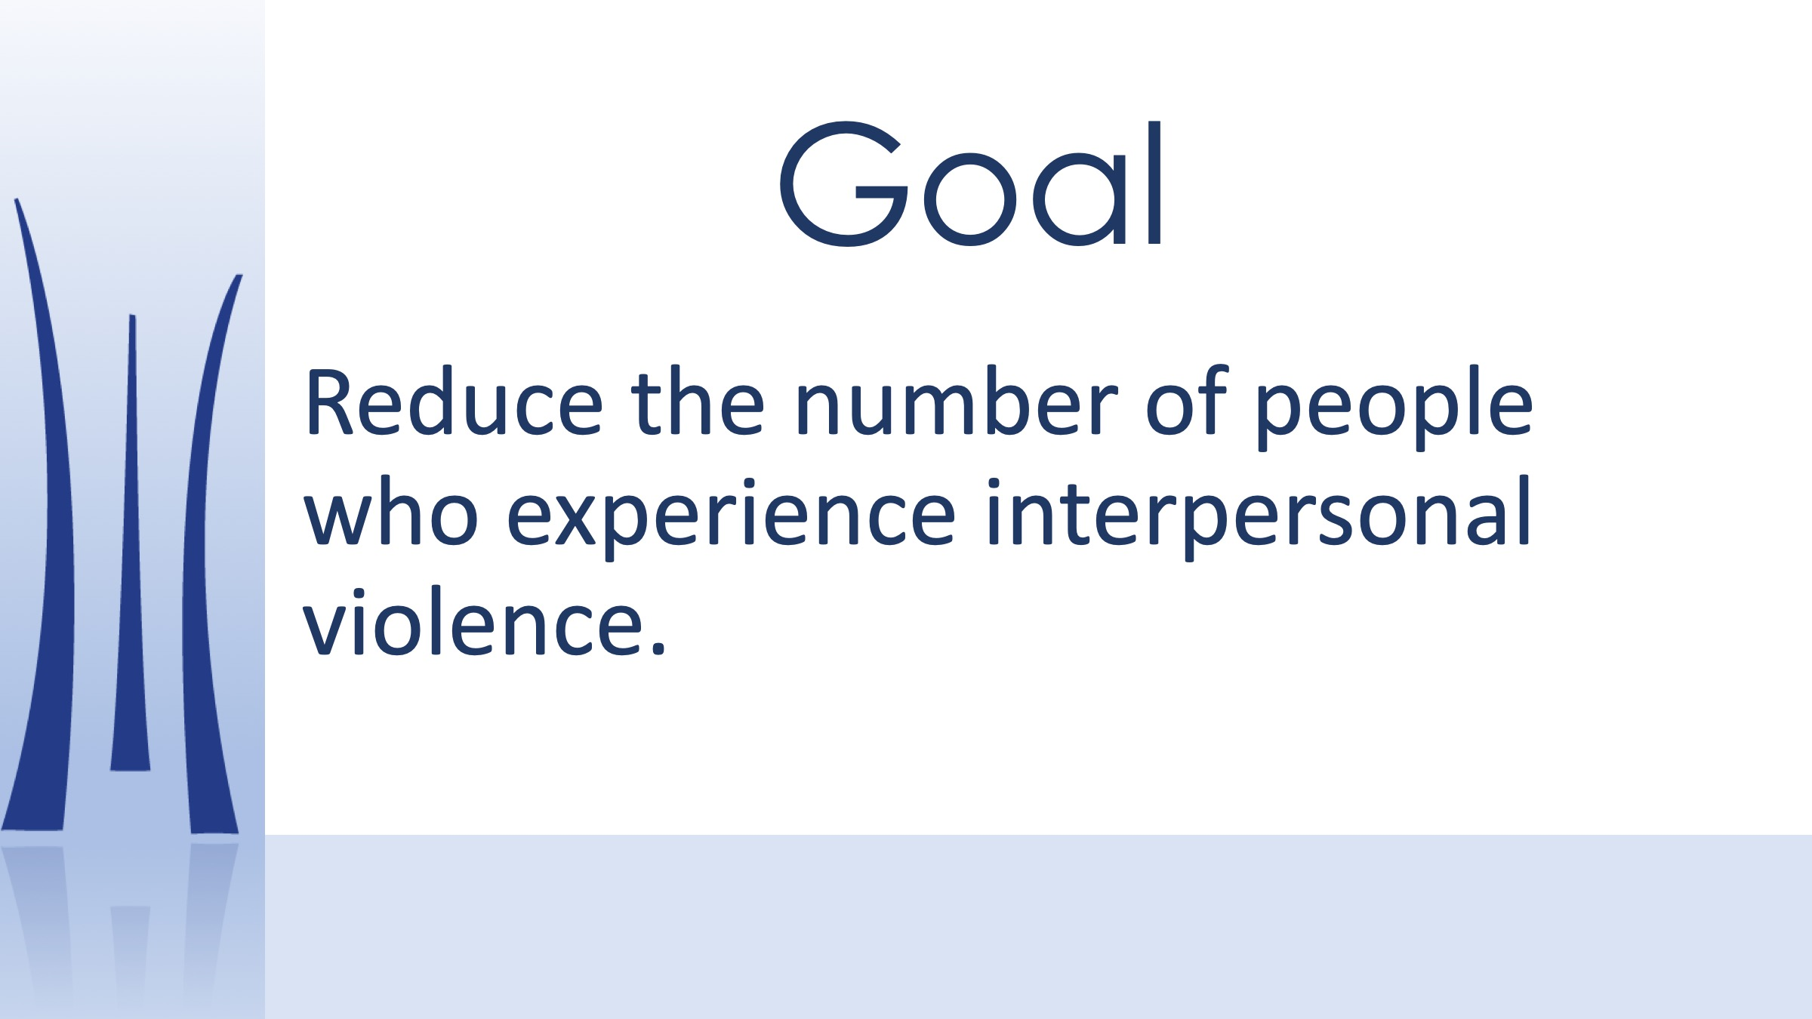

Slide 4


Slide 5
AF CORE VALUES
Integrity First
Service Before Self
Excellence In All We Do

Slide 6
Prevention
Values Based Response
vs.
Emotions Based Reaction

Slide 7


Slide 8


Slide 9


Slide 10
A close friend of yours seems obsessed with his/her ex. They are calling, following, and emailing them all the time, even though the ex has made it clear the relationship is over.
Notes:
editable

Slide 11
You notice a colleague leaving a bar with someone who seems too drunk to take care of themselves. You are worried about potential sexual assault.
Notes:
editable

Slide 12
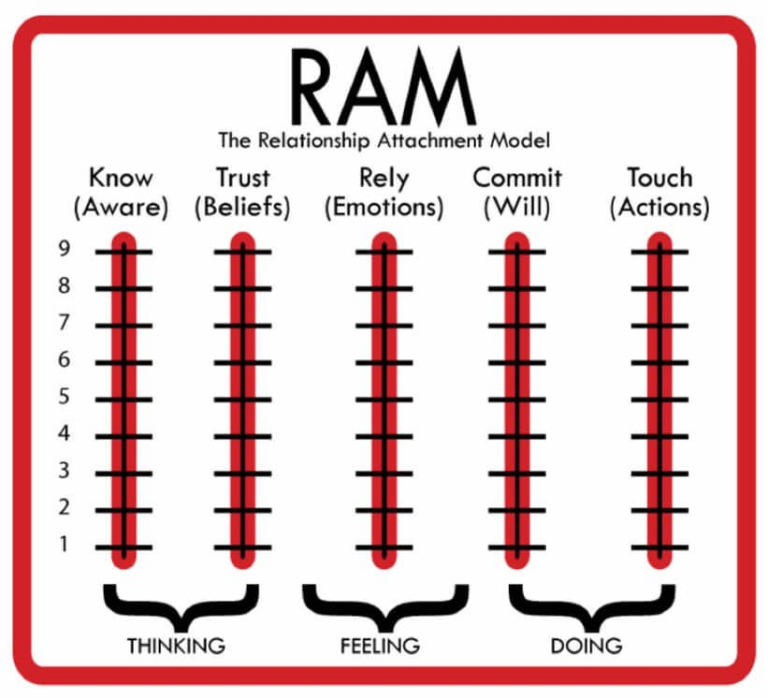

Slide 13

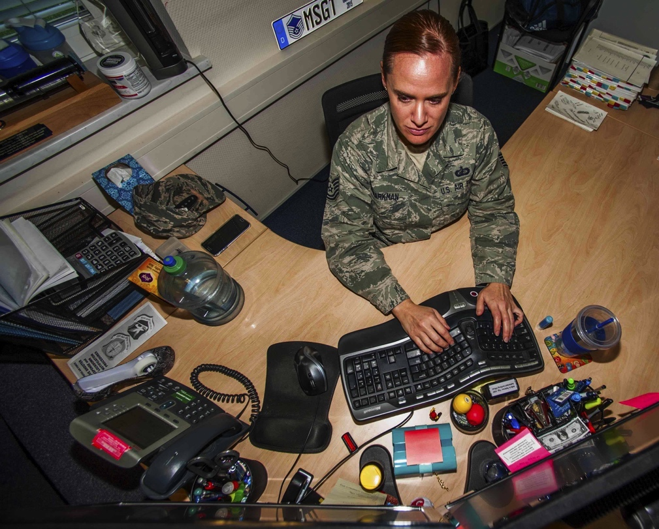
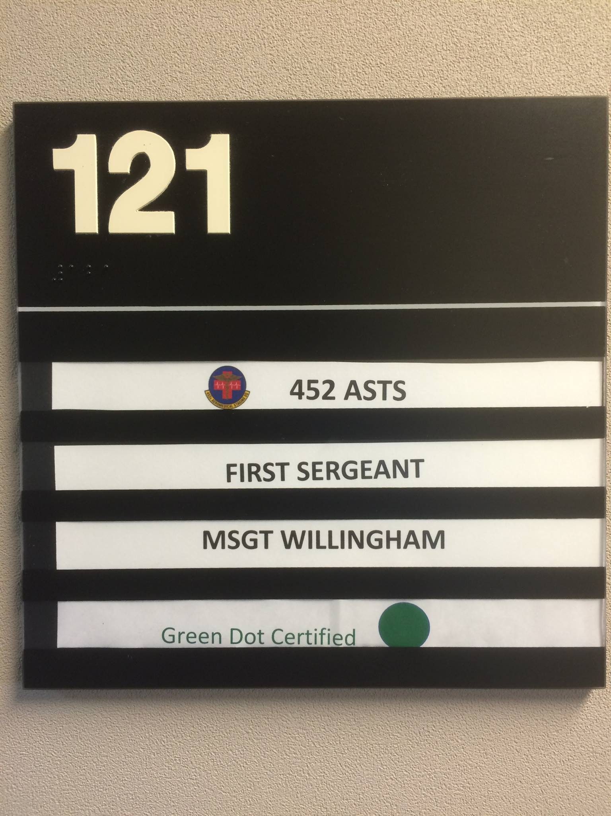
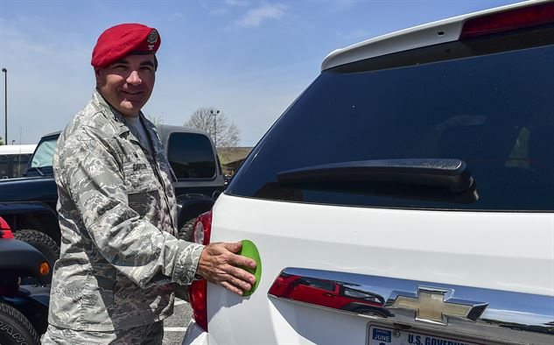
Your Spaces
Notes:
editable

Slide 14


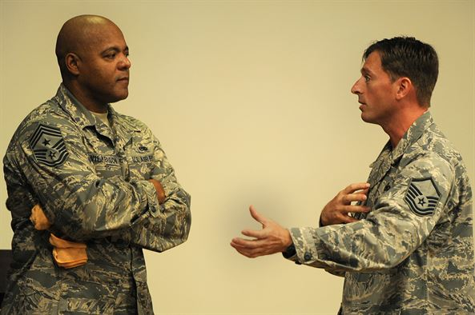



Social media, Conversations or Social Life.
Notes:
editable

Slide 15
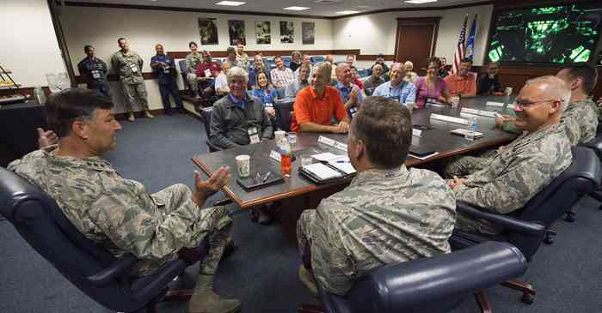
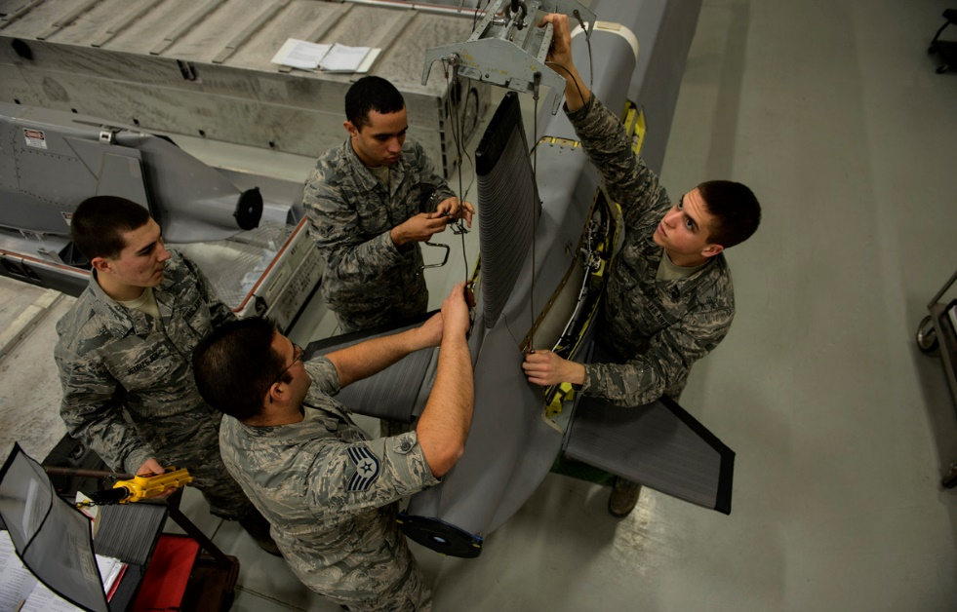
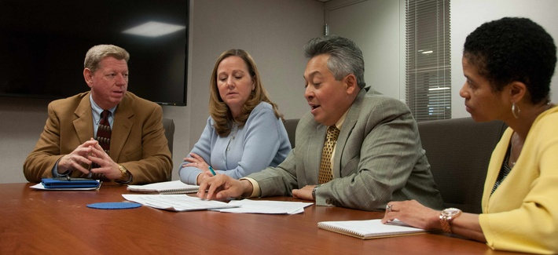
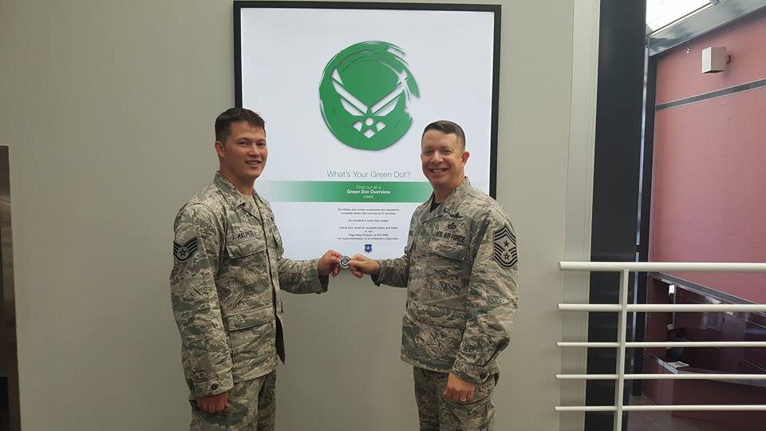
Sphere of Influence
Meetings
Speeches
Work Unit
Other
Notes:
editable

Slide 16
THANK YOU
Michael.haltom.4@us.af.mil
Integrated Prevention & Response
Notes:
editable

