Slide 1
Hill AFB
NEO Ethics Training
John Bergstresser
75 ABW/ JA
May 2023

Slide 2
Classification
The classification of the brief is UNCLASSIFIED, and the discussion can go up to UNCLASSIFIED.
Briefer: John Bergstresser (75 ABW/ JA)

Slide 3
Purpose
To provide newly hired federal employees initial ethics training as required by 5 CFR 2638.304.
CFR – Code of Federal Regulations
Briefer: John Bergstresser (75 ABW/JA)

Slide 4
Overview
Public trust
Misuse of position
Financial conflicts of interest
Impartiality
Gifts
Off-duty employment
HATCH Act
Government purchases
Briefer: John Bergstresser (75 ABW/JA)

Slide 5

Public Trust
The fundamental principle of ethics and standard of conduct is that “public service is a public trust”
We work for the public and therefore require the public’s trust.
We need to ensure the public that we are being objective, unbiased, and responsible as we do our jobs.
Briefer: John Bergstresser (75 ABW/JA)
Notes:
Reference 14 General Principles of Ethical Conduct handout – form the foundation of the standards of conduct and conflict of interest laws we are going to discuss today.
As federal employees, you are now engaged in a public service, as a result, we have to ensure that we continue to keep the public’s trust. We need the public to trust that we are objective, unbiased, and responsible in the execution of our mission. The public wants to make sure that their taxpayer dollars are at work and that you are using that money in a responsible manner and that we are executing the mission we are tasked to execute. Without the public’s trust, Congress or your agency’s leadership may reorganize how monies are distributed if they feel that we are not acting in the public’s best interest.

Slide 6
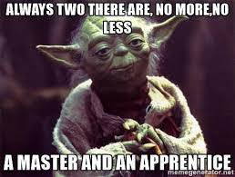
Public Trust
Selfless Service
Responsible Stewards
Be responsible in the use of government time and resources
Do not misuse your public position for private gain
Briefer: John Bergstresser (75 ABW/JA)
Notes:
If you read through the 14 General Principles, most of the principles fit into two general concepts”
Selfless Service and being Responsible Stewards
Selfless service means not using your position for private gains. If you’re a mechanic, you might be working on planes, you shouldn’t use the knowledge or information gained by working on those planes to invest in certain stocks, accept gifts from defense contractors, or do anything which may appear as if you are using your position to gain a financial or personal benefit. The same goes for whether you work as a program manger and have access to contract biddings, or police officers who have access to security information.
Being responsible stewards simply means being respectful and responsible of the government’s time and resources. You are here to help carry out a mission, not to on Instagram, Tinder, Facebook all day, it also means avoiding taking office supplies, or other resources that would help achieve a mission objective. So please, don’t steal the toilet paper.
Keep these basic concepts in mind as we continue through today’s training as they can help identify potential ethics concerns
For the rest of the training we are going to look at a few scenarios and see if we can identify the potential ethics rules that apply.

Slide 7

Scenario 1
Your spouse was recently offered a great position as Senior Executive for a large company. You are currently working at Hill AFB.
Is this something your ethics attorney should be concerned about?
Yes.
And so should you.
Me looking at a question I don’t know the answer to
Briefer: John Bergstresser (75 ABW/JA)
Notes:
Things to consider:
What does the spouse do as a S.E?
What benefits does the spouse earn from their position?
What does the company do? Does the company contract with the DoD? What about with HAFB? Do any of the sub contractors do work here?
This would be considered a conflicts of interest. See the real world impact on the next page

Slide 8
Case Study
A former Department of the Treasury employee and her husband were sentenced to a year in prison for a scheme to funnel contracts to companies they personally controlled. The employee, who served as an Employee Development Specialist, was responsible for determining the training needs of Treasury employees and procuring private training services.
Investigators discovered that over the course of two years, the employee had awarded 105 training contracts valued at more than $139,600 to companies owned by her husband. The employee pled guilty to several charges, including violations of 18 U.S.C. 208, participating personally and substantially in matters in which she or her spouse had a financial interest.
She was sentenced to a year of prison and three years supervised release, and was ordered to pay $54,500 in restitution. Her husband also pled guilty to several charges, including wire fraud and conspiracy, and received the same sentence as his wife.
Briefer: John Bergstresser (75 ABW/JA)
Notes:
It is important to understand here that it was the wife who committed the ethics violation, but despite that, the husband is also criminally charged.
When someone commits an ethics violation, we do not charge you with “committing an ethics violation.” We charge you with the specific violation that was committed. In this case, the wife was charged with participating personally and substantially in matters in which she or her spouse had a financial interest, in other words, a conflict of interest.

Slide 9

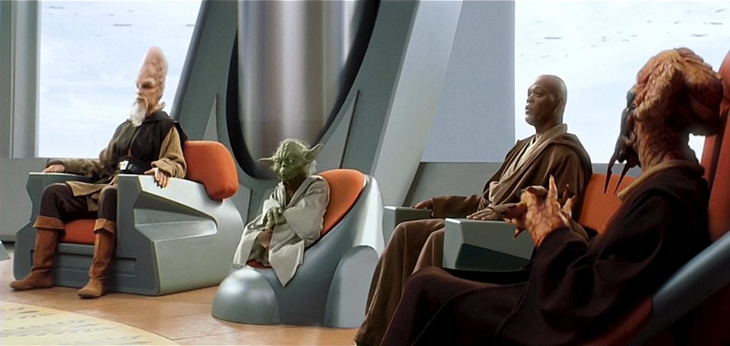



Conflicts of Interest(s)
Basic Rule:
You may not participate personally and substantially in particular matters in which you have a financial interest.
Financial Interest includes:
Spouse
Minor children
Business partners
Organizations in which you are an officer, director, trustee, etc.
Any person or organization whom are you negotiating with… or seeking employment.
Briefer: John Bergstresser (75 ABW/ JA)
Notes:
When discussing financial interest, be sure to also discuss the types of financial interest. This isn’t just cash for service/ goods.
It also includes:
Stocks & Bonds
Retirement Plans (non-government)
Investment Clubs
Collectibles
Real Estate
Book Deals
Patents
Partnerships/Outside Businesses
Spouse Employment
Board Member
Executor/Trustee
Potential Employer

Slide 10

Scenario 2
You received a great offer from Hill AFB and left your previous company on good terms. Now, as part of your job here, you help review new project proposals.
You come across a project which you think your former company would be interested in participating in. Can you tell your previous boss about this project?
It’s a trap,
isn’t it?
Briefer: John Bergstresser (75 ABW/ JA)
Notes:
Why yes Admiral Ackbar, it is a trap.

Slide 11
Case Study
A former Federal Reserve Bank of New York employee was fined $2,000, and sentenced to a year of probation with community service after pleading guilty to stealing Government documents. The former Bank employee provided the stolen documents to his former supervisor from the Bank, who worked at Goldman Sachs. Some of the stolen documents included examinations of a bank that Goldman was currently advising.
Briefer: John Bergstresser (75 ABW/ JA)

Slide 12
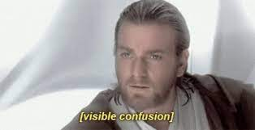
Impartiality
Basic Rule:
Whether a reasonable person with knowledge of the circumstances could question your impartiality on a matter you are assigned to.
Similar to financial interests; ethics officials look at if you have a covered relationship.
Any member of your household.
Someone who you do or seek business.
Someone your spouse, dependent children, or parents seek to has business with.
Anyone you have worked for in the past 12 months.
Organizations which you are an active member.
Briefer: John Bergstresser (75 ABW/ JA)
Notes:
Impartiality and Conflicts of Interest often are synonymous and go hand in hand. However, Conflicts of Interest primarily look at what YOU gain from personally and substantially participating in a matter, but Impartiality looks at who ELSE gains from your participation or the participation of someone you have a close relationship with.
The basic rule for impartiality is fairly simple. If any reasonable person with knowledge of the circumstances could question your impartiality on a matter to; then you should definitely consult with an ethics attorney/ advisor.
The Ethics attorney will be looking at whether you have a ‘covered relationship’ with anyone on here.
A member of your household – this is regardless of whether you are related or not. If they live under the same roof as you, they could be considered a member of your household. Be careful if you are living with roommates, or with a significant other since you could potentially have a covered relationship.
Anyone you have business with or are seeking to do business with. – If you own your own company and are seeking to do business with someone else who may have a contract with the AF, then it may appear you are acting impartial. Simply hiring someone to work on your roof, or do some home repairs is not ‘doing business’.
Just like the above, except we also look at your family members, spouse, parents, and any children whom you still financially support. This does not mean they have to be under 18, they could be in college or living on their own, but if you are financially supporting them more than 50% of the tax year, they are a dependent child.
Anyone you have worked for in the past 12 months. Think of our previous case study. The federal worker gave information to his prior employers and as a result was fined and charged.
Any organizations which you are an active member. I am a member of the American Bar Association so I can attend courses, but I am not an active member. I do not play a part in their day to day operations. Similarly if you are in a trade organization, social club, or professional organization (Fraternal Order of Police, Aircraft Mechanics Fraternal Order, Rotary Club, Kiwanis, etc) simply being a member is not going to make you in a covered relationship. If you are consistently organizing events, helping run the organization, sitting on their board, then you may have triggered this.

Slide 13

Recusals
You are responsible for knowing your financial interests and who you have a covered relationship with.
Recuse when necessary.
Make your recusal in writing!
Share your recusals!
Follow through on your recusal!
Fill out your Financial Disclosure Forms (if required).
FDF – Financial Disclosure Form, OGE Form 450.
Briefer: John Bergstresser (75 ABW/ JA)
Notes:
Program managers, contracting officers, and anyone involved in government purchases or contracts must file a FDF. They will receive notification from our ethics office that they will need fill one out and return to us.
Even if you do not fill out a FDF, you should still know what you financial interests are, whether you or anyone is in a covered relationship, and when in doubt, contact the Ethics Office!

Slide 14

Scenario 3
You’ve been invited to go to a mixer that’s being organized by a company that frequently contracts with the Air Force.
Do you see any reason why you can’t attend the party?
Briefer: John Bergstresser (75 ABW/ JA)

Slide 15
Case Study
Just prior to a major contract award, a Bureau Director went out to dinner with one of the potential competitors at a swanky Washington restaurant. The wine alone cost over $100 per bottle. Too bad the Director didn't realize that a Washington Post reporter was at the next table
The story received front-page coverage in the next day’s Post. By that afternoon, the Director announced that he had accepted a job in private industry — a job he couldn't refuse (with his father-in-law). The Standards of Ethical Conduct for Employees of the Executive Branch (5 C.F.R. Part 2635) generally prohibit Federal personnel from accepting gifts (including meals) from persons who do business or seek to do business with the employee’s agency.
Briefer: John Bergstresser (75 ABW/ JA)

Slide 16

Gifts from Outside Sources
Basic Rule:
May not solicit or accept anything of value because of your official position or by a prohibited source.
Prohibited source:
Anyone who does or seeks to do business with the Agency or whose interest can be affected by the performance or non-performance of your job.
Briefer: John Bergstresser (75 ABW/ JA)

Slide 17
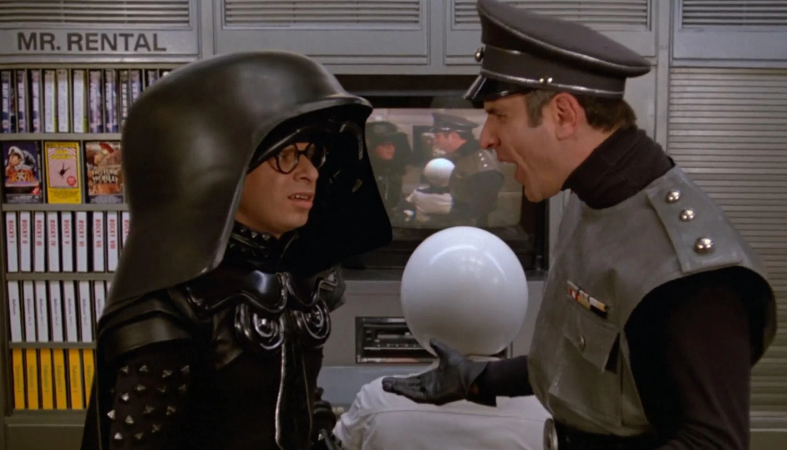
Gifts
What’s considered a gift?
Gratuity,
Favors,
Discounts,
Entertainment,
Hospitality, or
Other items having monetary value.
Briefer: John Bergstresser (75 ABW/ JA)
Notes:
Basic Gift Rule: may not solicit or accept anything of value (a gift) given because of your official position or by a prohibited source.
Prohibited Source – anyone who does or seeks to do business with the agency or whose interest can be affected by the performance or non-performance of your job.
A gift includes any gratuity, favor, discount, entertainment, hospitality, or other item having monetary value. This would include free attendance at an event and meals.

Slide 18



Gifts – The Exceptions
Not a gift:
Modest refreshments
Anything you pay fair market value for
Items paid for by the Government
Discounts available to public or all government employees
Exceptions:
$20/ $50 Rule
Personal Relationship
Awards/ Honorary Degree(s)
Speaking in an official capacity
WAGs
WAGs – Widely Attended Gatherings (usually 20+ people).
Briefer: John Bergstresser (75 ABW/ JA)
Notes:
Items not considered gifts:
Modest refreshments
Anything you pay fair market value for
Items paid for by the government (training materials/tote bag example, event paid for by another government agency)
Exception to the gift rule:
$20: cannot pay down value of the gift, cannot accept cash even if under $20 (includes visa type gift cards), contractor lunch example of $50/source/year (tie back to appearance and revision in reg that recommends turning down a gift that creates a situation in which someone might question your impartiality)
Gift based on a close personal relationship (generally does not cover friendship simply due to working together, must have other facts showing a close, personal relationship outside of work), spouse holiday party example
Awards and honorary degree – requires written determination from an ethics official (bona fide award in that it is an award given on a regular basis with written criteria)
WAG: (1) meets criteria for widely attended gathering and (your attendance is in the interest of the agency because it with further agency programs and operations (generally a determination to be made by your supervisor)
Widely attended in that there must be a large number of persons in attendance with a diversity of views or interests (are attendees all from the same company/org or from a mixture of private sector, govt, academia, non-profit, etc.) where there is an opportunity for an exchange of ideas (preclude events such as theatrical/musical performances and sporting events)
Must receive a determination in writing

Slide 19
Gifts Between Employees
Basic Rule #2
Gifts may be given down but never up.
Supervisors may give gifts, but they can never receive gifts.
Exceptions:
Occasional gift of $10 or less (think holiday gift exchanges)
Food shared in the office (potlucks, retirement party, pinning ceremony)
Special and infrequent occasions (baby showers, wedding, retirement, etc)
NOT holidays.
Must be appropriate to the occasion.
Briefer: John Bergstresser (75 ABW/ JA)

Slide 20
Gifts – The Miscellaneous
Fundraising is prohibited.
This means you CANNOT solicit others to buy Girl Scout Cookies.
Soliciting contractors is prohibited.
Contractors, even those who work with your teams, cannot be solicited to donate to a party, etc.
May go around the office to ask for money to give to employee who is going away (can only be up to $300.00).
Briefer: John Bergstresser (75 ABW/ JA)

Slide 21

Scenario 4
Wanting some extra money, you decided that you’d like to take a part-time job. May you take a part-time job?
Briefer: John Bergstresser (75 ABW/ JA)

Slide 22
Case Study
An O-5 in communications decided that his day job wasn’t enough, so he started a side business photographing local sports events. While on duty, he asked a subordinate to create photo products for his personal business during official time. The officer also requested a press pass on behalf of the Defense Media Activity, which he then used to gain exclusive entry into sporting events to take pictures in his off-duty time. When he was finally caught for misusing the press pass, he received a letter of concern from command.
Briefer: John Bergstresser (75 ABW/ JA)

Slide 23
Off- Duty Employment
Basic Rule:
A DoD employee shall obtain approval from the agency before engaging in a business activity or compensated outside employment with a prohibited source.
Rationale:
Ensuring that your off-duty employment does not create a conflict of interest (working for a contractor), appearance of impropriety, or could otherwise damage the reputation of the Air Force/ DoD.
This is also to protect YOU. Certain careers could put your security clearance at risk!
Briefer: John Bergstresser (75 ABW/ JA)
Notes:
(d) Prohibited source means any person who:
(1) Is seeking official action by the employee's agency;
(2) Does business or seeks to do business with the employee's agency;
(3) Conducts activities regulated by the employee's agency;
(4) Has interests that may be substantially affected by the performance or nonperformance of the employee's official duties; or
(5) Is an organization a majority of whose members are described in paragraphs (d)(1) through (4) of this section.

Slide 24
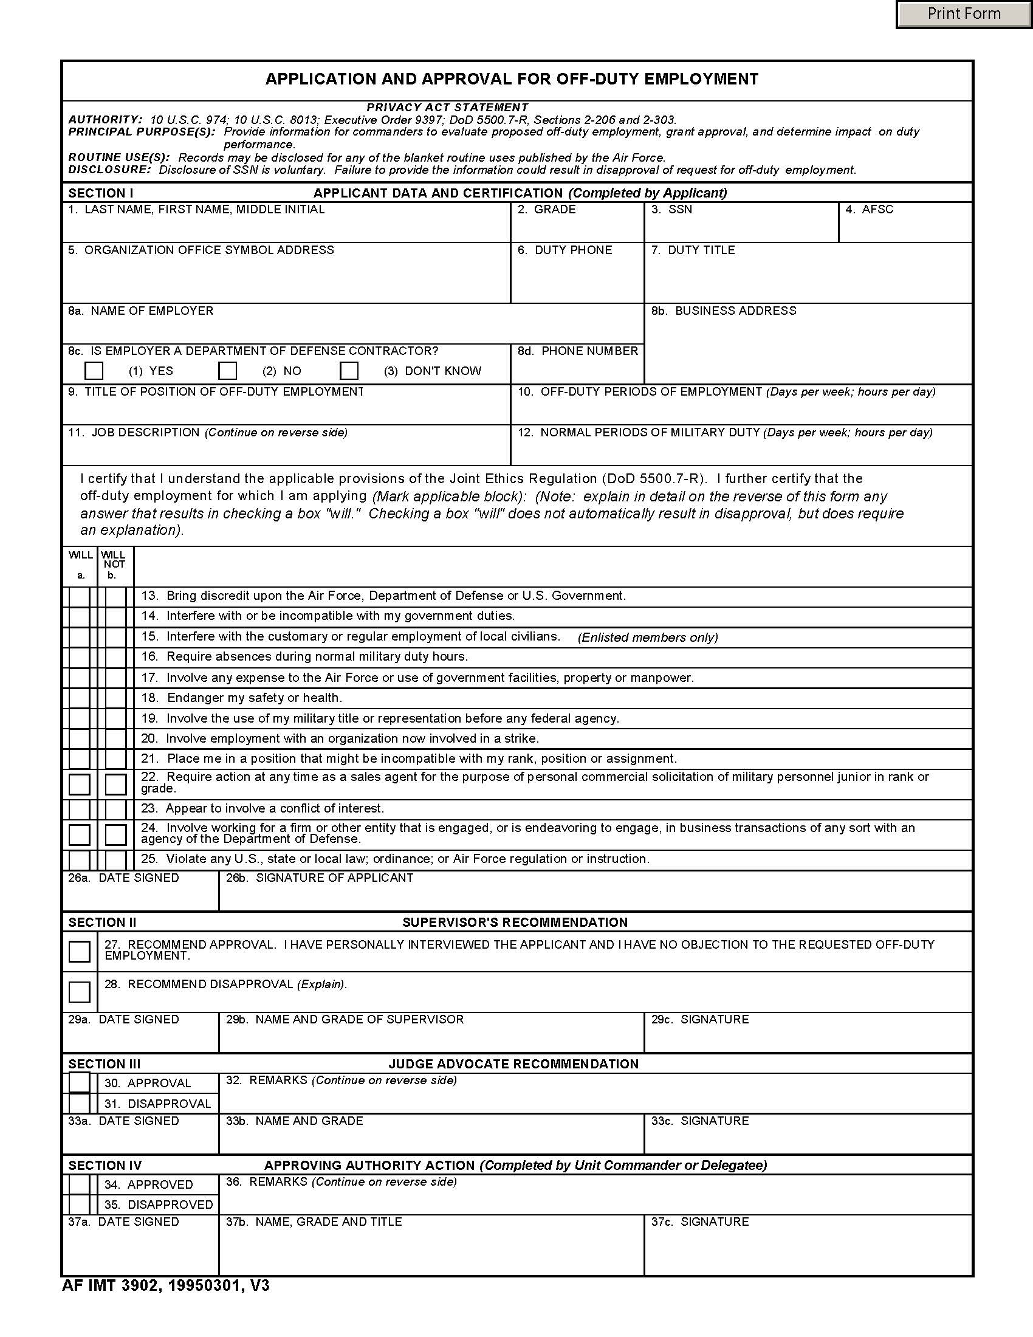
Off Duty Employment - Form
Forms are located in the front and on table by the door.
Fill out the form and provide to your supervisor.
Better to fill out than to get caught. Ignorance of AF Regs is not a defense.
Briefer: John Bergstresser (75 ABW/ JA)

Slide 25
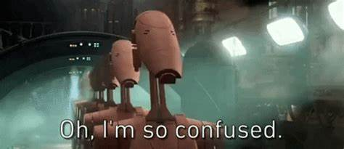
Scenario 5
After having a fulfilling career at Hill AFB, you decide to work for another company.
Issues?
Briefer: John Bergstresser 75 ABW/JA

Slide 26
Case Study
A Government employee that was involved in approving a contract for audio/visual equipment left the Government to work for that contractor. At the completion of work, the Government had paid approximately $6 million for $841,000 worth of equipment. Several individuals were charged with fraud, and the employee that left the Government for the outside position was charged with violating the post-employment restriction in 18 U.S.C. § 207(a)(1). He received one year probation and a $25,000 fine
Briefer: John Bergstresser 75 ABW/JA

Slide 27
Post- Employment Restrictions
Basic Rule
Cannot represent (make communications to or appearances before) a third party (such as a future employer) back to the government or its employee on any particular matter in which you were involved personally and substantially while a government employee
Lifetime ban
Even if not personally and substantially involved, cannot represent back to the government on any particular matter if the matter was pending under the employee's official responsibility during the employee's last year of Government service.
Two year ban.
Briefer: John Bergstresser 75 ABW/JA
Notes:
Lifetime bans –
Communications or appearances are done intentionally on behalf of the new employer before a department, agency, court, or court-martial in which YOU had personally participated and substantially and have a financial interest and involves a party which would have an interest in the outcome of your communication or appearance.

Slide 28
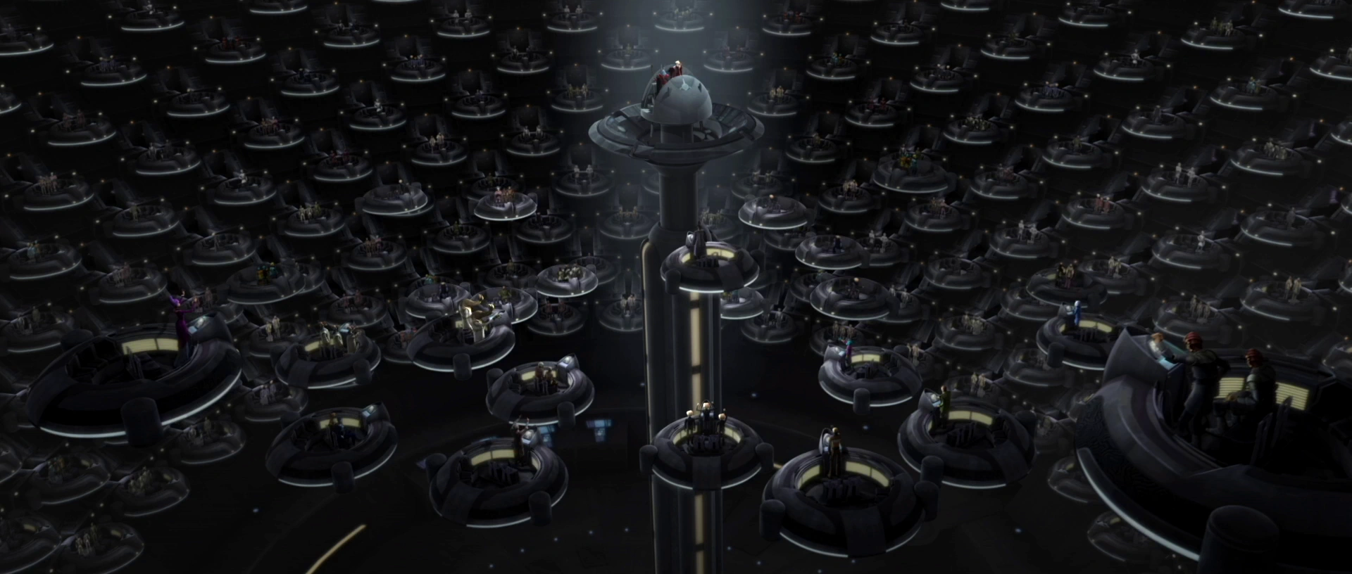
HATCH Act
No political activities while:
On duty,
On Government property (including while using a gov’t vehicle),
In uniform or official duty wear.
You cannot:
Ask for or handle donations
Use your job to influence election
Influence subordinates
Run as a candidate in partisan elections
Briefer: John Bergstresser 75 ABW/JA
Notes:
No political activity
On duty
On government property (including while using a govt vehicle)
Wearing a uniform or official insignia
Even outside of the workplace (Be wary of using Facebook or social media when posting political content!!)
CAN’T EVER
Ask for/handle donations
Use your job to influence elections
Influence subordinates
Be a candidate in partisan political elections
CAN
Vote
Petition
Campaign
Stump
Volunteer
Express opinions

Slide 29
Government Purchases
Basic Rule:
Unless you are authorized to make purchases on behalf of the Government. Do NOT buy, or imply that we will buy, any goods or services.
If you bind the Government in a purchase. You may be responsible for the FULL cost of the item.
Briefer: John Bergstresser 75 ABW/JA
Notes:
How to avoid unauthorized commitments? Contact the contracting office! And don’t:
make any verbal or written commitments to contractors if not authorized to do so.
pay for any items out-of-pocket and expect reimbursement.
make any changes outside the scope of the contract
let contractors use government equipment without proper authority and documentation.
give the impression that they have been given authority to make purchase if they do not have that authority.
exceed GPC thresholds (supplies and equipment, $3,000; services, $2,500; construction, $2,000).
Could be on the hook for the bill if you make an unauthorized commitment.

Slide 30
Data is current as of May 2023.

