Slide 1
Environmental Awareness
Environmental Branch
75 CEG/CEIE
2023
Version 5

Slide 2
Environmental Management System (EMS)
Key concepts:
  Everybody impacts the environment, and subsequently the mission
  Hill AFB has some of the most stringent environmental requirements when compared to other installations
“Environment” includes your surroundings as a whole, including but not limited to:
  Flora and fauna
  Air and water
  The people you work with
  The buildings you work in

Slide 3
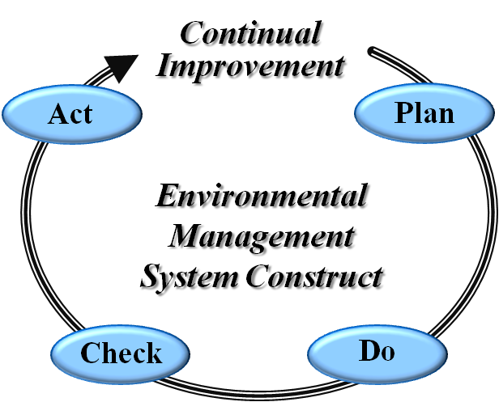
Environmental Management System (EMS)
Overall goal: minimize/eliminate risks and subsequent impact to environment and Mission
Systematic approach and team effort focused on continual improvement
Committed to:
  Compliance with legal requirements
  Pollution prevention
  Risk reduction
Force Instruction (AFI) 32-7001, Environmental Management

Slide 4
Scope of the EMS
Encompasses all environmental functions under the purview of Hill AFB
Includes all personnel performing work on Hill-AFB managed lands, that support the Mission
  Military, civilians, contractors, tenants, and organizations
  Hill AFB, the Utah Test and Training Range (UTTR), Little Mountain Test Facility, or other geographically separated unit
You are a part of the EMS!

Slide 5
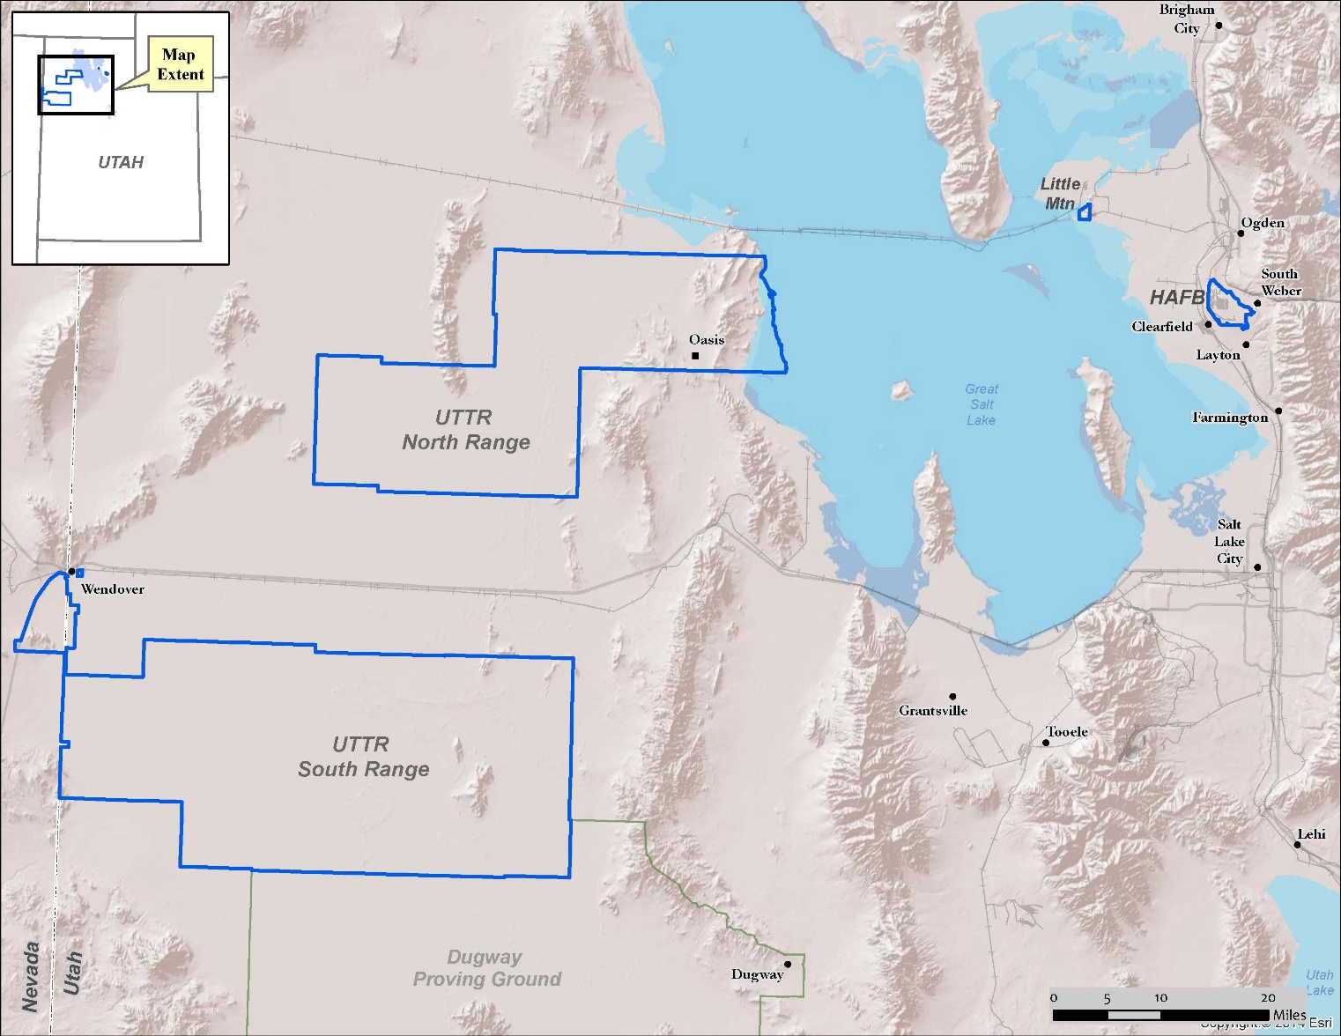
Scope of the EMS
Hill AFB-Managed Lands

Slide 6
Responsibilities and Requirements
All personnel must receive job-specific training
All personnel must be aware of:
  Environmental Policy / Commitment Statement
    AF Policy Directive (AFPD) 90-8
    Hill AFB Instruction (HILLAFBI) 32-7001, communicated by Hill AFB Visual Aids (HILLAFBVAs) 32-2 & 32-3
EMS information is on eDASH: https://usaf.dps.mil/teams/10624/Hill/SitePages/Home.aspx
Notes:
AFPD 90-8, “Environmental, Safety & Occupational Health Management and Risk Management”
ER = Environmental Representative
UEC = Unit Environmental Coordinator
Please disseminate the information on the slides to your organizations and shops.
The Environmental Policies / Commitment Statements are available on AF e-Pubs

Slide 7
Hill AFB Environmental Policy
Hill AFB is committed to continued excellence, leadership, and stewardship in protecting the environment and sustaining the mission by implementing the following:
Promote efficiency – conduct activities in an efficient, integrated, and fiscally sound manner
Obey requirements – comply with all federal, state, and Air Force environmental laws, regulations, directives, and instructions
Work together – integrate efforts as part of Team Hill to achieve our end goals
Evaluate progress – continually evaluate performance and improve our process
Reduce pollution – reduce or eliminate the use of hazardous chemicals and release of pollutants, while encouraging recycling
Notes:
ER = Environmental Representative
UEC = Unit Environmental Coordinator
Please disseminate the information on the slides to your organizations and shops.
The Environmental Policies / Commitment Statements are available on AF e-Pubs

Slide 8
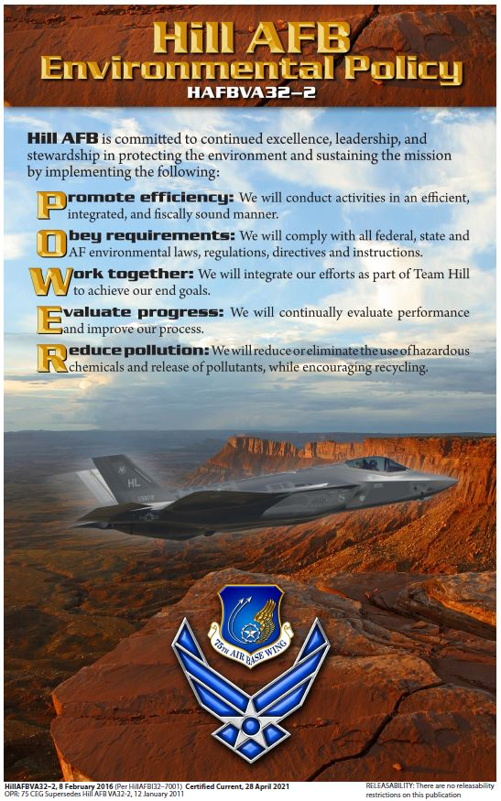
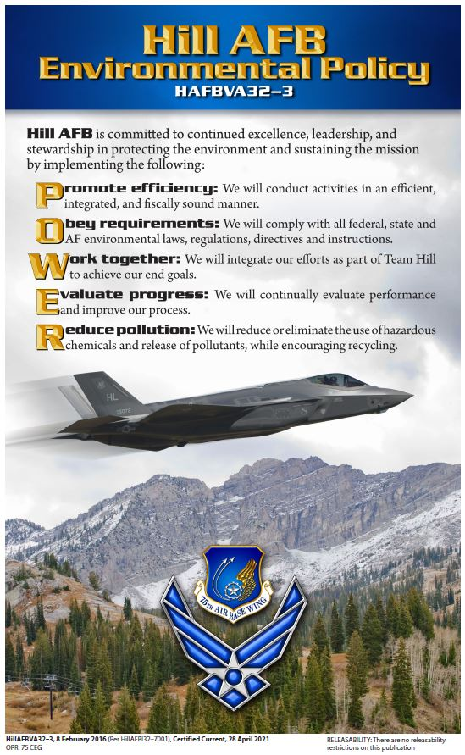
Environmental Policy Visual Aids
Notes:
ER = Environmental Representative
UEC = Unit Environmental Coordinator
Please disseminate the information on the slides to your organizations and shops.
The Environmental Policies / Commitment Statements are available on AF e-Pubs

Slide 9
EMS Representatives
Each organization has unit environmental coordinators (UECs) available to provide environmental guidance and support
  UEC Roster available at https://usaf.dps.mil/teams/10624/Hill/Lists/UECRoster/AllItems.aspx Environmental Policy / Commitment Statement
You may also contact the EMS POCs shown below
EMS POCs
Amanda Burton, 75 CEG/CEIEA EMS Coordinator & HAZMAT Program Manager DSN 775-3647; Cell (801) 721-8567 Amanda.Burton.7@us.af.mil | Emily Lindquist, 75 CEG/CEIEA Environmental Technician Cell (801) 389-2160 Emily.Lindquist.ctr@us.af.mil
Notes:
ER = Environmental Representative
UEC = Unit Environmental Coordinator
Please disseminate the information on the slides to your organizations and shops.
The Environmental Policies / Commitment Statements are available on AF e-Pubs

Slide 10
Risks and Impacts
Risk analysis
  Performed annually
  Focuses on actual and probable impacts to the environment and mission
What types of things can affect the environment?
    Processes (welding, soldering, painting, etc.)
    Products (missiles, aircraft, hazardous materials, etc.)
    Activities (operating machinery and equipment, etc.)
    Services (AAFES, Auto Hobby Shop, etc.)
Notes:
ER = Environmental Representative
UEC = Unit Environmental Coordinator
Please disseminate the information on the slides to your organizations and shops.
The Environmental Policies / Commitment Statements are available on AF e-Pubs

Slide 11
Example
Activity / Process
Painting (using a HAZMAT)
Impacts
  Generates air emissions, such as from open containers or use of unauthorized HAZMAT
  Generates hazardous waste
Risks
  Degradation of air quality
  Air quality permit violation, resulting in fines and work stoppages
  Spills (soil and water contamination)
  Exposures
  Disposal costs

Slide 12
Example
Activity / Process
Dumping Simple Green down the industrial waste drain (for example, washing floors, then rinsing residual material down the drain)
Impacts
  Generates waste
  Potential IWTP shut-down (Simple Green hinders the process of removing metals from wastewater)
Risks
  Work stoppages
  Costs AF (309 CMXG and 309 AMXG) ~ $1.5M / day
  Discharge permit violations, with fines of $25,000 per day for each regulated metal
  Spills (soil and water contamination)
  Potential exposures
  Disposal costs
Notes:
Dumping simple green down an industrial waste drain will hinder our metals removal process - we call it a chelator. It forms a barrier around the metals and it would not be attracted to our polymer which will turn into sludge.
It is $1.5M just for Bldgs 505 and 507 in 309 CMXG, and 225 in 309 AMXG

Slide 13
Environmental Risks, Aspects & Impacts
High priority risks are most likely to adversely impact the environment and Mission
Top-rated risks are as follows:
  Natural Resources – Invasive Species / Wildland Fire
  Fire Fighting Foam – Aqueous Film Forming Foam (AFFF) / Per- & Polyfluorinated Substances (PFAS):
  Air – Nitrogen Oxides (NOx)
Other high-rated risks:
  Wastewater
  Community Outreach
  Air – Internal combustion, aircraft engine testing, fuel transfer, surface coating / corrosion control, tanks
Environmental Action Plans (EAPs) are in place to address risks
Notes:
Air – NOx: Need new boilers before 2024 to reduce NOx, thereby ensuring we are not in violation of Utah State's PM2.5 Serious Nonattainment SIP. Replacement project is underway but risks include failure and violation of the Title V Operating Permit, State Implementation Plan and significant fines and potential loss of steam unless completed on time.
Air – Other top-rated AQ risks: The nature of the CAA and the Title V permit are such that failure to comply can result in a revocation of our permit. Without a permit we could no longer legally emit. As nearly all production results in air emissions, we may be obligated to curtail production and thus impact to the mission.
Example of AQ ICOM impact (actual recent real world example): One of the Landfill Gas Generators (Internal Combustion Engines) failed its annual emission testing. This failure has led to a loss of the use of the unit until it can be repaired and thus a loss of production. This example translates to all other emission units determined critical or even catastrophic with respect to the potential loss of facility wide steam production.
Wastewater: This aspect takes wastewater treatment into consideration. A sludge dryer was installed and details are being worked out with the associated conveyer to make is useable. Got rid of SO2, so there is a decrease in safety concerns. There are risks associated to the IWTP, which are based on what customers may dump. Although there are controls in place, if something were to happen, it will critically affect the mission and likely have an overall significant impact on the environment. For example, the inability to continue supporting the mission is possible (likely due to releases) and could result in a work stoppage, triggering significant manpower issues and costs for the AF.
Storm Water: Env Risk Severity is Critical because if a release from Pond 3 were to occur and Kays Creek was impacted, we would have to do remediation and it would be more than 200K.
Invasive Species: Because of the work to mitigate invasive species on the UTTR over the last several years, we are able to slightly downgrade the risk. While technically the risk is still high, enough work in critical areas has started to "move the needle" in the right direction. This includes aerial spraying and rangeland restoration activities. This aspect is also directly tied to Wildland Fire and much has been done in management to reduce fire risks as well but we must stay vigilant as we are still at a critical point in turning this around. Climate change is also a consideration that plays into this aspect.
Community Considerations: Indoor air issues have been identified in 6-10% of the locations sampled and only 6 private, off-base drinking wells have been identified within four miles radius of the base. If contaminants are found in the indoor air or drinking water, it will have a critical impact to community relationship and, therefore, the Mission.

Slide 14
Environmental Impacts
Everybody has an impact on the environment and Mission
Examples of ways you may impact the environment and Mission:
  Use of hazardous materials such as cleaning products, solvents, paints, and antifreeze
  Use of equipment such as degreasers, paint booths, boilers, or generators
  Generation and management of hazardous waste such as spent solvent, blast media, or old paint
  Office tasks such as recycling, printing, using electricity / energy, or using water
  Transportation, including fuel use and carpooling
Be aware of how you may impact the environment and Mission!

Slide 15
Awareness
All civilian and military members are required to obtain an annual local emissions test and certify completion of it by entering it into the AF-wide ECARS System
  If you work on-base less than 60 days a year or your vehicle is in a special category, you must still update your status in ECARS annually
  See flyer for details

Slide 16
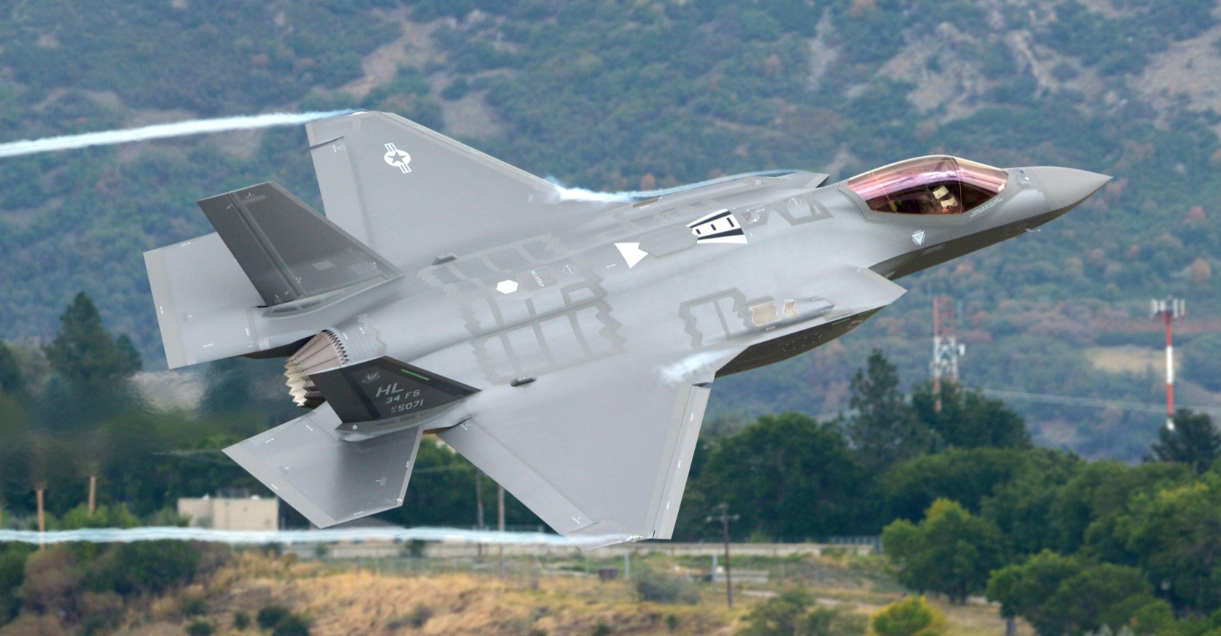
Conclusion
For further information, refer to Hill AFB eDASH: https://usaf.dps.mil/teams/10624/hill/SitePages/Home.aspx

