Slide 1
AIR FORCE CUSTOMS AND COURTESIES
Michael Tucker
777-1109
Jason Bertoldie
777-2151

Slide 2
AIR FORCE CUSTOMS AND COURTESIES
What it Means
Proven traditions that explain what should and should not be done in a situation
Acting respectively and courteously when interacting with others
A form of order and respect among uniformed and civilian Airmen

Slide 3
AIR FORCE CUSTOMS AND COURTESIES
Ranks and Insignias
Air Force military and civilian personnel work closely together every day
Rank is how we distinguish levels of authority and responsibility
Officer, Enlisted and Civilians all have rank structures

Slide 4
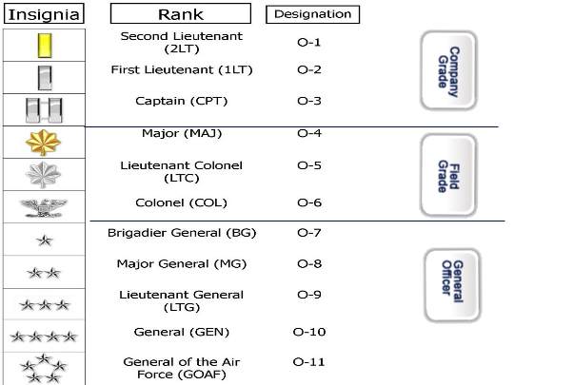
AIR FORCE CUSTOMS AND COURTESIES
Officer Ranks and Insignias
Notes:
We will begin with officer personnel ranks officers are grouped into three categories:
Company Grade Officers
Field Grade Officers
General Officers
Notice the in Sydney associated with each group

Slide 5
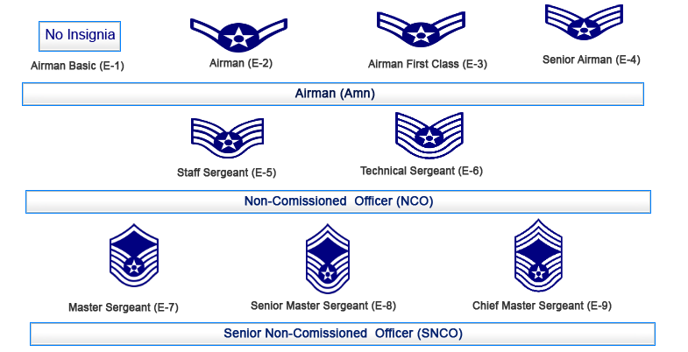
AIR FORCE CUSTOMS AND COURTESIES
Enlisted Ranks and Insignias
Notes:
Now let's look at the enlisted personnel and the rank of airman:
Airman Basic (the lowest enlisted rank and has no insignia)
Airman is a chevron with one stripe
Airman First Class is a chevron with two stripes.
Senior Airman is a chevron with three stripes.
Please note these ranks are all addressed as airman. Notice with all ranks of Airman the stripes come out the circle with a star.

Slide 6
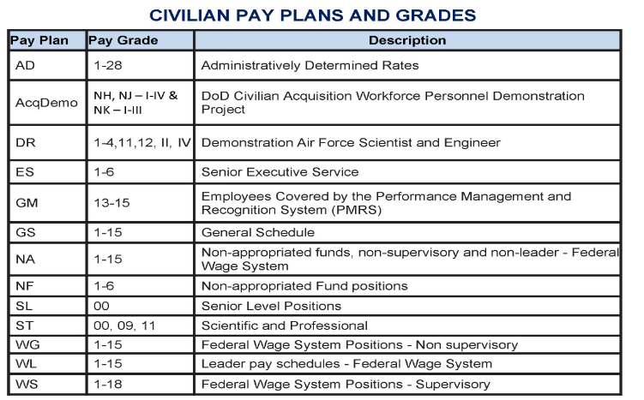
AIR FORCE CUSTOMS AND COURTESIES
Civilian Rank Structure/Pay Grade
Notes:
The Office of Personnel Management provides policy on a variety of pay plans and grades for most civilians in the federal government.
Civilian grades classifies their expertise and experience, entitles them to appropriate pay scale and benefits, and requires respect for their scope of responsibility.
This chart shows just some of the civilian grades.

Slide 7
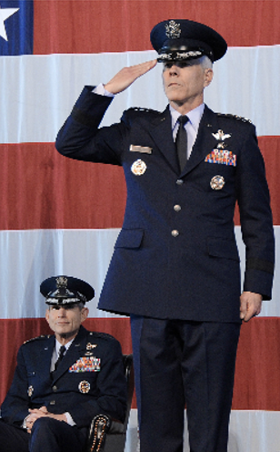
AIR FORCE CUSTOMS AND COURTESIES
Saluting
  Associated with the military
  Uniformed military custom
  Civilians do not salute
  Initiated by junior member
  Rendered to the United States flag while in uniform
Notes:
Airforce customs our practices normally established by usage over a long period of time. Many of these have evolved as military tradition.
Customs can apply on and off, military installations and include:
Saluting
Ceremonies.
Precedence

Slide 8

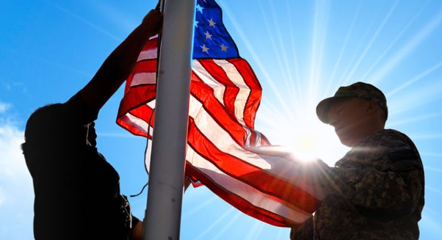
AIR FORCE CUSTOMS AND COURTESIES
Ceremonies
Reveille:
  Signifies the start of the duty day
  Symbolic or actual raising of the flag
  Recording played over Giant Voice PA system
  Played at 0730 every weekday
Notes:
Airforce customs our practices normally established by usage over a long period of time. Many of these have evolved as military tradition.
Customs can apply on and off, military installations and include:
Saluting
Ceremonies.
Precedence

Slide 9
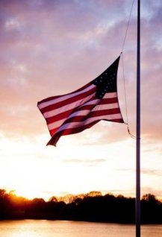
AIR FORCE CUSTOMS AND COURTESIES
Ceremonies
Retreat:
  Signifies end of the duty day
  Symbolic or actual lowering of the flag
  Recording played over Giant Voice PA system
  Played at 1700 every weekday
  Followed by National Anthem
Notes:
Airforce customs our practices normally established by usage over a long period of time. Many of these have evolved as military tradition.
Customs can apply on and off, military installations and include:
Saluting
Ceremonies.
Precedence

Slide 10
AIR FORCE CUSTOMS AND COURTESIES
Ceremonies
When ceremonial music is played on base:
  If outside:
    stand quietly until finished
    Face flag or music source
    Cover heart while National Anthem is playing
  If in a vehicle:
    Safely pull over to the side of the road
    Wait patiently until finished
Notes:
Airforce customs our practices normally established by usage over a long period of time. Many of these have evolved as military tradition.
Customs can apply on and off, military installations and include:
Saluting
Ceremonies.
Precedence

Slide 11
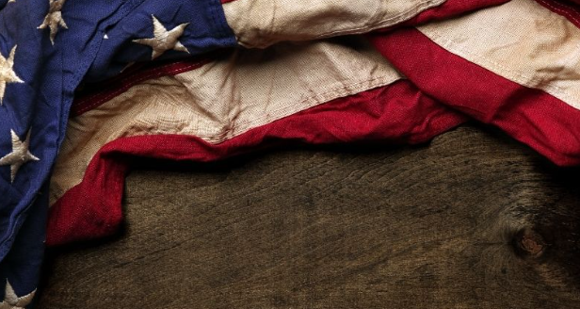
AIR FORCE CUSTOMS AND COURTESIES
Flag Etiquette
Respect for the Flag:
  Do not:
    Dip to any person or thing
    Use as furniture covering or apparel
    Drape over any part of a vehicle, train, boat or airplane
    Display, fasten, use or store in a way that it could be damaging
    Use as a receptacle for receiving or carrying objects
    Use for advertising purposes
    Mark it in any manner
Notes:
Airforce customs our practices normally established by usage over a long period of time. Many of these have evolved as military tradition.
Customs can apply on and off, military installations and include:
Saluting
Ceremonies.
Precedence

Slide 12
AIR FORCE CUSTOMS AND COURTESIES
Organizational Culture
Civility:
  Existed since the dawn of civilization
  Establishes expectation for treatment of others
  Demonstrates appropriate respect
  Respects the rights and ideas of others
  Show not yourself glad at the misfortune of another …Speak not injurious words neither in jest nor earnest; scoff at none although they give occasion.
  -George Washington
Notes:
Airforce customs our practices normally established by usage over a long period of time. Many of these have evolved as military tradition.
Customs can apply on and off, military installations and include:
Saluting
Ceremonies.
Precedence

Slide 13

AIR FORCE CUSTOMS AND COURTESIES
Communication
Telephone Etiquette:
  Always think customer service
  Be professional
  Answer phone with:
    Organization
    Name
    Duty title
  Answer the caller’s questions or find them someone who can
  You represent the Air Force and DoD so make a good first impression
Notes:
Airforce customs our practices normally established by usage over a long period of time. Many of these have evolved as military tradition.
Customs can apply on and off, military installations and include:
Saluting
Ceremonies.
Precedence

Slide 14

AIR FORCE CUSTOMS AND COURTESIES
Communication
Email Etiquette:
  Be professional
  Begin with a friendly greeting
  Use appropriate signature block
  Never “Reply All” unless your position requires
  Generalize content
  Mark unclassified and classified content as required
  Be brief and to the point (remember BLUF)
Notes:
Airforce customs our practices normally established by usage over a long period of time. Many of these have evolved as military tradition.
Customs can apply on and off, military installations and include:
Saluting
Ceremonies.
Precedence

