Slide 1
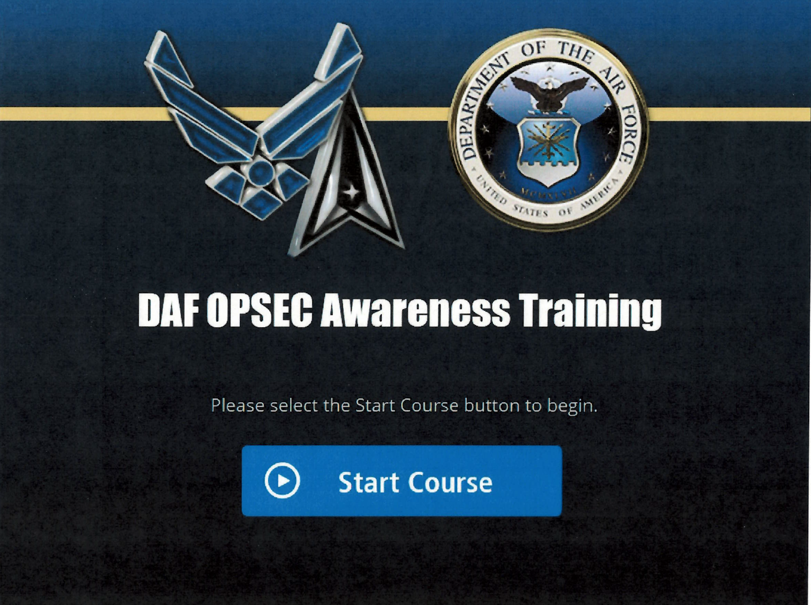

Slide 2
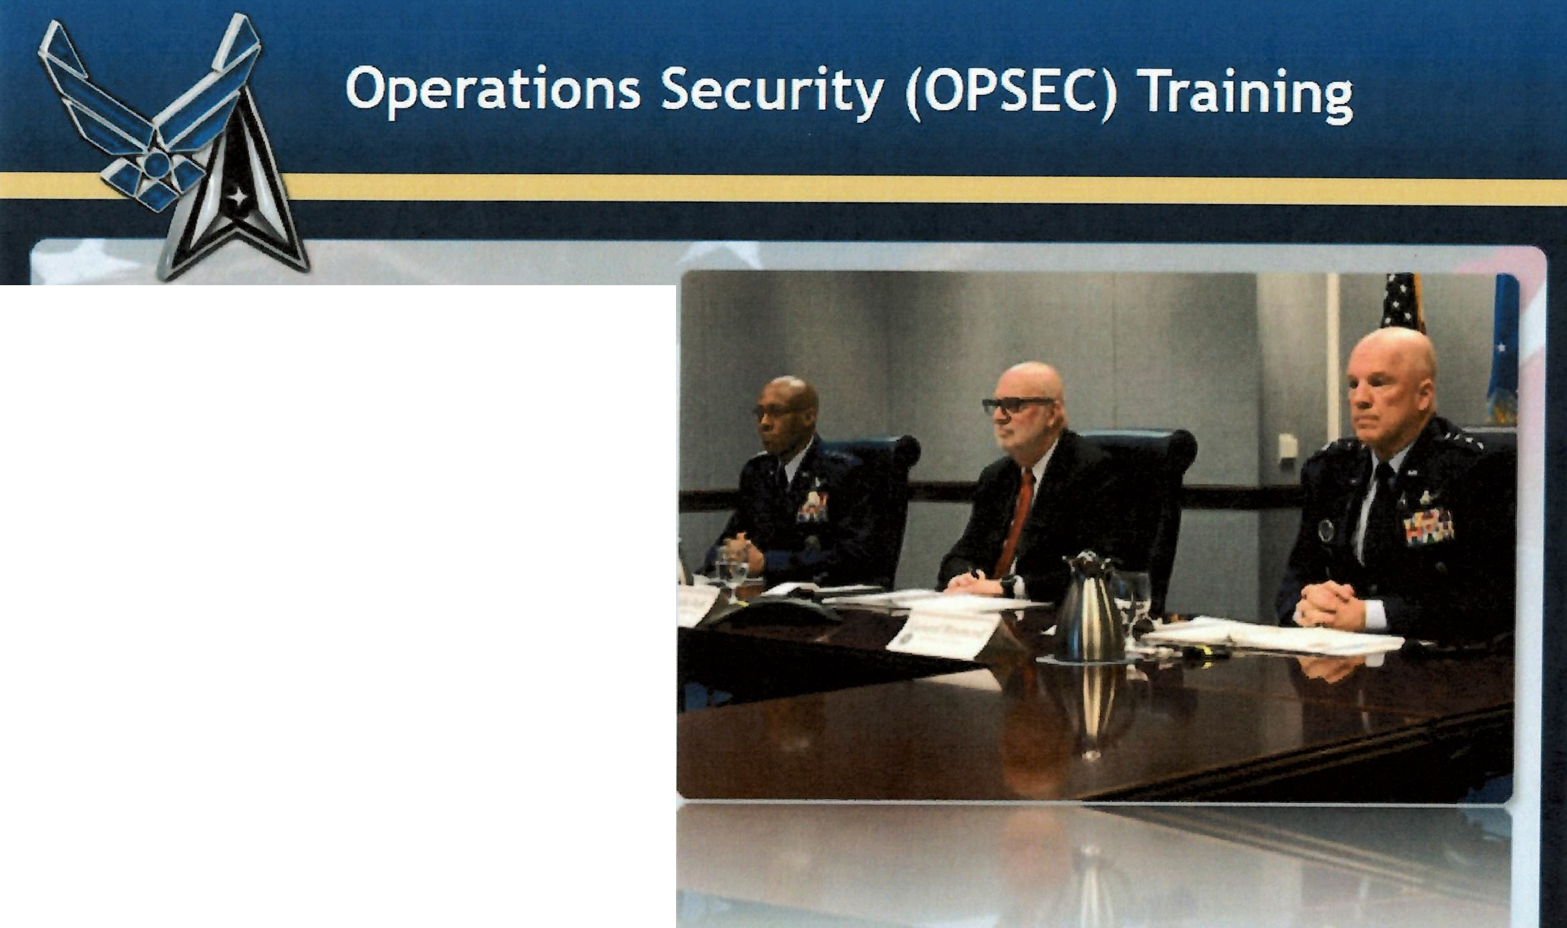
Introduction
Welcome to the Department of the Air Force's Operations Security Training.
This material is provided in response to the Department of the Air Force's OPSEC Reset Plan.
This material must be augmented with additional OPSEC education tailored to your organization's OPSEC needs.
2 of 17

Slide 3

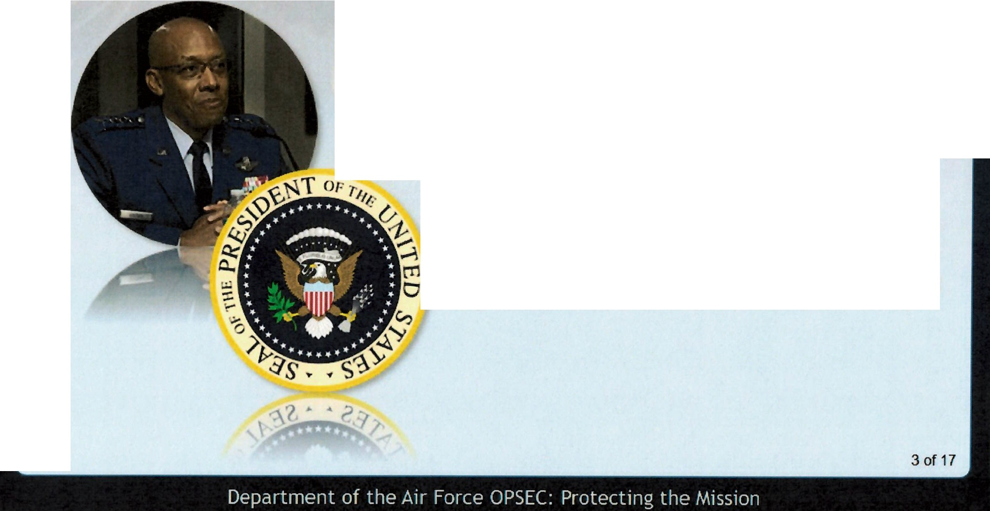
Introduction (cont.)
"Our adversaries are watching, and they will continue their efforts to negate our long-standing warfighting advantages."
General Charles Q. Brown Jr. United States Air Force Chief of Staff
National Security Presidential Memorandum-28,
The Natjonal Operatfons Secudty Program.
Signed 13 January 2021
£Tl
0

Slide 4
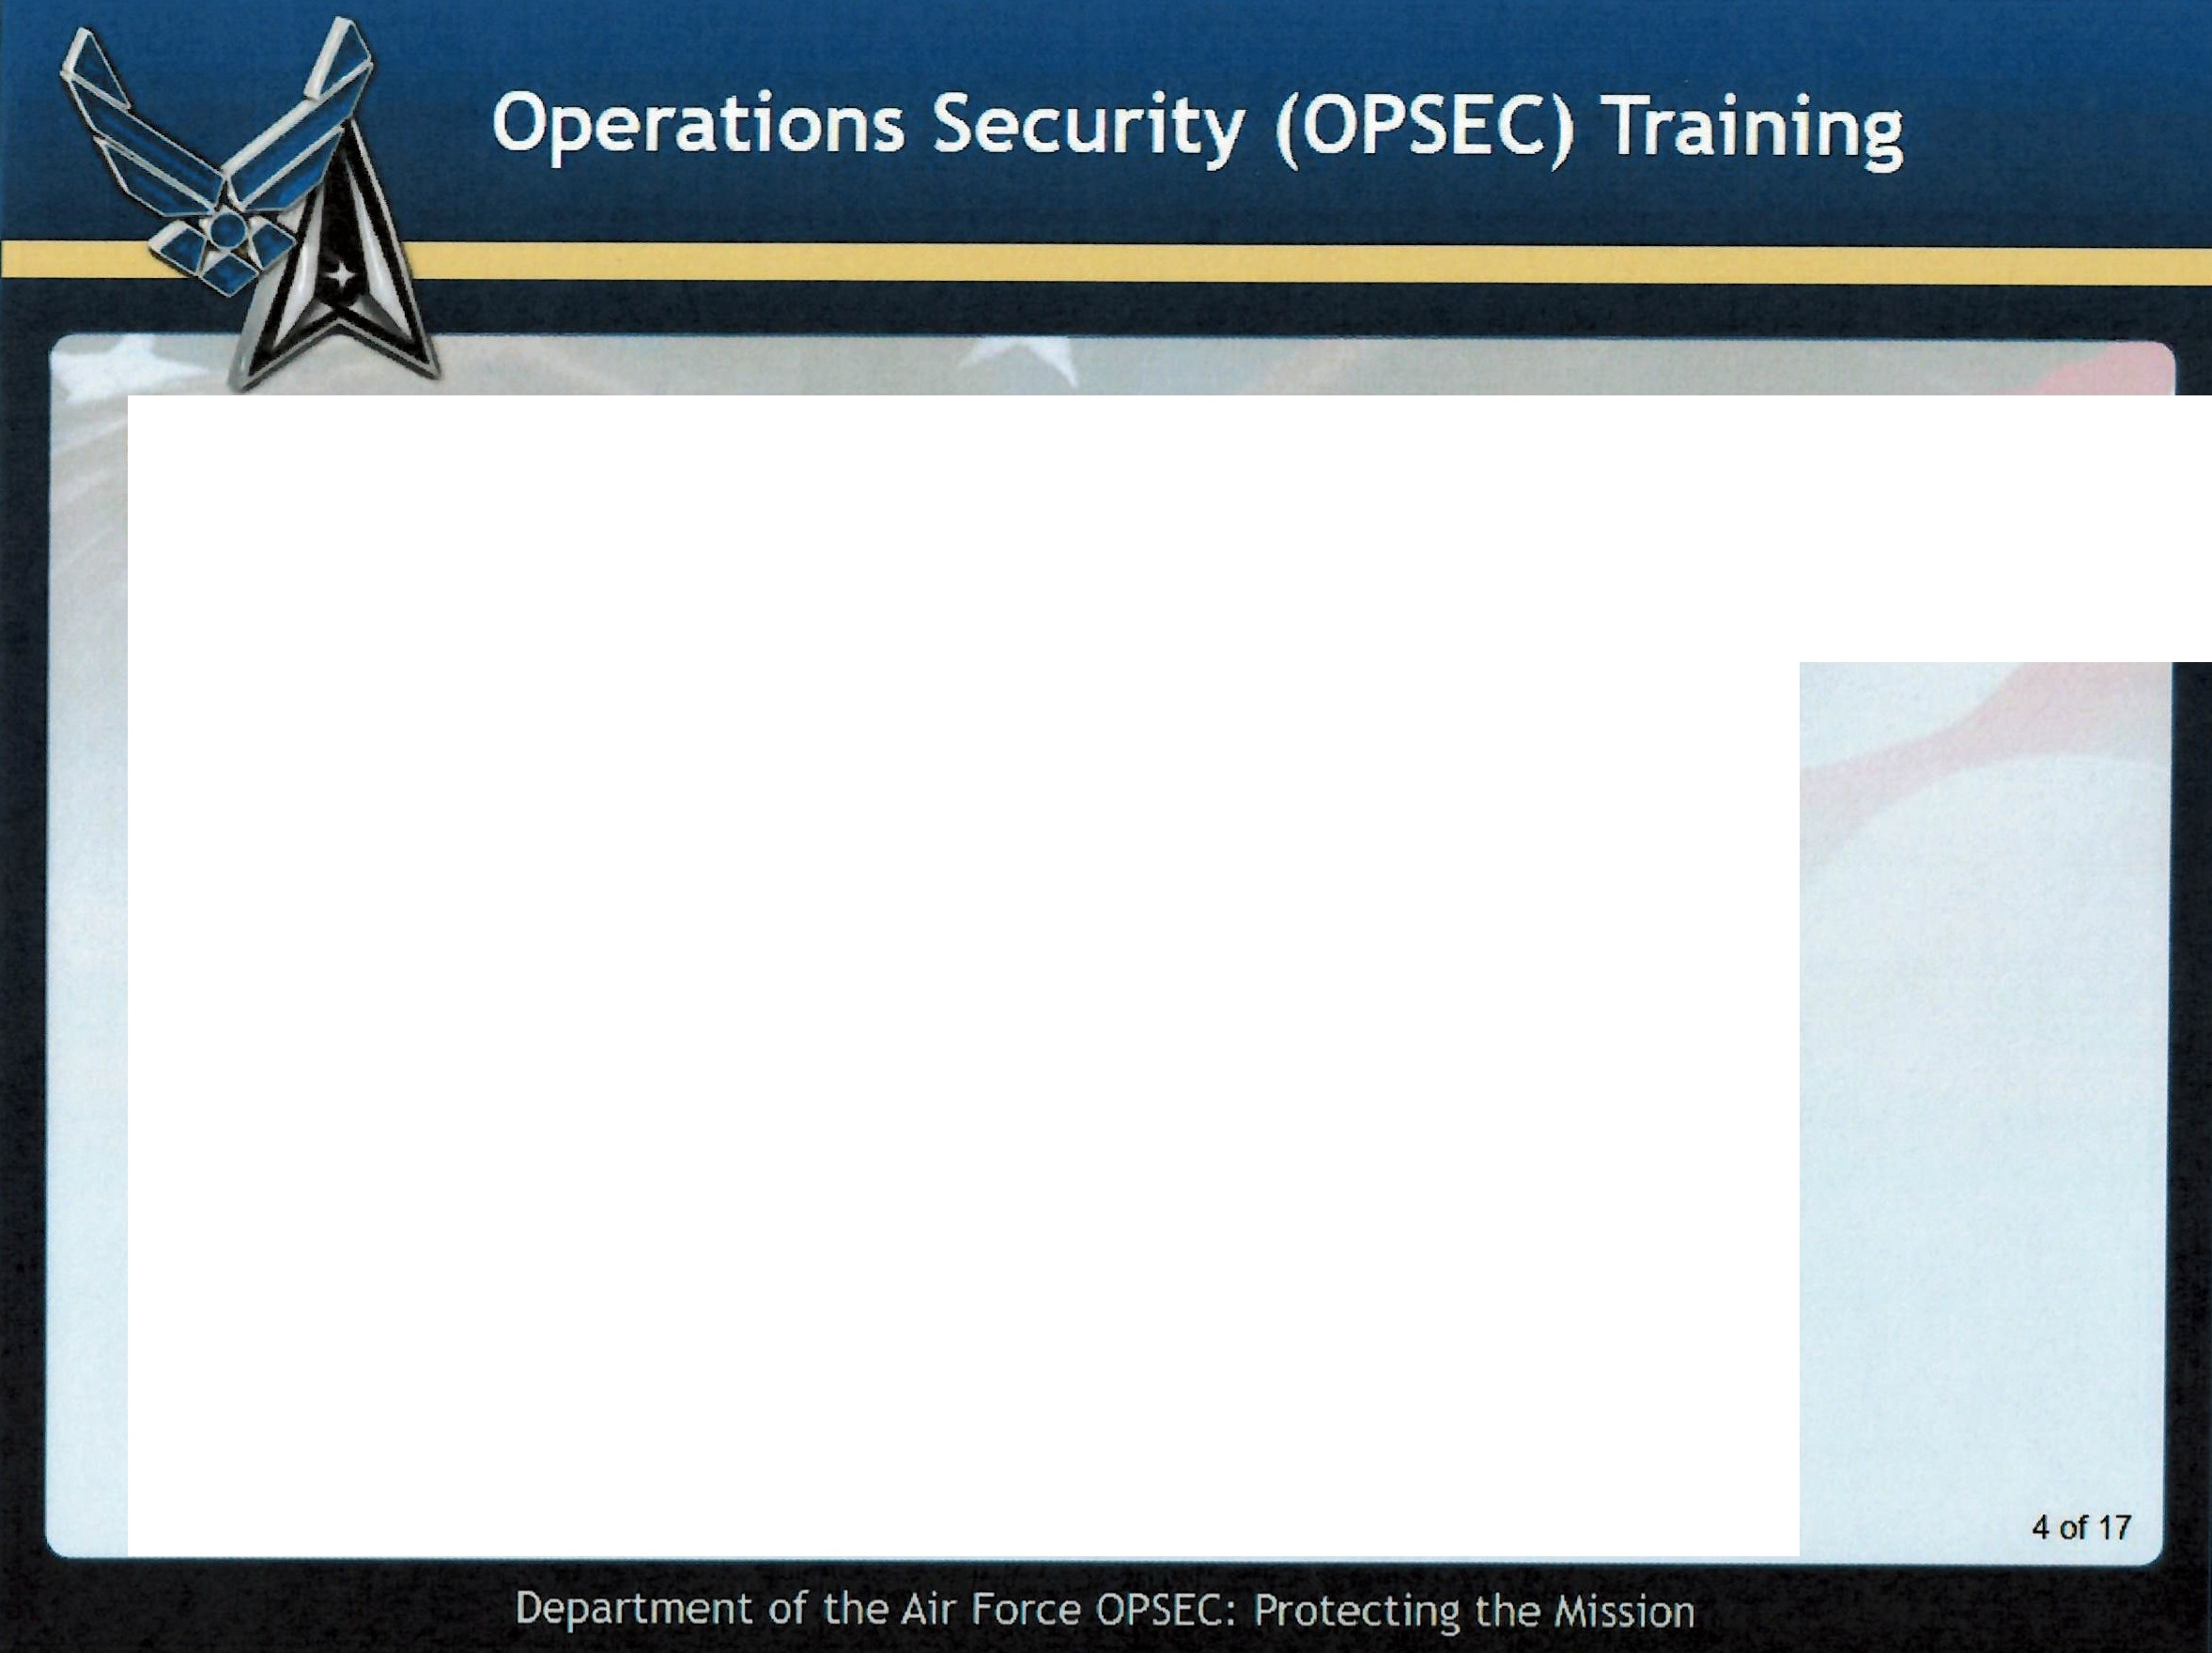
Objectives
In this lesson you will learn:
The definitions of OPSEC, Critical Information (Cl), and OPSEC threat
The purpose of OPSEC in the workplace
The means by which our adversaries collect critical information
OPSEC countermeasures to protect critical information
Protecting Controlled Unclassified Information (CUI) from Unauthorized Disclosures (UD)
Points of contact to report possible OPSEC vulnerabilities

Slide 5
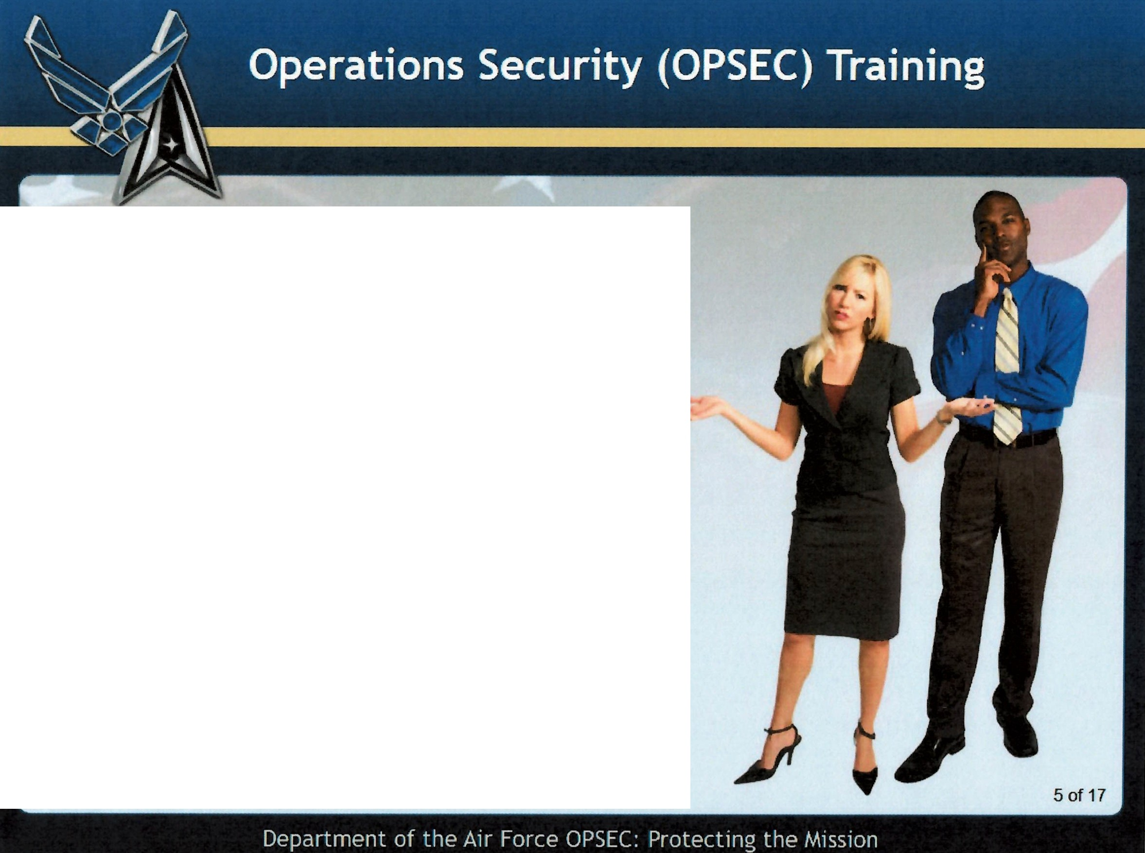
Why This Training? Why now?
The Department of Defense's ability to effectively protect its sensitive information has been significantly hampered due to ongoing unauthorized disclosures of
sensitive operational information.
-..
The loss of our sensitive information, even
unclassified small bits of information, has a direct and negative impact on our ability to effectively execute operations while ensuring our personnel remain safe.
This training will address these concerns along with new guidance regarding how OPSEC relates to DoD guidance on Unauthorized Disclosures (UD) of Controlled Unclassified Information (CUI).

Slide 6
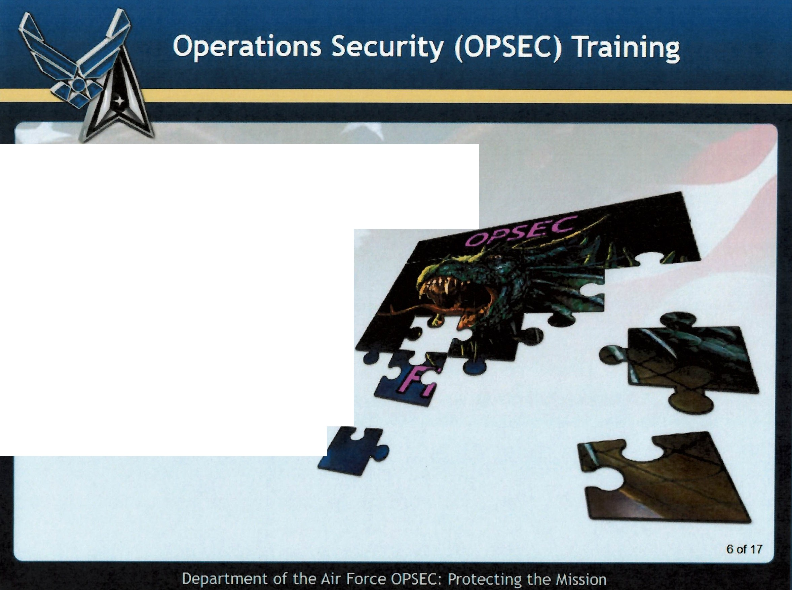
OPSEC
America's adversaries collect information pertaining to
U.S. military activities and technology to further their own agendas.
Even pieces of unclassified information can hold great value to an adversary.
By putting together enough small details and indicators, an adversary may piece together enough about
U.S. military plans and operations to do us harm.

Slide 7
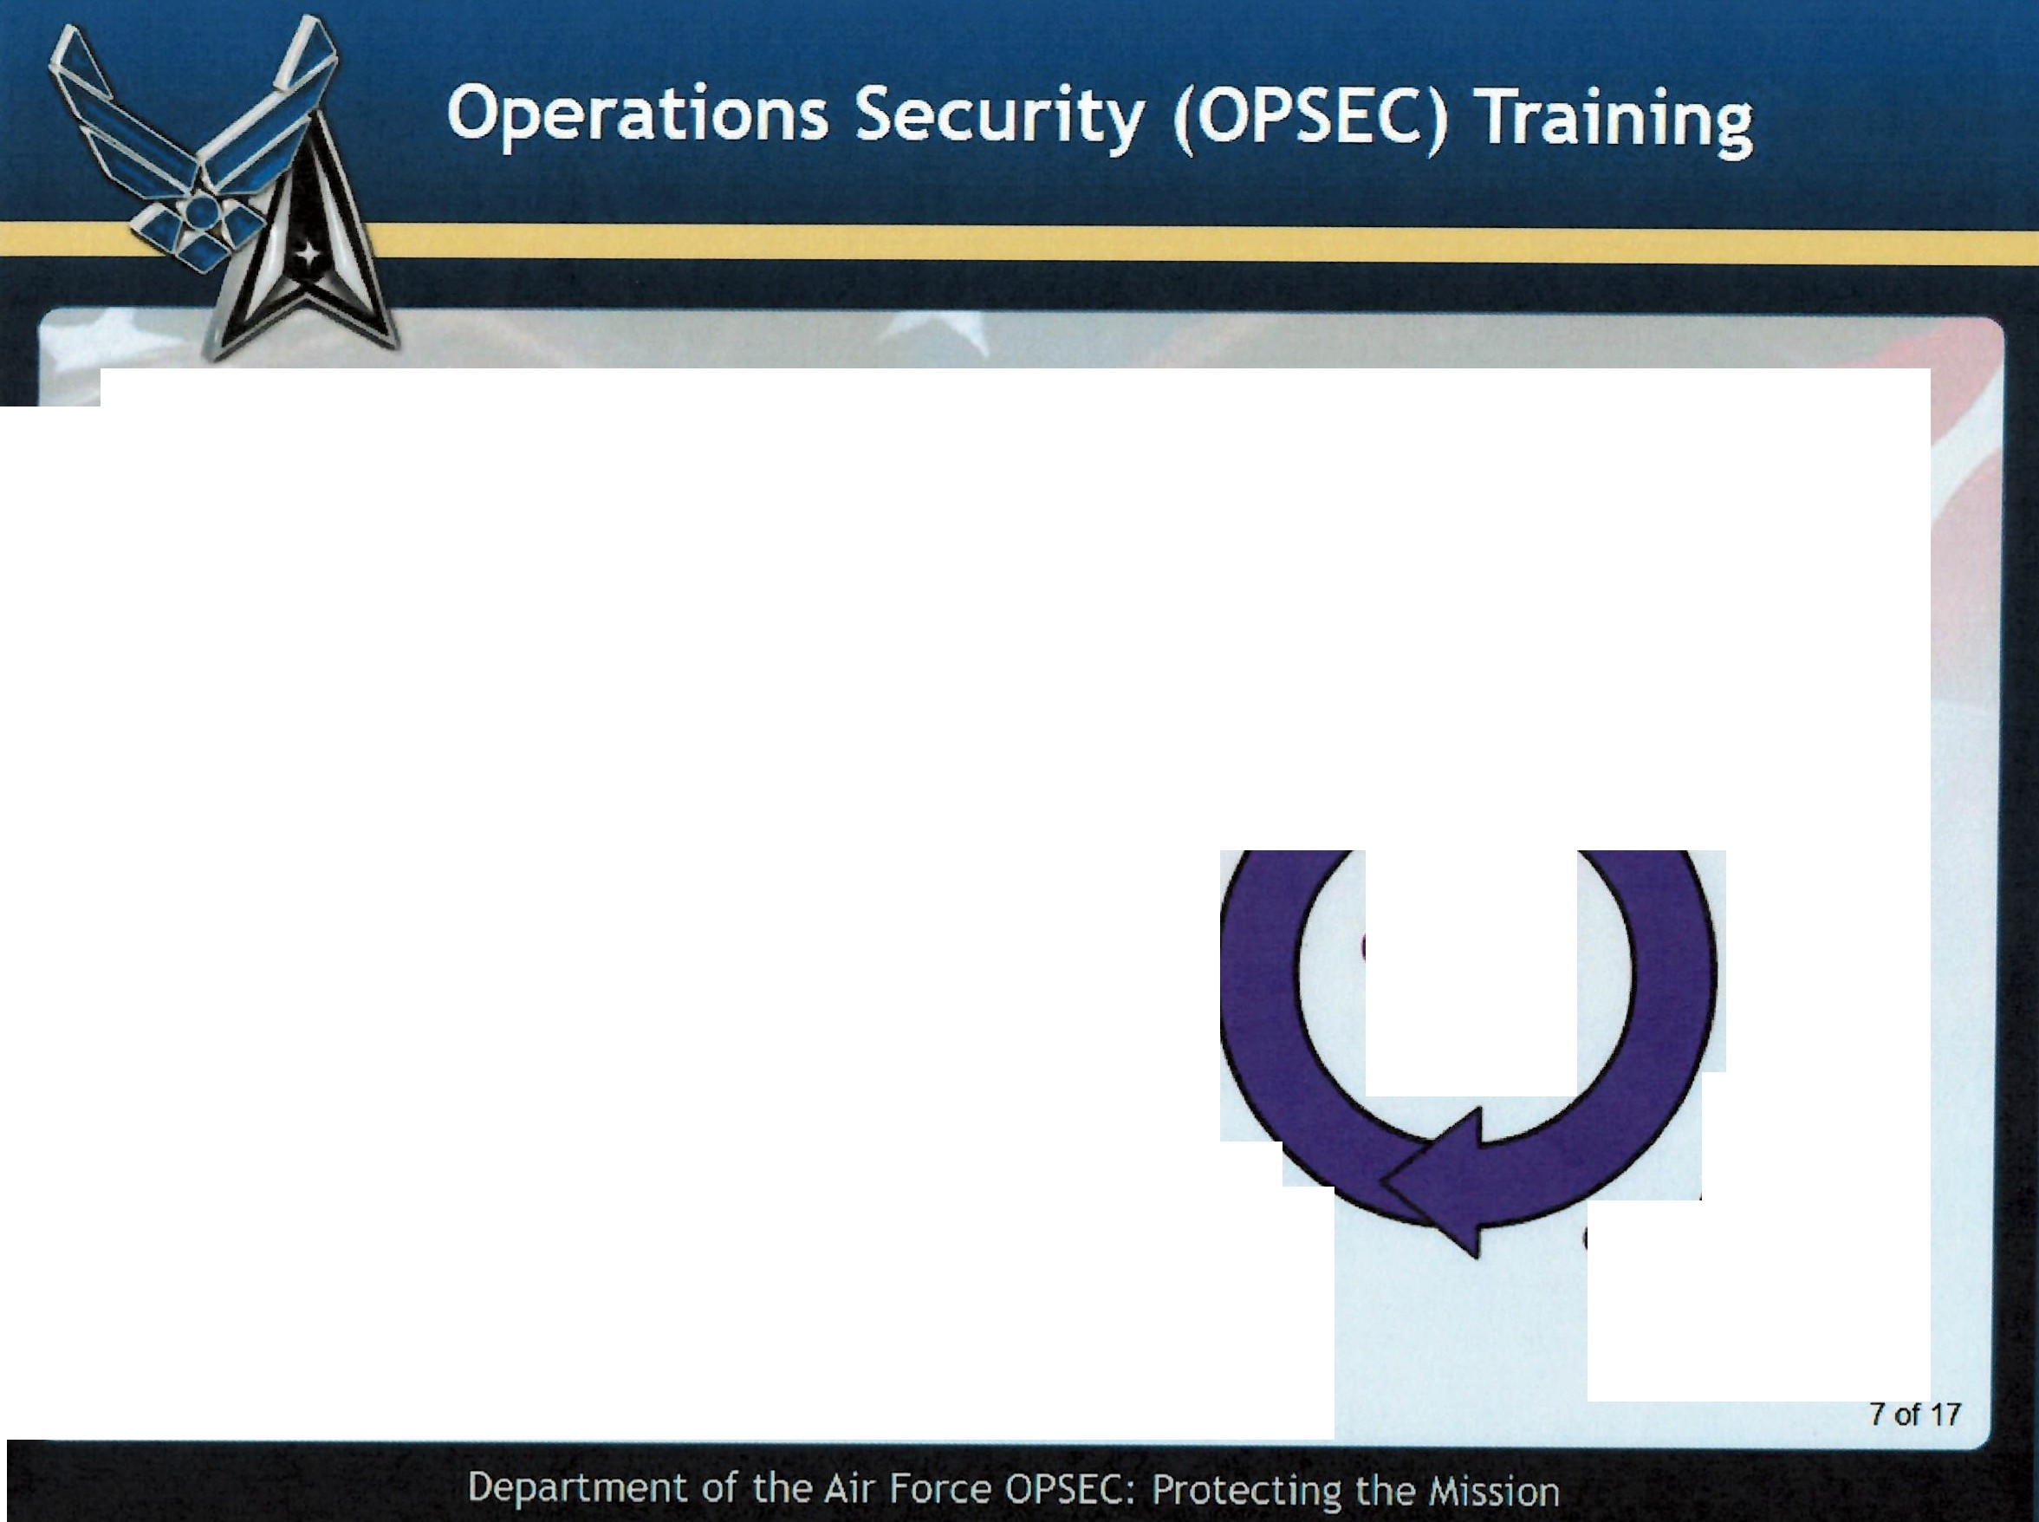
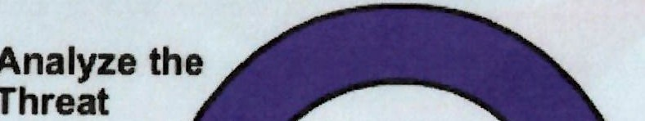
OPSEC Defined
Operations Security (OPSEC) is designed to deny adversaries the ability to collect, analyze, and exploit information that might provide an advantage against the United
States by preventing inadvertent compromise of
Analyze the
Critical Information through a process of continual assessment that identifies and analyzes
Critical Information, vulnerabilities, risks, and external threats.
(Reference: NSPM-28)
In other words, OPSEC's desired effect is to influence the adversary's behavior and actions by protecting
Vulnerability
OPSEC
Cycle
Assess the Risk
friendly operations and activities.
Identify
Critical Information and Indicators
Apply Countermeasures

Slide 8
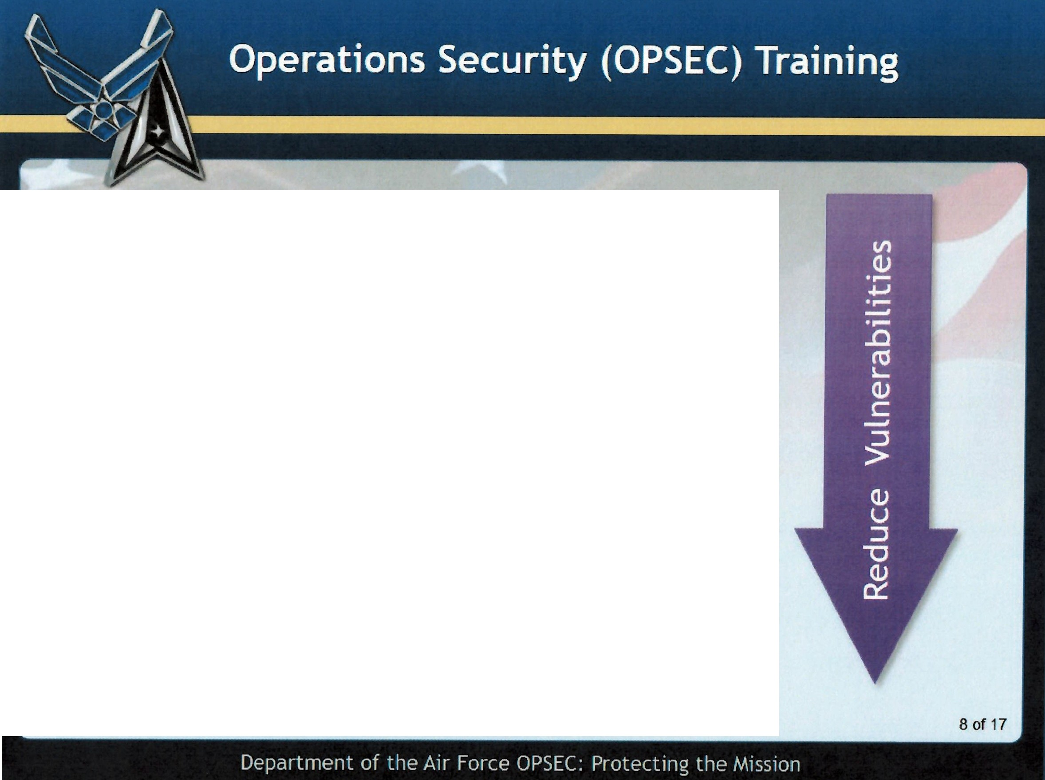
What is the purpose of OPSEC in your workplace?
The purpose of OPSEC is to reduce vulnerabilities to Air Force operations from adversary collection and exploitation.
OPSEC in the workplace is the responsibility of EVERYONE! We must all commit to reducing vulnerabilities that allow our adversaries access to our critical information, and observe key indicators that could lead to loss of critical information that can tip-off our adversaries to impending friendly operations or activities.
Regardless of your rank, position responsibilities, or assigned organization, you are an attractive target for our adversaries.
In short, adversary exploitation of friendly vulnerabilities is an adversary's primary gateway to potentially accessing friendly critical information.

Slide 9
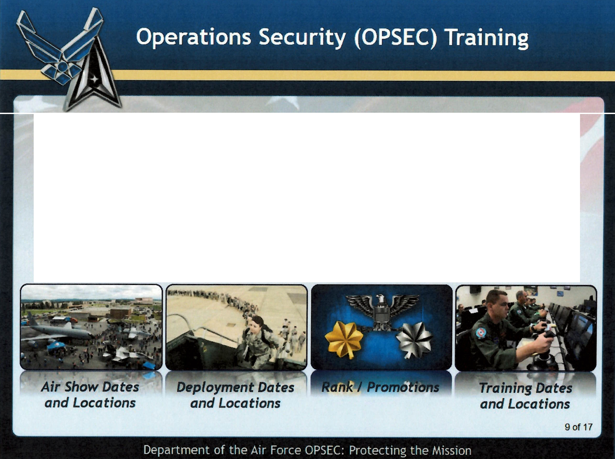
Critical Information
Critical information includes specific facts (like puzzle pieces) about friendly intentions, capabilities, and activities needed by adversaries for them to plan and act effectively.
Take a moment to select each of the four images displayed, and determine what information would harm the Air Force's ability to effectively carry out its missions, if it was available to one, or more adversaries.
Select each of the images below to continue.

Slide 10
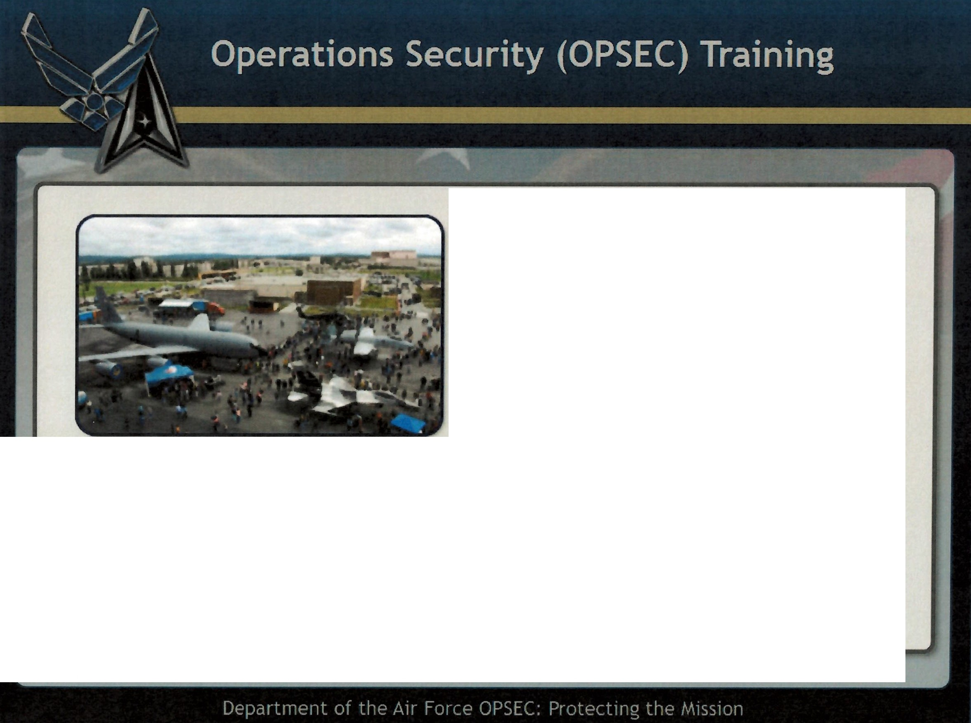
Are Air Show Dates and Locations Critical Information?
Choose the correct answer and select the Submit button.
No, this is not Critical Information
,,
"
Yes, this is Critical Information
Correct!
This is Not Critical Information
I
This Might be Critical Information
I
\...

Slide 11
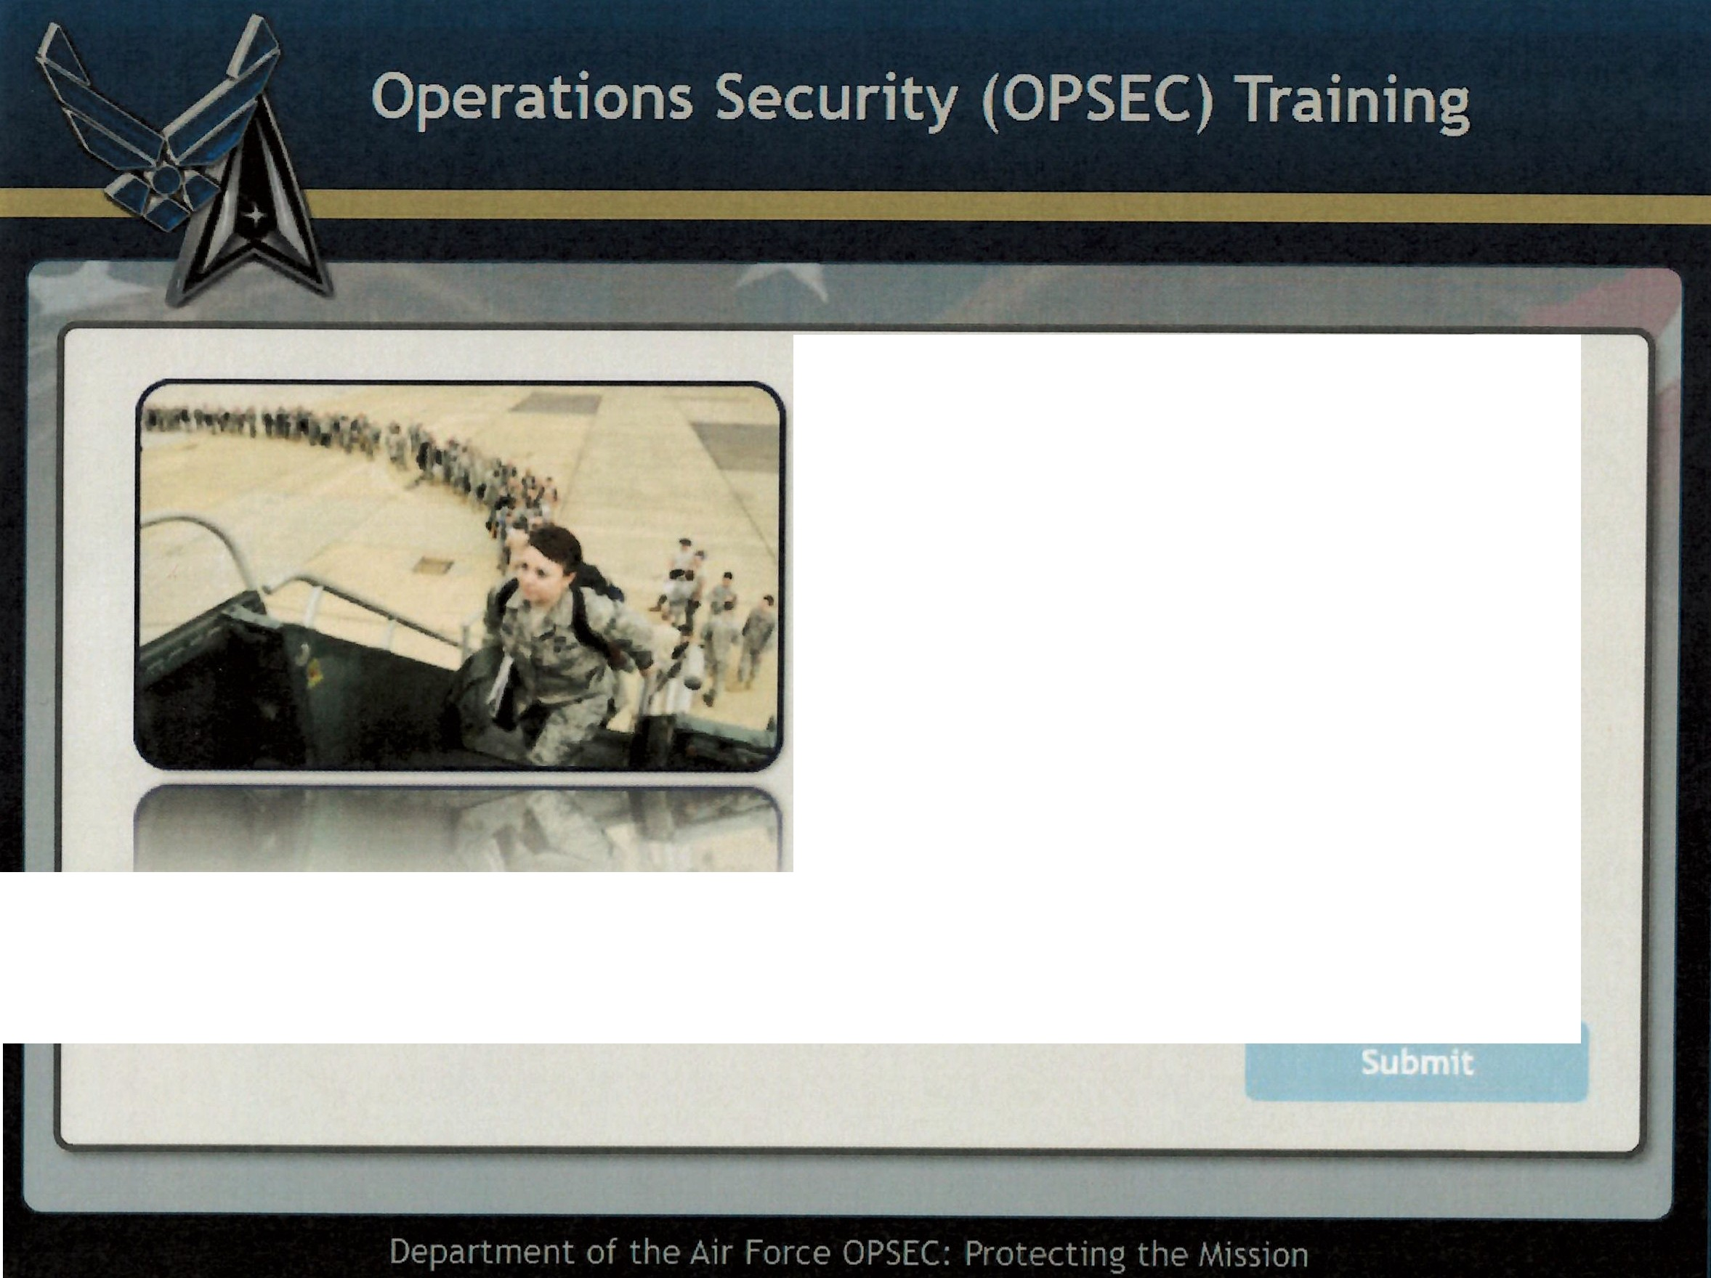
Are Deployment Dates and Locations
Critical Information?
Choose the correct answer and select the
Submit button.
No, this is not Critical Information
Yes, this is Critical Information This Might be Critical Information

Slide 12
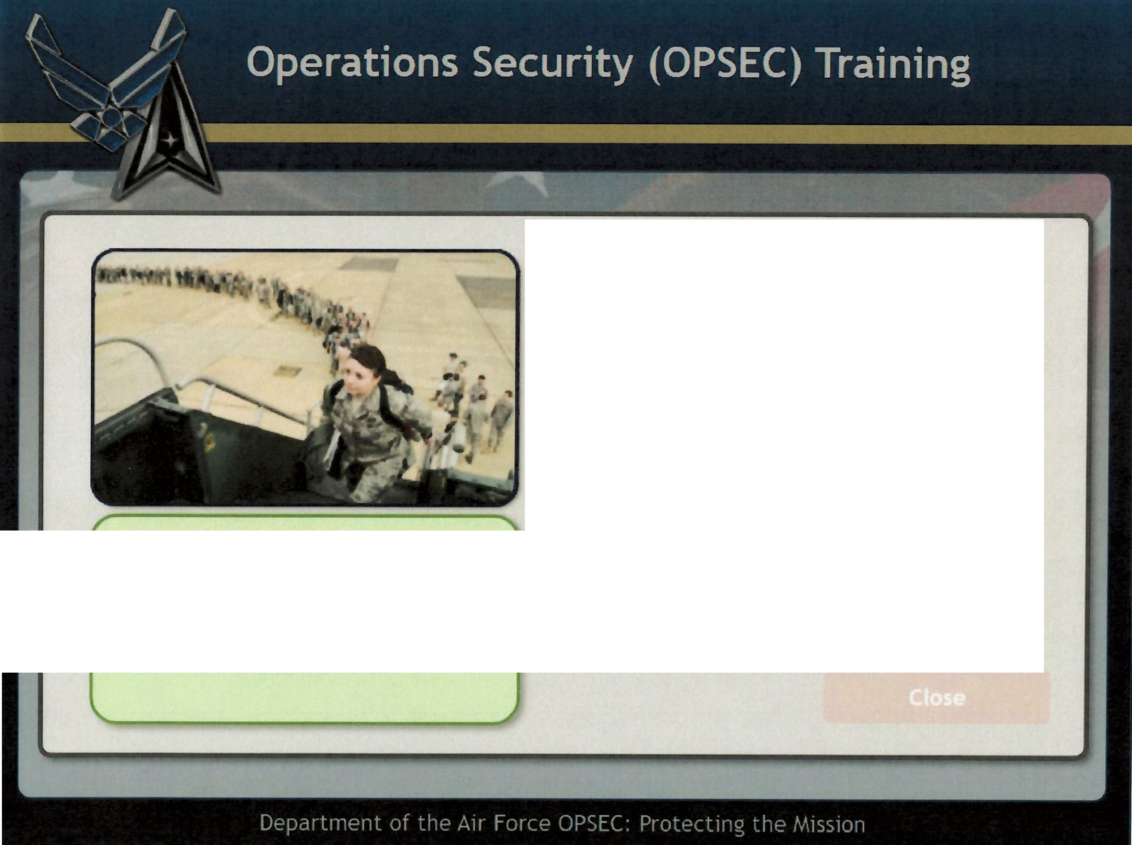
Are Deployment Dates and Locations
Critical Information?
Choose the correct answer and select the Submit button.
No, this is not Critical Information
· Yes, this is Critical Information
Correct!
Yes, this Is Critical Information
This Might be Critical Information

Slide 13
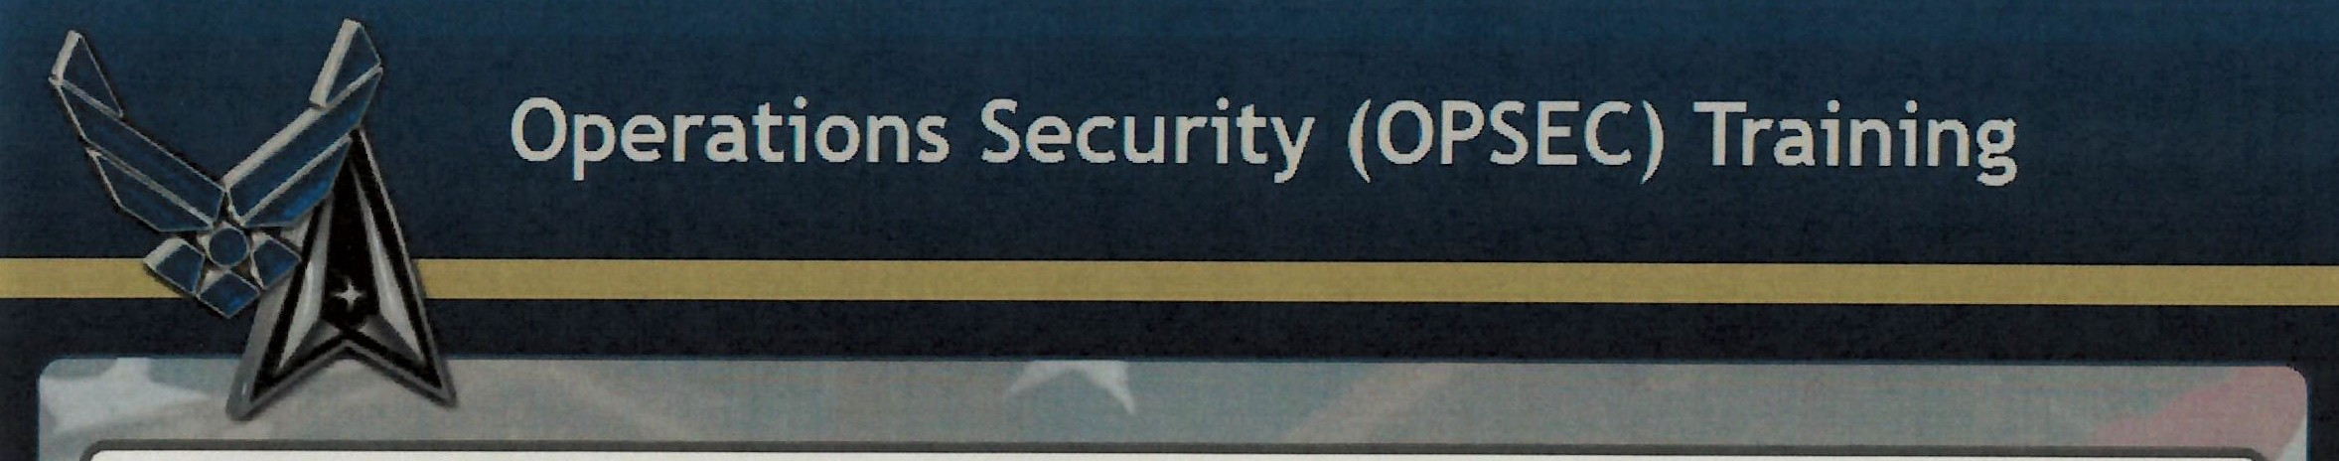
-1-... r:
.,O(;;\
Are Ranks and Promotions Critical Information?
Choose the correct answer and select the Submit button.
-'\ .. .,..·:I.,_-:· --
·.
'
e: No, this is not Critical Information
,.
'
Yes, this is Critical Information
Correct!
This is Not
Critical Information
I.
This Might be Critical Information
Replay
Close
\..

Slide 14
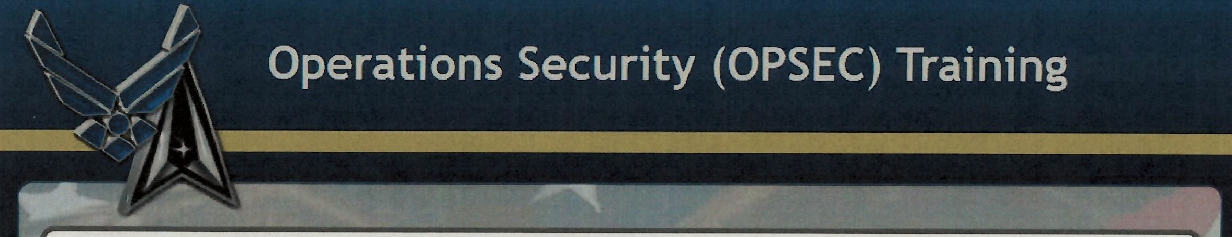
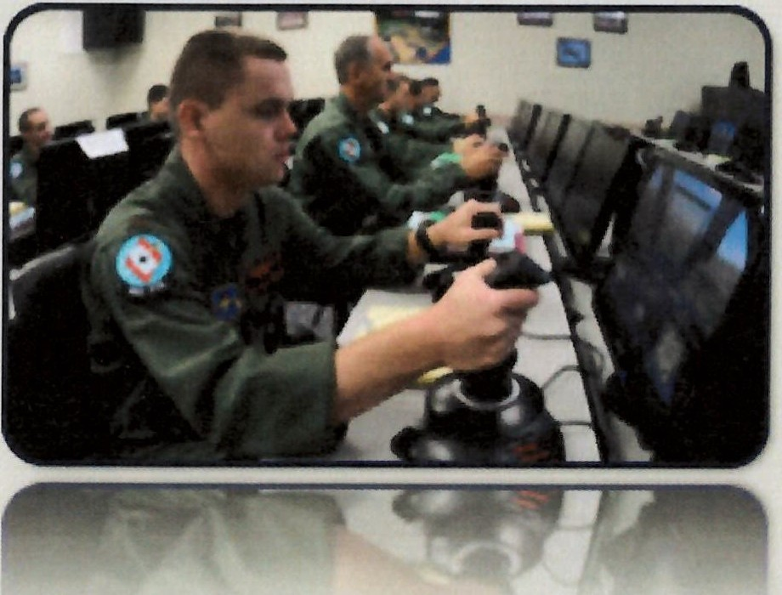
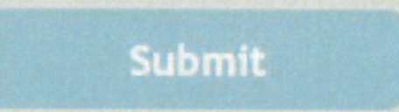
Are Training Dates and Locations Critical Information?
Choose the correct answer and select the Submit button.
No, this is not Critical Information
Yes, this is Critical Information This Might be Critical Information

Slide 15
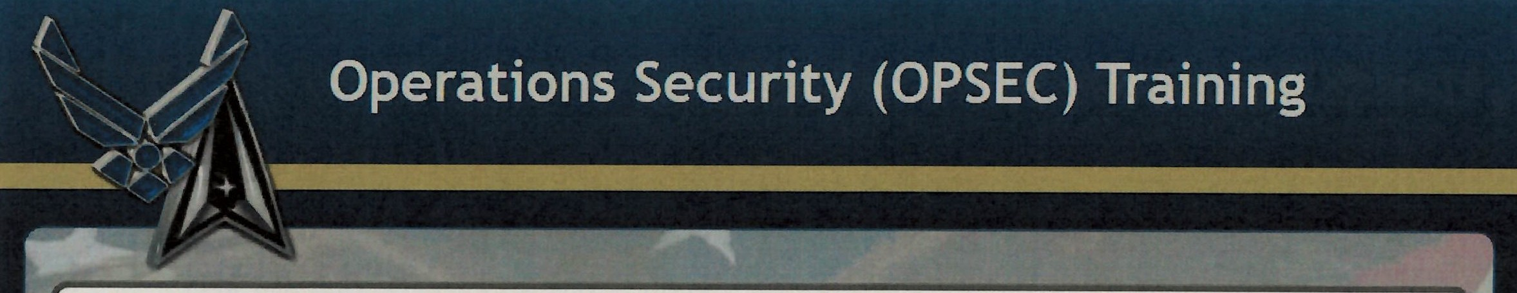
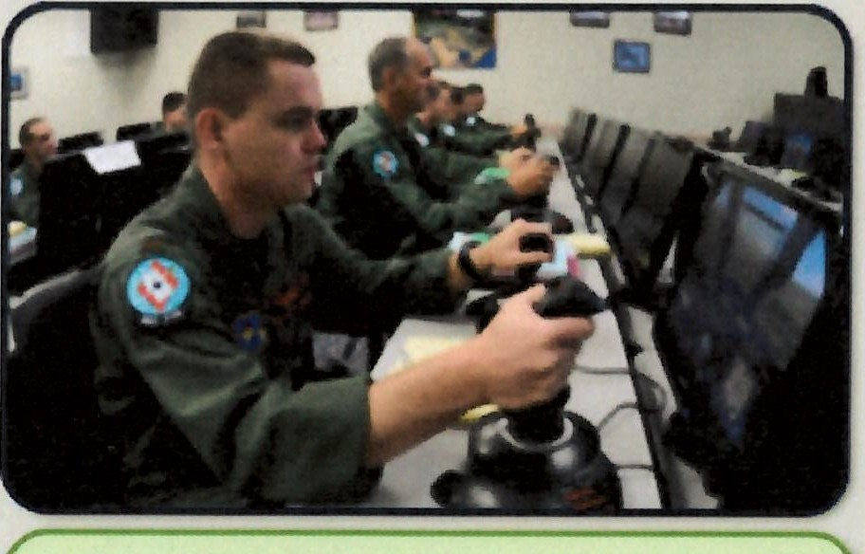

Are Training Dates and Locations Critical Information?
Choose the correct answer and select the Submit button.
No, this is not Critical Information
Yes, this is Critical Information
That is Correct!
This Might be Critical Information
e) This Might be Critical Information

Slide 16
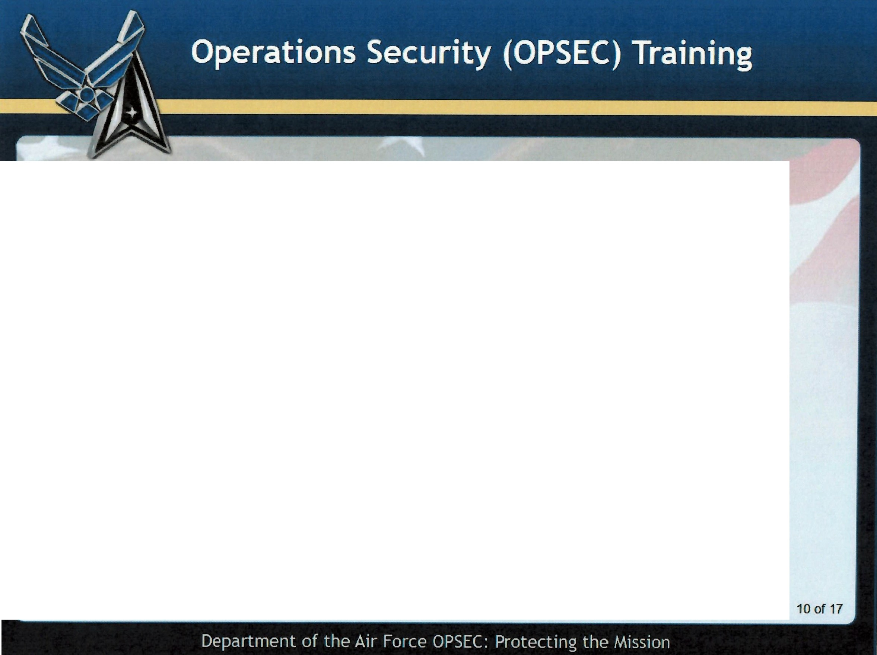
Critical Information Resources
Critical Information about your unit, that you must protect, includes:
Please Contact your OPSEC POC for a copy of your current Critical Information and Indicators List (CIIL).

Slide 17

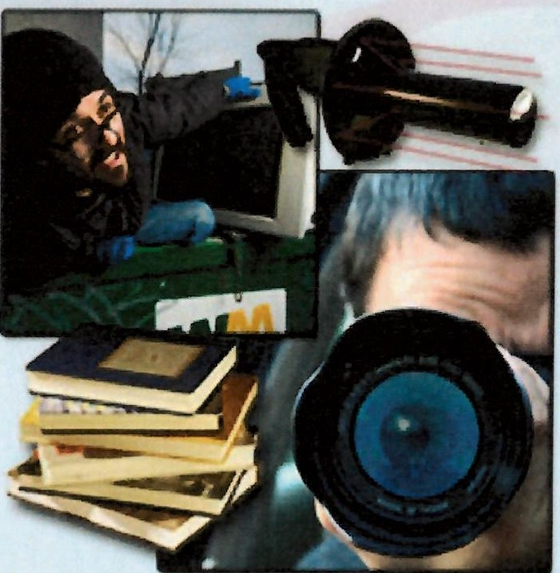
Threats
An OPSEC threat is an adversary that has the capability + intent to take any actions detrimental to the success of our activities or operations.
They use the internet to glean data from web pages, blogs, chat groups, and social media postings.
They use people to collect information - informers, listening to conversations in public, social engineering, etc.
They can easily intercept our unsecured communications - your unsecure phone call, unencrypted e-mails, radios, etc.
They can gain information from going through our trash and recycling where we work and live.
They can observe our actions to detect patterns to predict behavior.
11 of 17

Slide 18
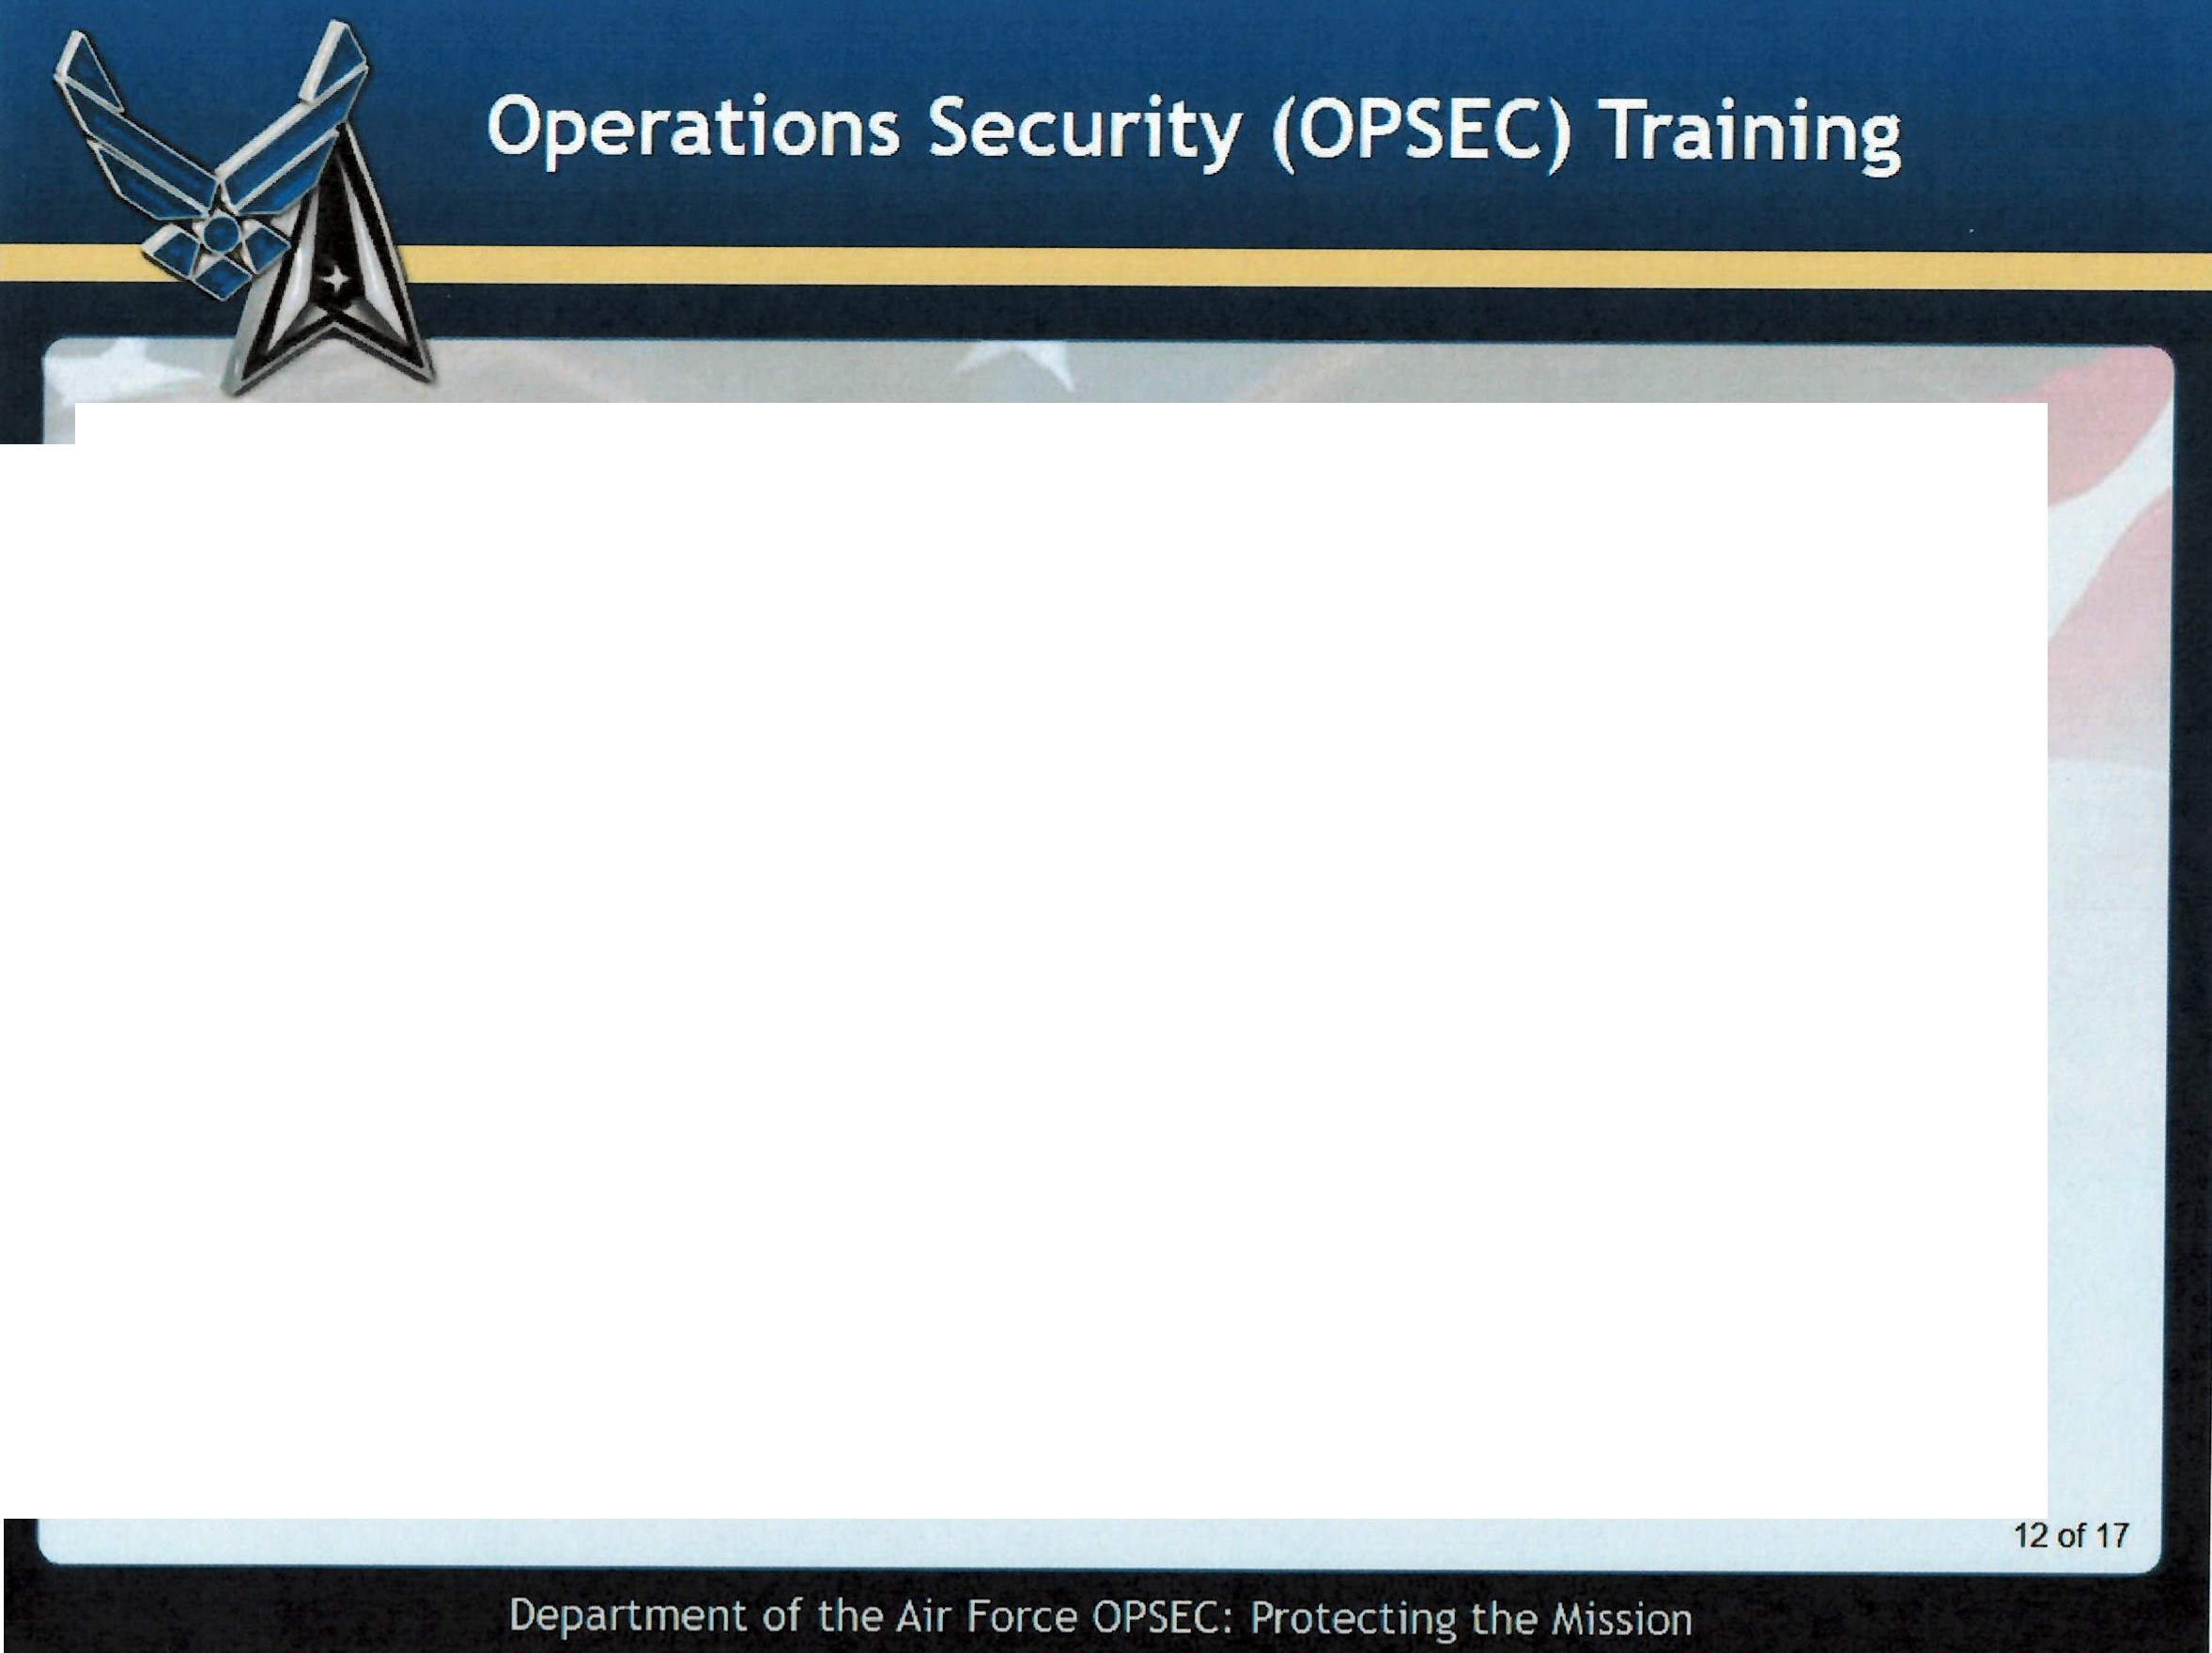
What countermeasures will protect our critical information?
Know what your unit considers critical information.
Encrypt all e-mails with sensitive information.
Ensure all information is reviewed by Public Affairs for OPSEC concerns before it is released to the public (in any fashion).
Properly destroy any papers with sensitive information.
Don't discuss sensitive information with someone not authorized to know the information.
Be cautious of sensitive discussions in public (in-person and online).
Remain vigilant for attempts to oversee or gain your sensitive data.
Understand your stereotyped operations can be exploited.
Others as directed by your Commander/Director.

Slide 19
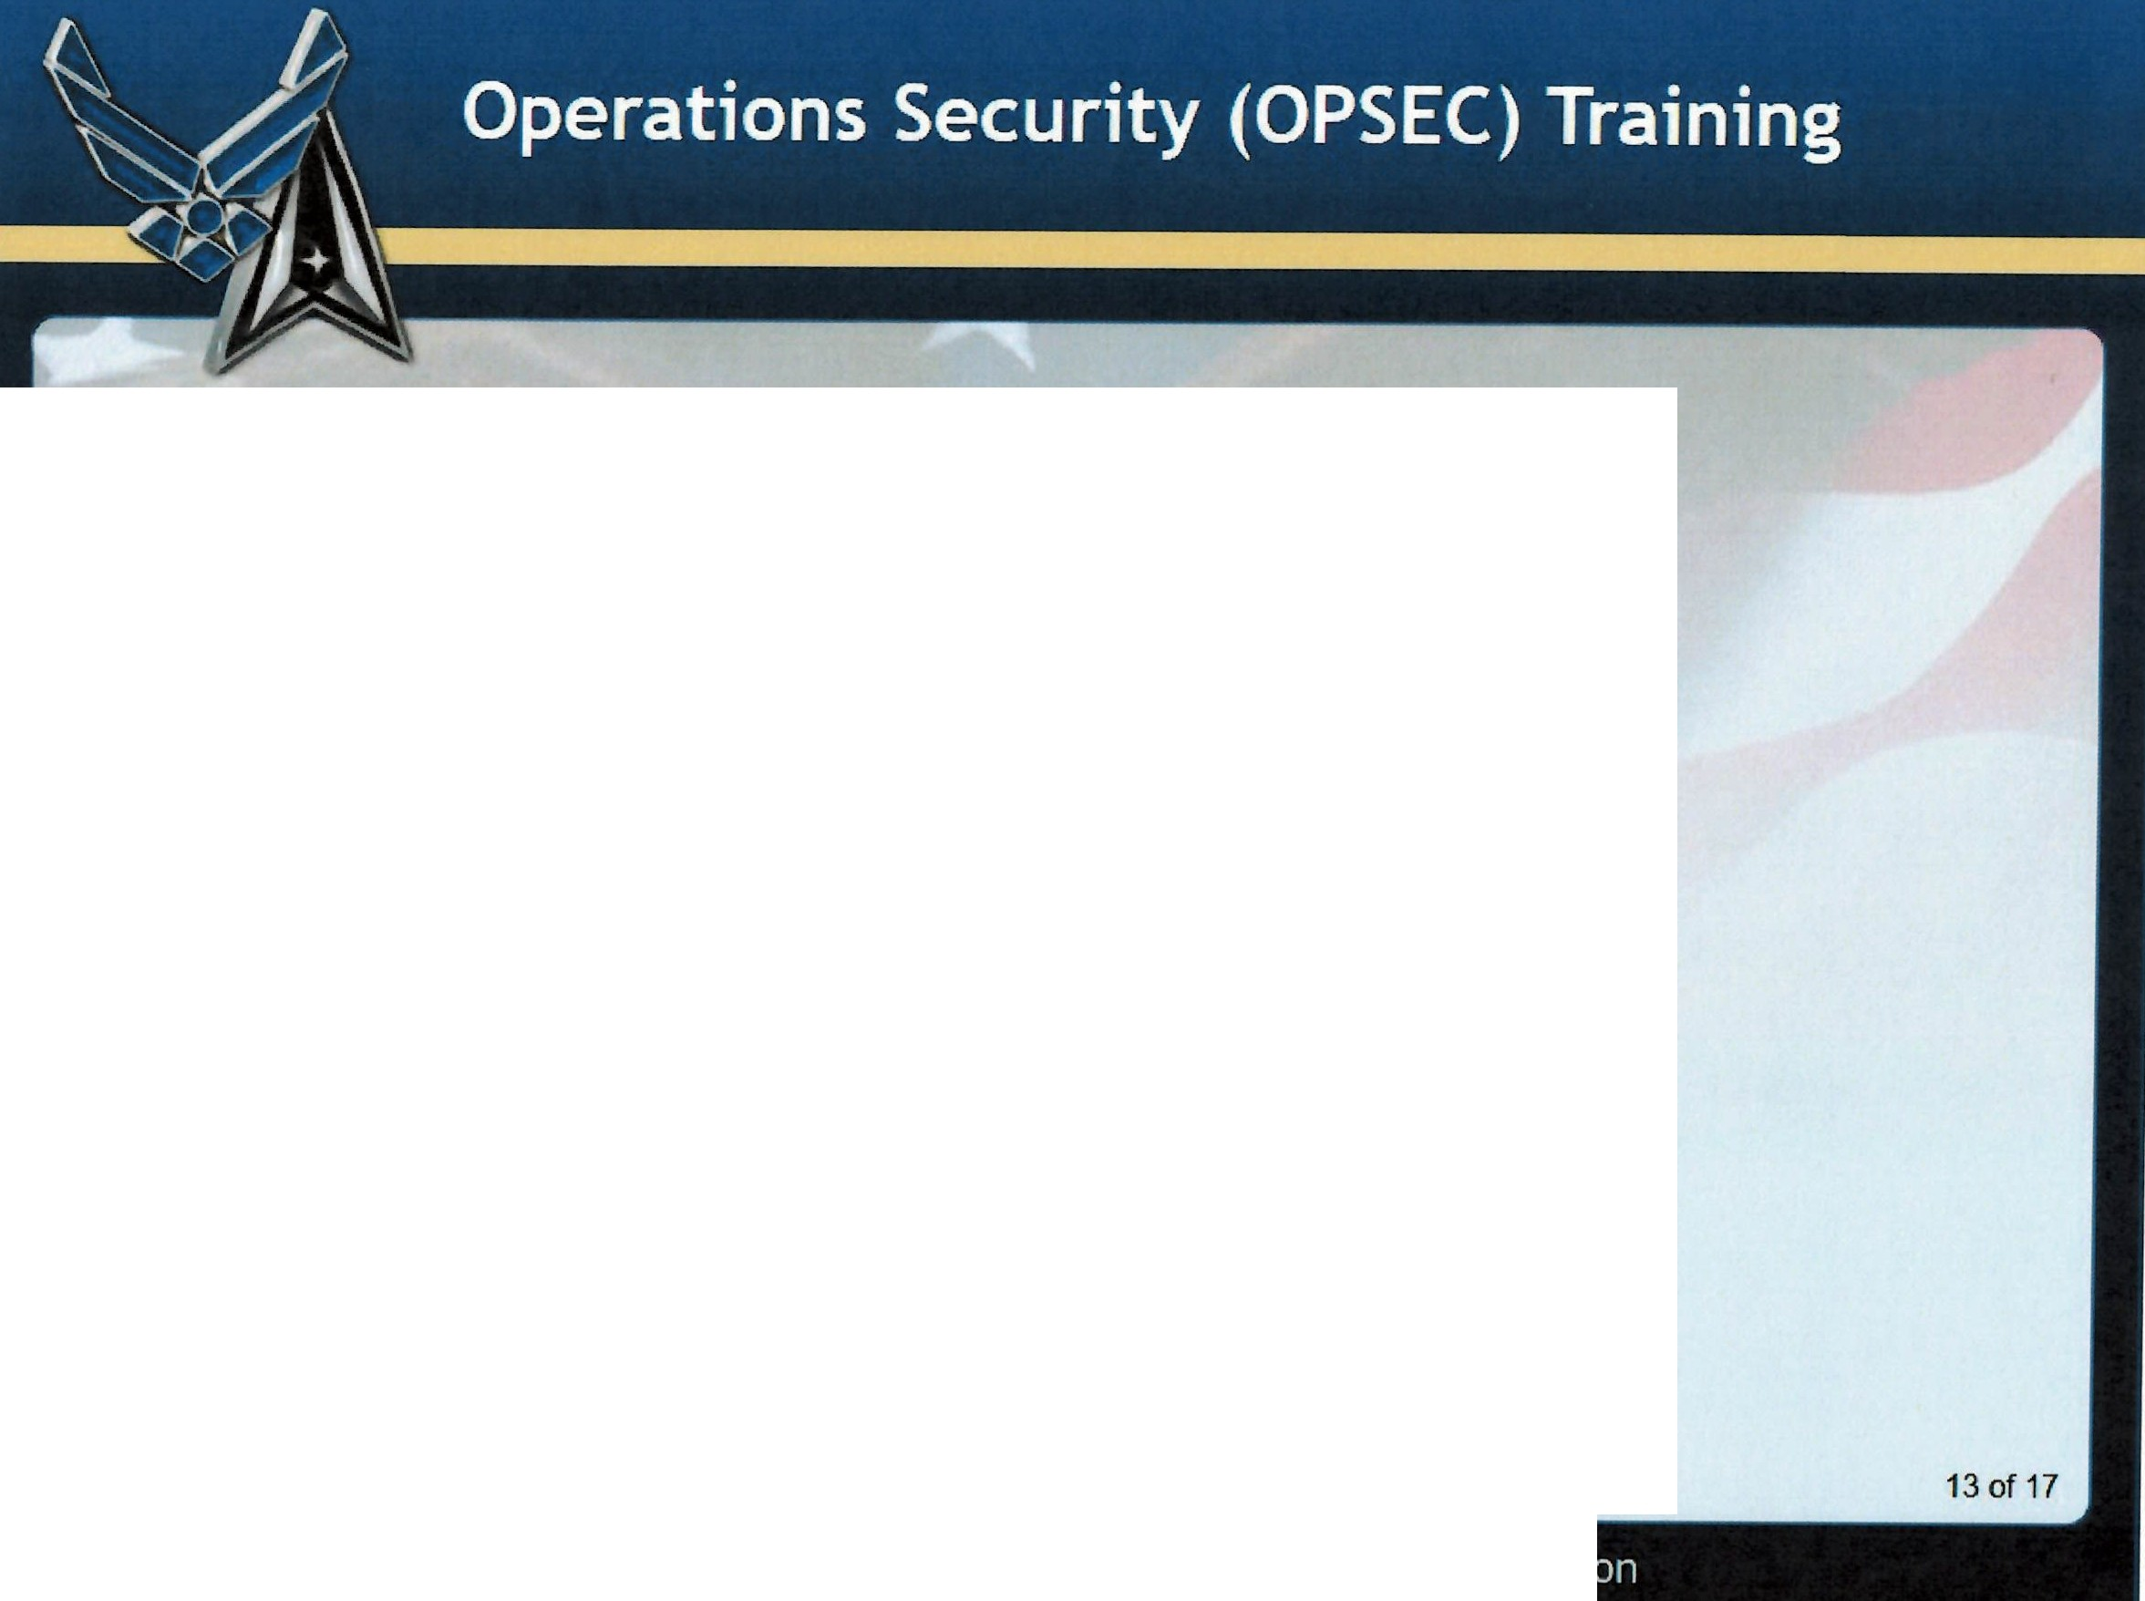
What is Controlled Unclassified Information (CUI)?
CUI is UNCLASSIFIED information that requires safeguarding or dissemination controls. CUI does NOT include CLASSIFIED information.
Within CUI, OPSEC is a dissemination control category that must be protected from unauthorized disclosure. Unauthorized disclosure of CUI must be reported in accordance with CUI guidance.

Slide 20
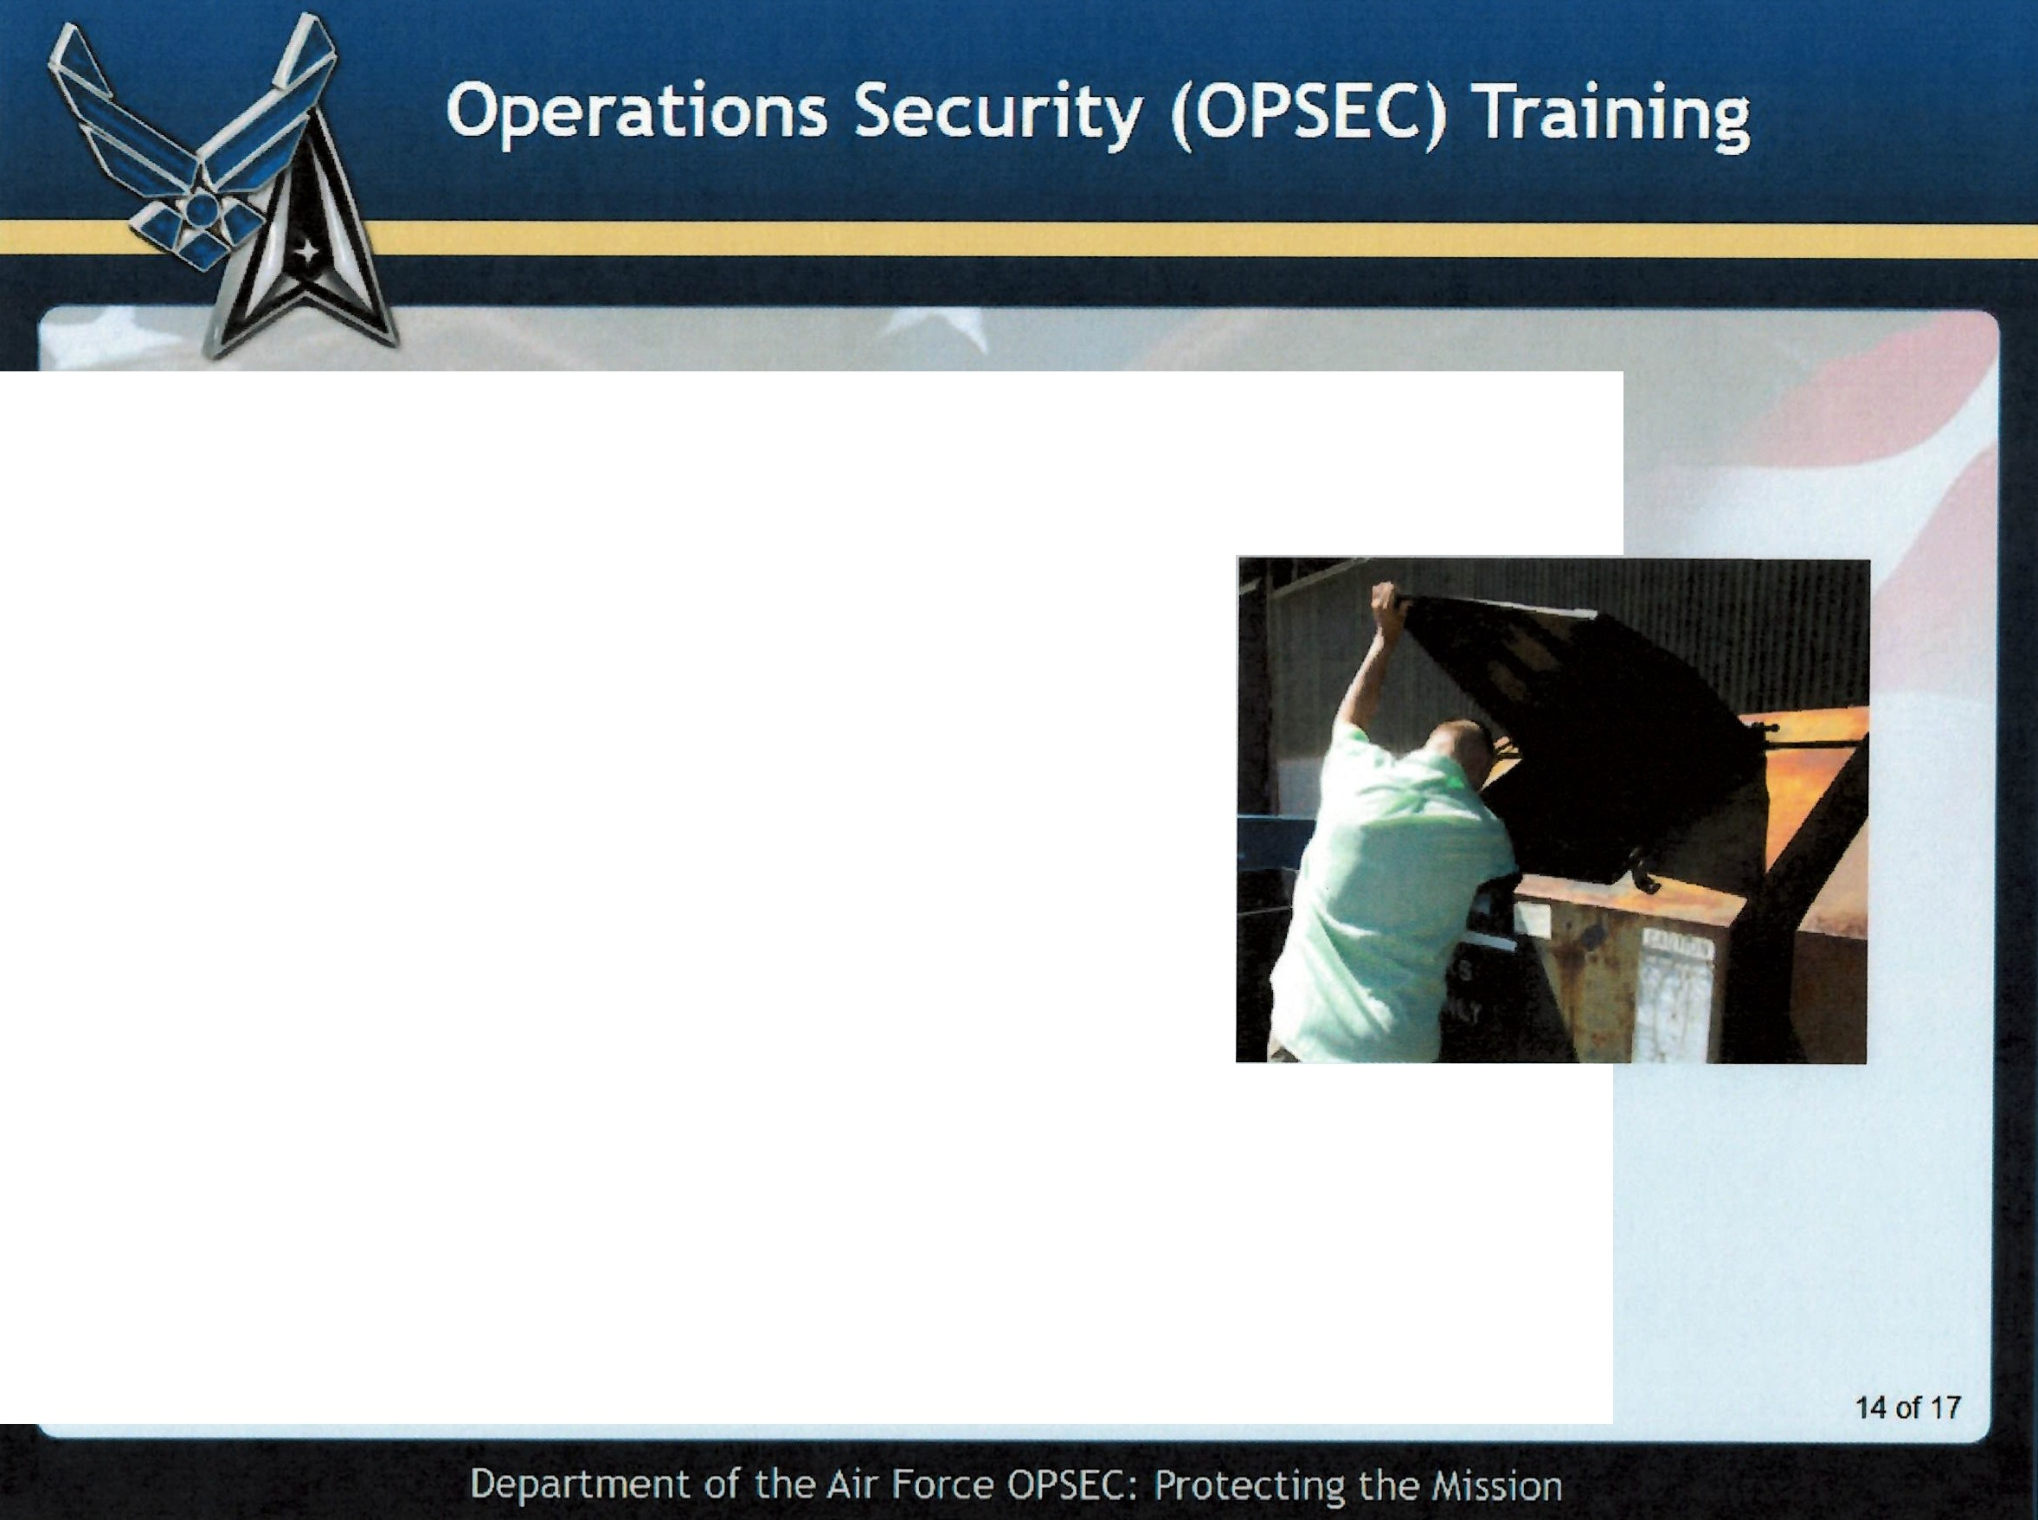
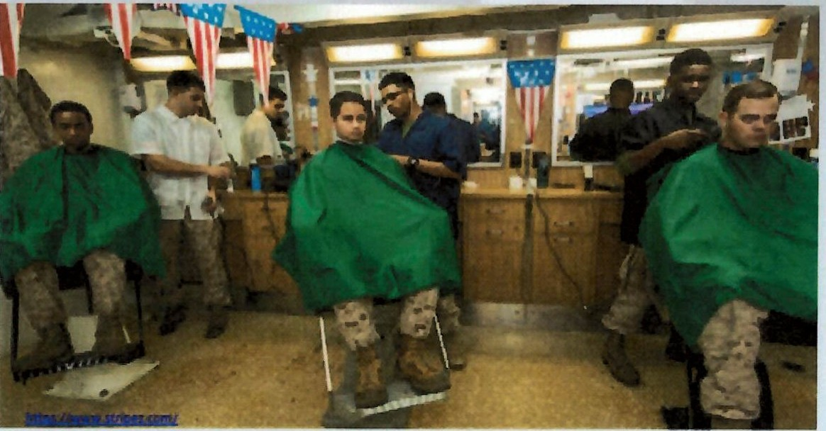
What is an Unauthorized Disclosure (UD) of CUI?
A communication or physical transfer of CUI to an unauthorized recipient.
How does a UD relate to OPSEC?
When we lose our critical information (or associated indicators that point to our critical information) it is considered an Unauthorized Disclosure.
Under the CUI program, any loss of CUI must be reported.

Slide 21
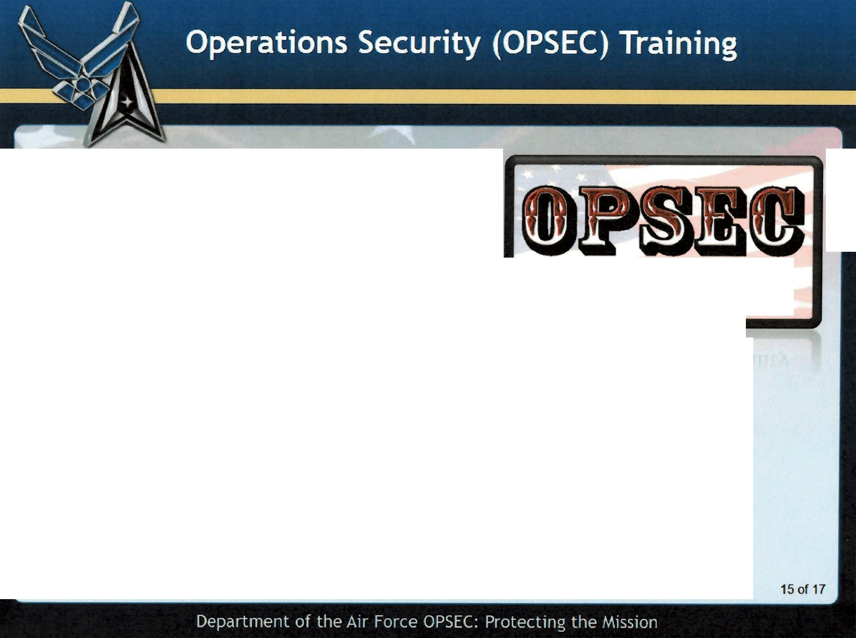
Reporting OPSEC Concerns
If you identify an Unauthorized Disclosure or detect a possible vulnerability to your organization's mission, you have the responsibility to report it.
it's
everyone's responsibility
Contact your unit OPSEC Signature Manager, your supervisor or your commander.
Organization OPSEC representatives include:
OPSEC Program Managers (HAF/USSF /MAJCOM/Field Command/DRU/ AFFOR or equivalent)
OPSEC Signature Managers (FOA/Delta/Wing or equivalent)
Unit OPSEC Coordinators (Supporting PMs and SMs)

Slide 22

Summary
In this lesson you learned:
The definitions of OPSEC, Critical Information (Cl), and OPSEC threat
The purpose of OPSEC in the workplace
OPSEC countermeasures to protect critical information
The means by which our adversaries collect critical information
Protecting Controlled Unclassified Information (CUI) from Unauthorized Disclosures (UD)
Points of contact to report possible OPSEC vulnerabilities
00
Department
of the Air Force OPSEC: Protecting the Mission

Slide 23
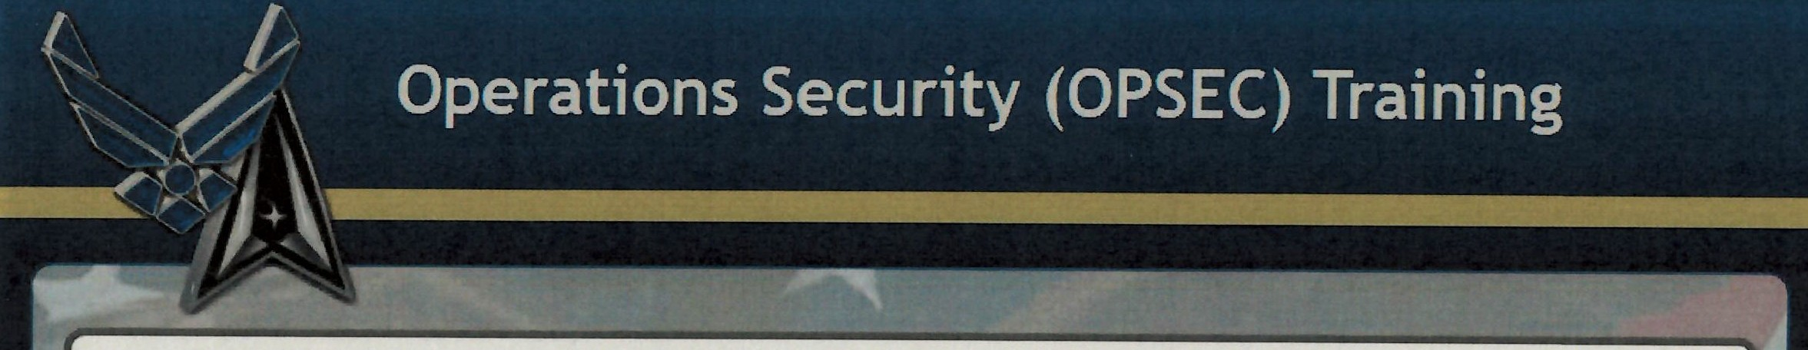

Question 1
Which of the following are examples of vulnerabilities exploited by our adversaries to collect our information?
Listening to conversations off-base Interception of unsecure phone calls
Going through trash and recycling containers
Data on web pages, blogs, chat groups, and social media postings All of the above

Slide 24
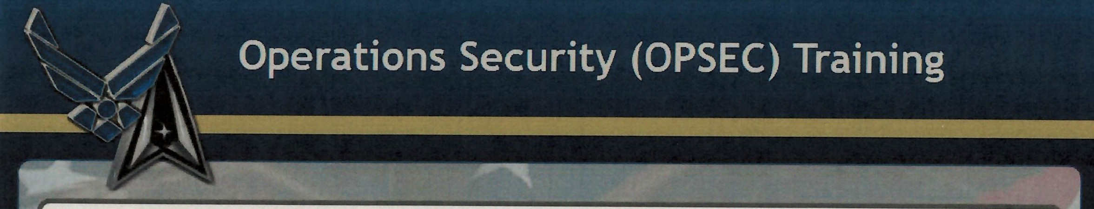
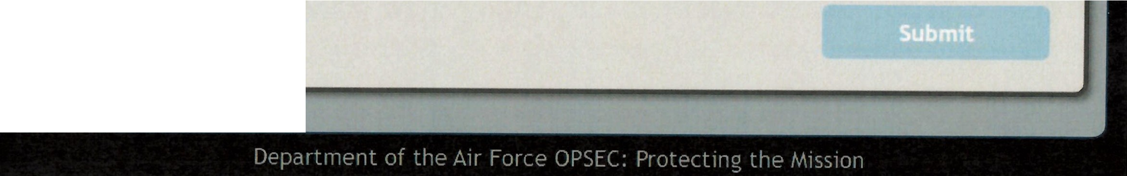
Which of the following are examples of vulnerabiHties exploited by our adversaries to collect our information?
Question 1
Listening to conversations off-base
Interception of unsecure phone calls
Going through trash and recycling containers
Data on web pages, blogs, chat groups, and social media postings ({)All of the above

Slide 25
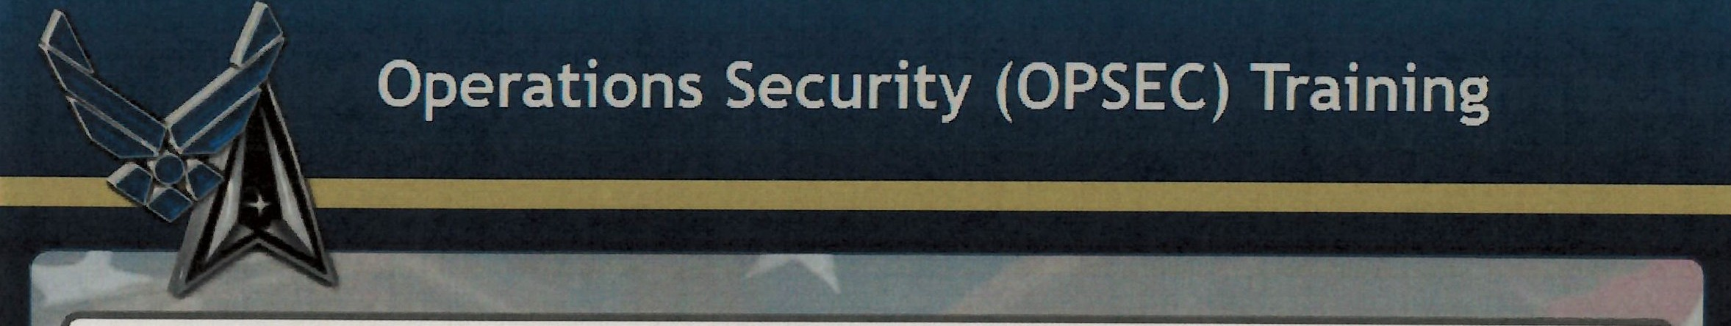
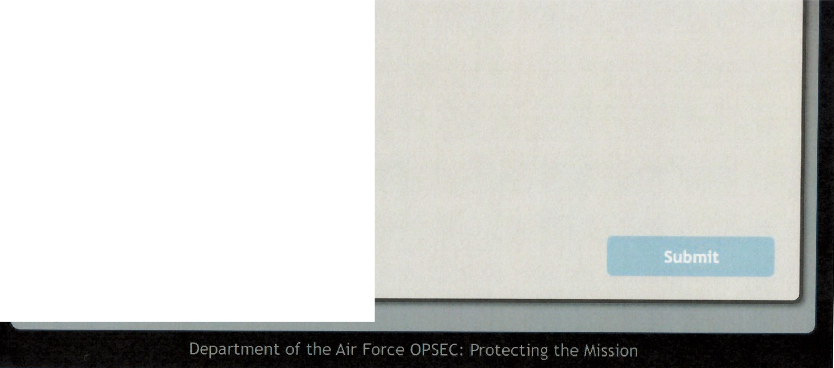
Question 2
Who should unit members contact when reporting OPSEC concerns?
Appointed OPSEC representatives Supervisor
Commander
All of the above

Slide 26
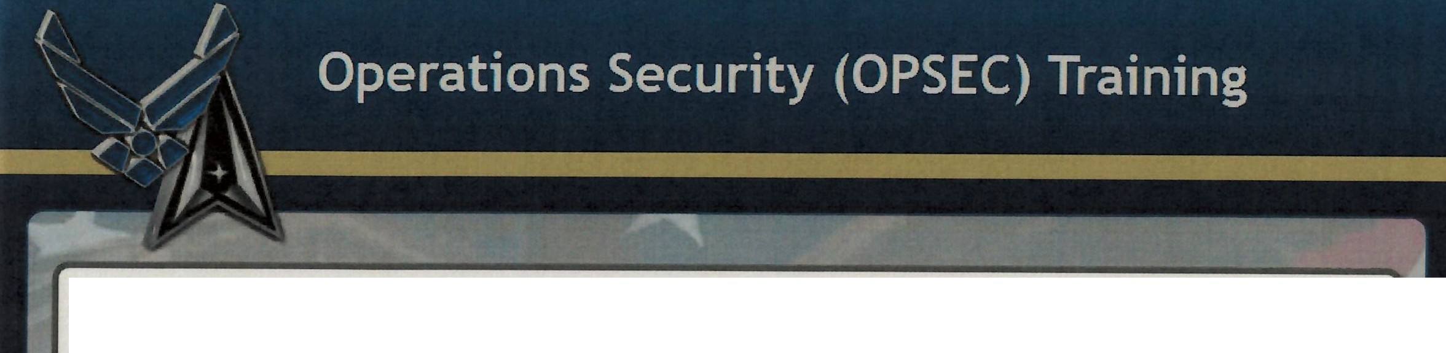
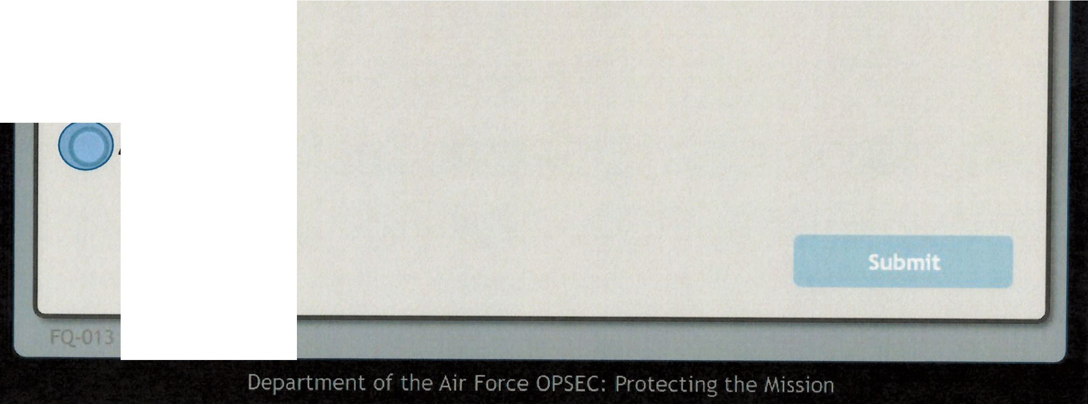
Question 2
Who should unit members contact when reporting OPSEC concerns?
Appointed OPSEC representatives Supervisor
Commander
All of the above

Slide 27
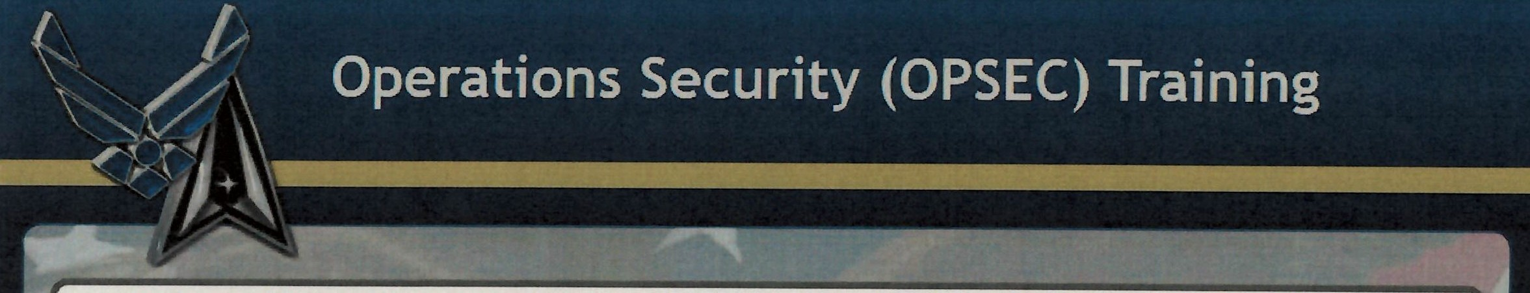
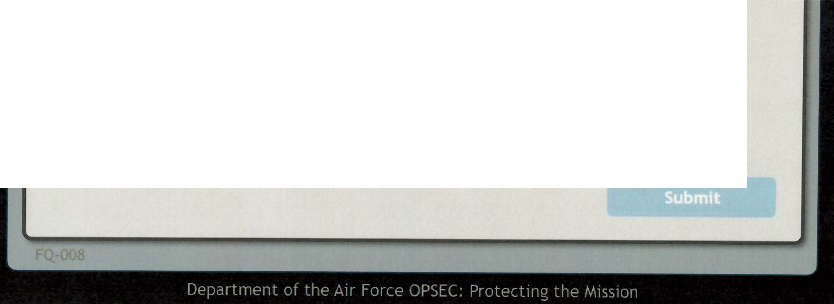
Question 3
Who should you contact to discuss items on your organization's critical information and indicator's list (CIIL)?
Facility Manager
OPSEC representative such as your organization's OPSEC Program Managers or Signature Managers or Coordinators
Security Forces Security Manager

Slide 28

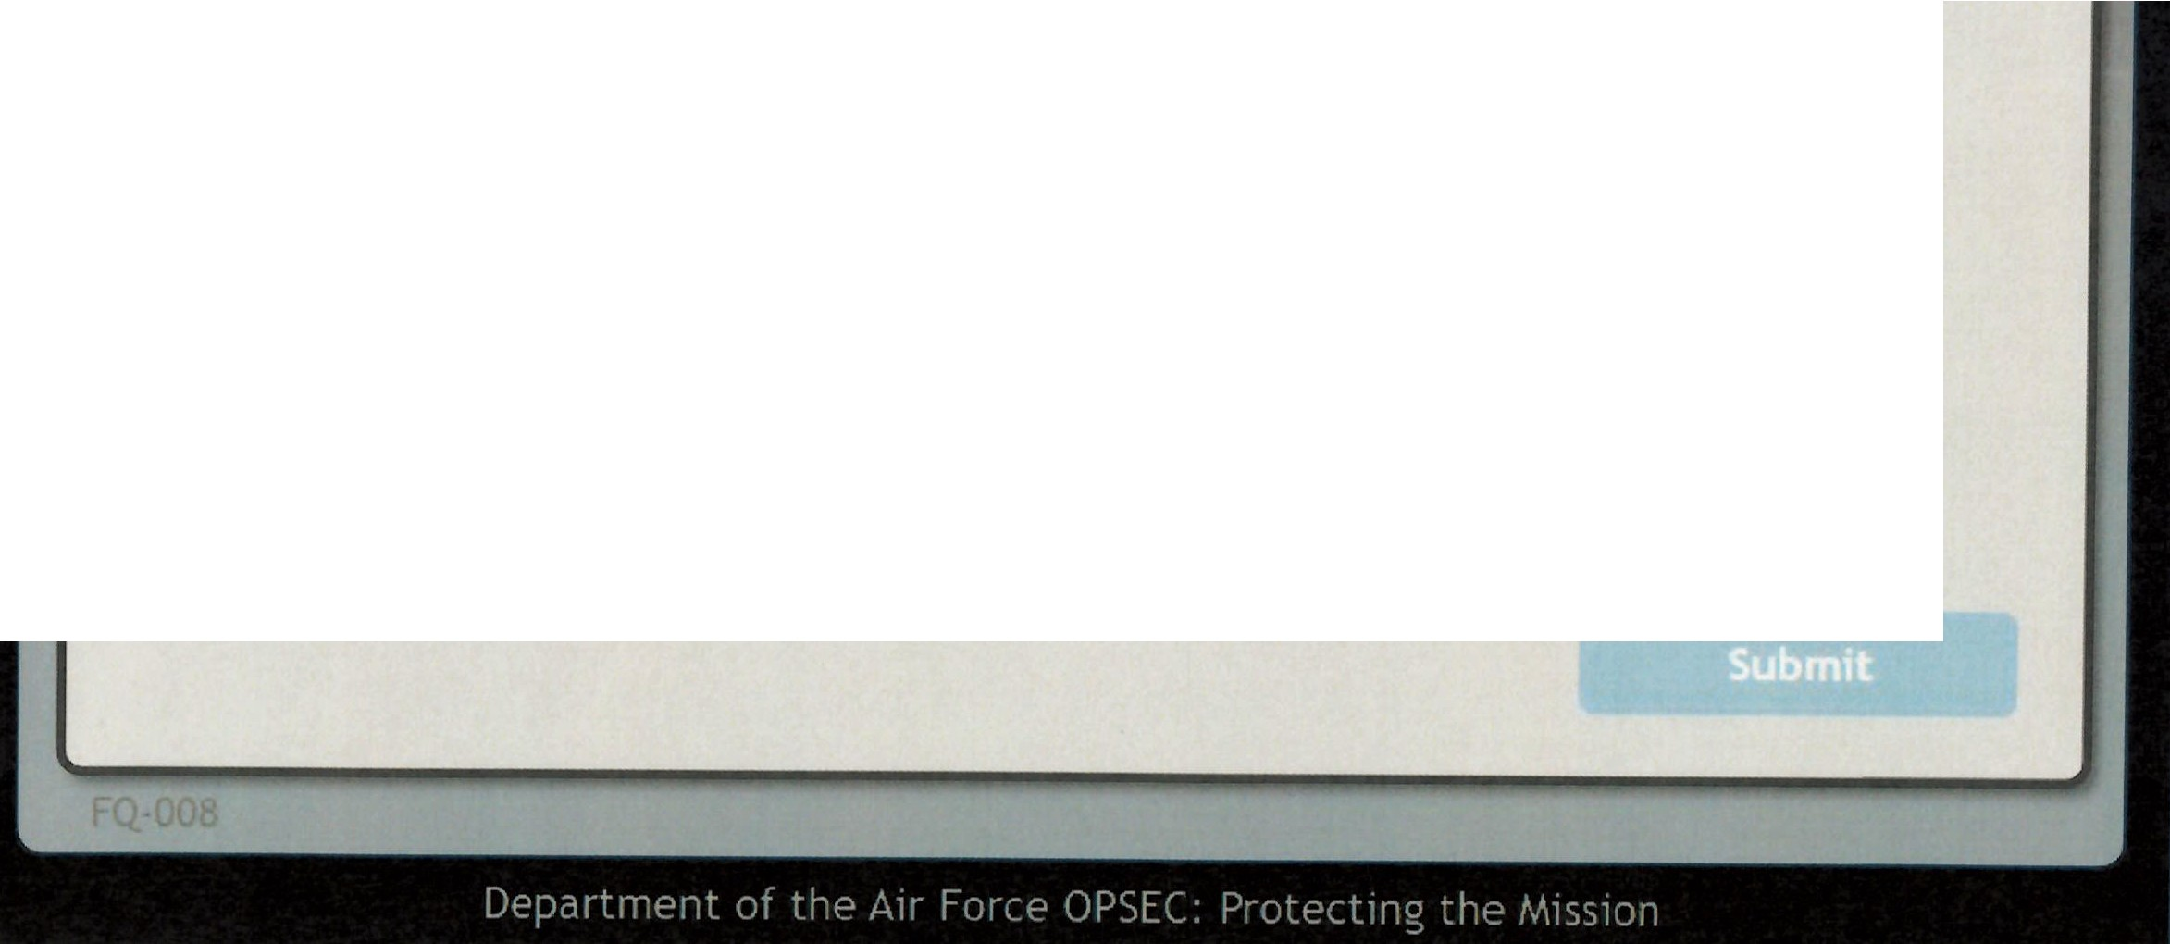
Question 3
Who should you contact to discuss items on your organization's critical information and indicator's list (CIIL)?
Facility Manager
OPSEC representative such as your organization's OPSEC Program Managers or Signature Managers or Coordinators
Security Forces Security Manager

Slide 29
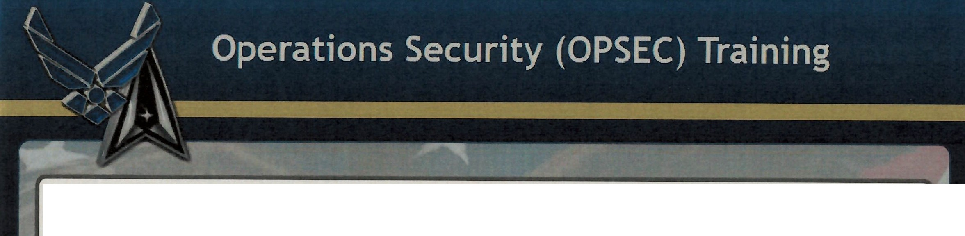
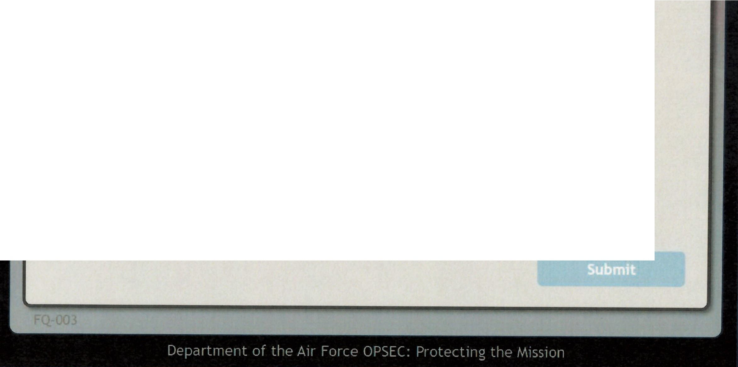
Question 4
An adversary with the and toundertake any actions detrimental to the success of programs, activities, or operations describes an OPSEC threat.
capability, intent intelligence, manpower intelligence, intent capability, manpower

Slide 30
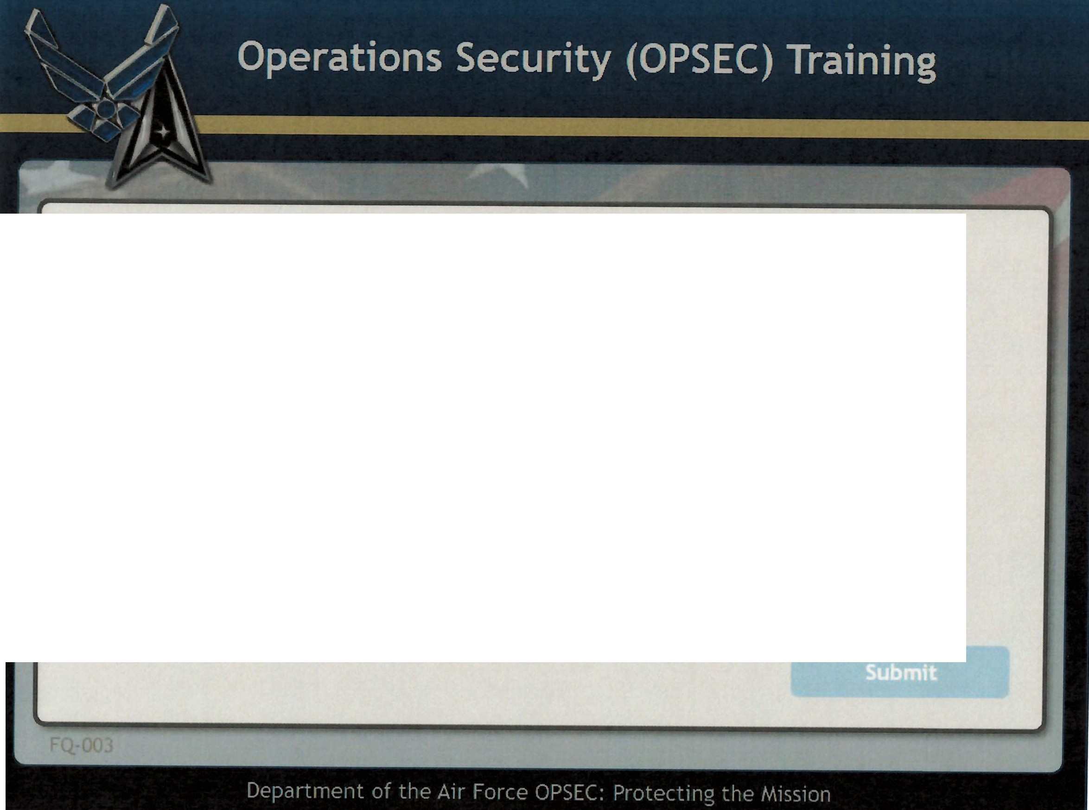
Question 4
An adversary with the and to undertake any actions detrimental to the success of programs, activities, or operations describes an OPSEC threat.
((J)capability₁ intent intelligence, manpower intelligence, intent capability₁ manpower

Slide 31
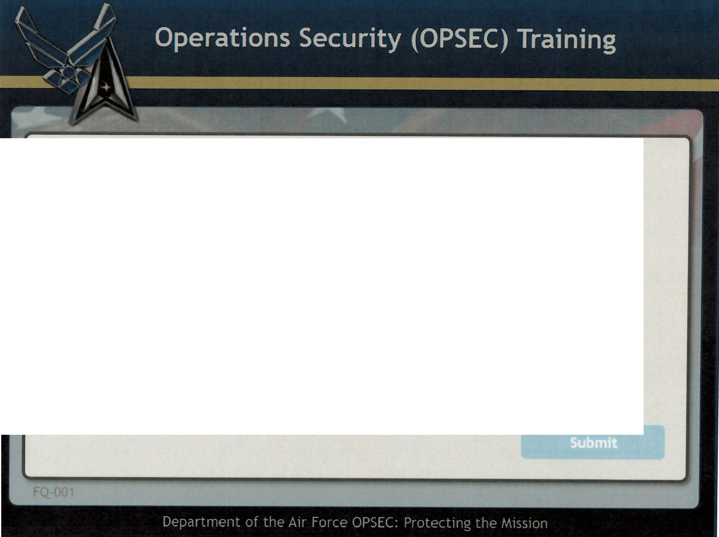
Question 6
OPSEC is a cycle used to identify, analyze, and control indicatini friendly actions associated with military operations and other activities.
essential indicators critical information critical indicators
essential information

Slide 32

Question 6
OPSEC is a cycle used to identify, analyze, and control indicatina friendly actions assodated with military operations and other activities.
essential indicators ([)critical information
critical indicators
essential information

Slide 33
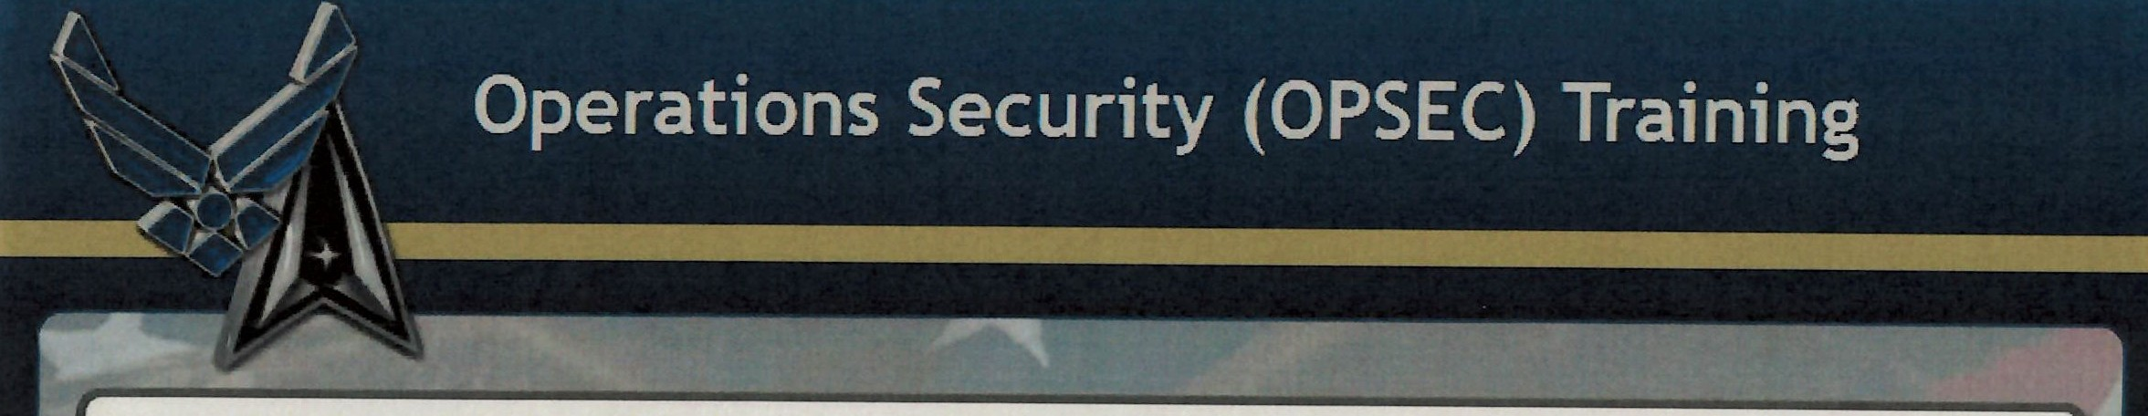


Question 7
The adversary CANNOT determine our operations or missions by piecing together small details of informatfon and indicators.
True
False

Slide 34
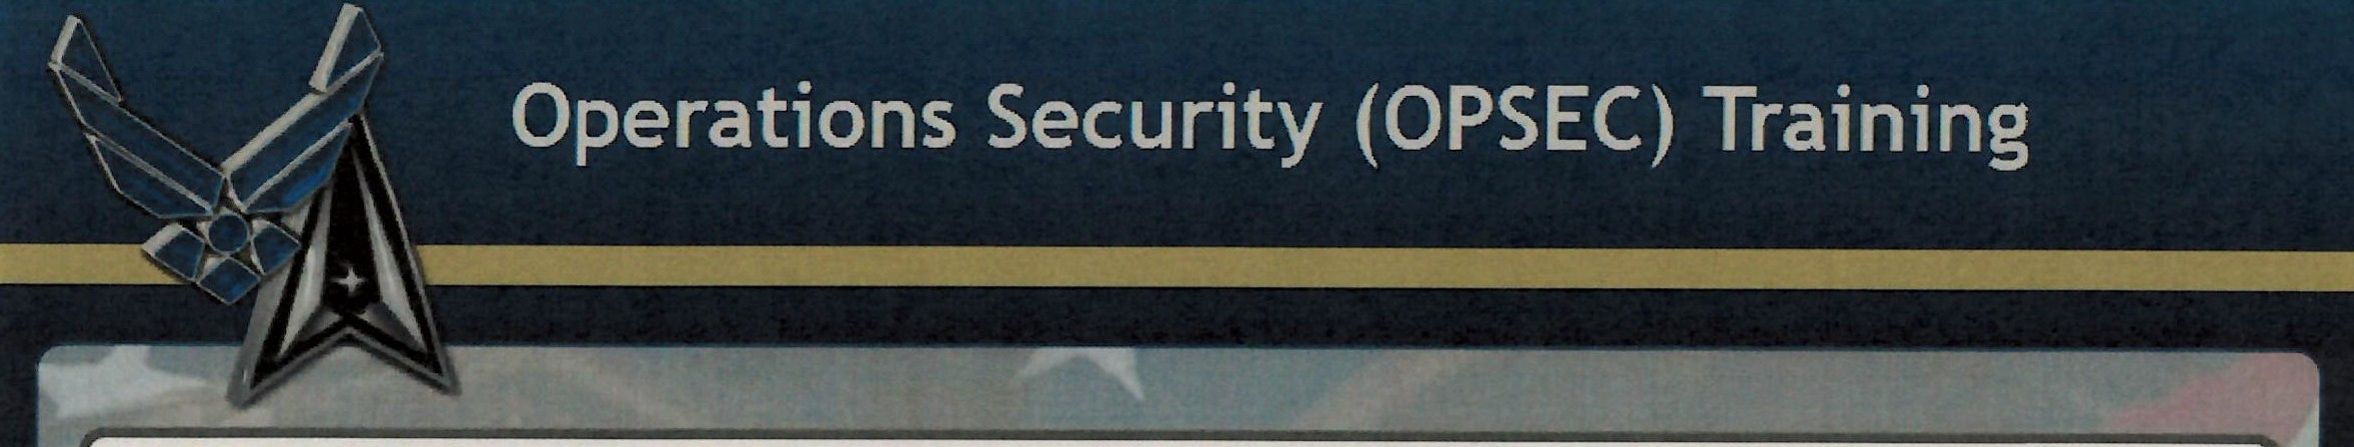
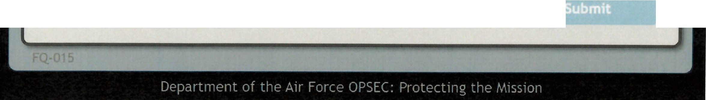
The adversary CANNOT determine our operatfons or missions by piecing together small details of information and indicators.
Question 7
(Cvrrue
False

Slide 35
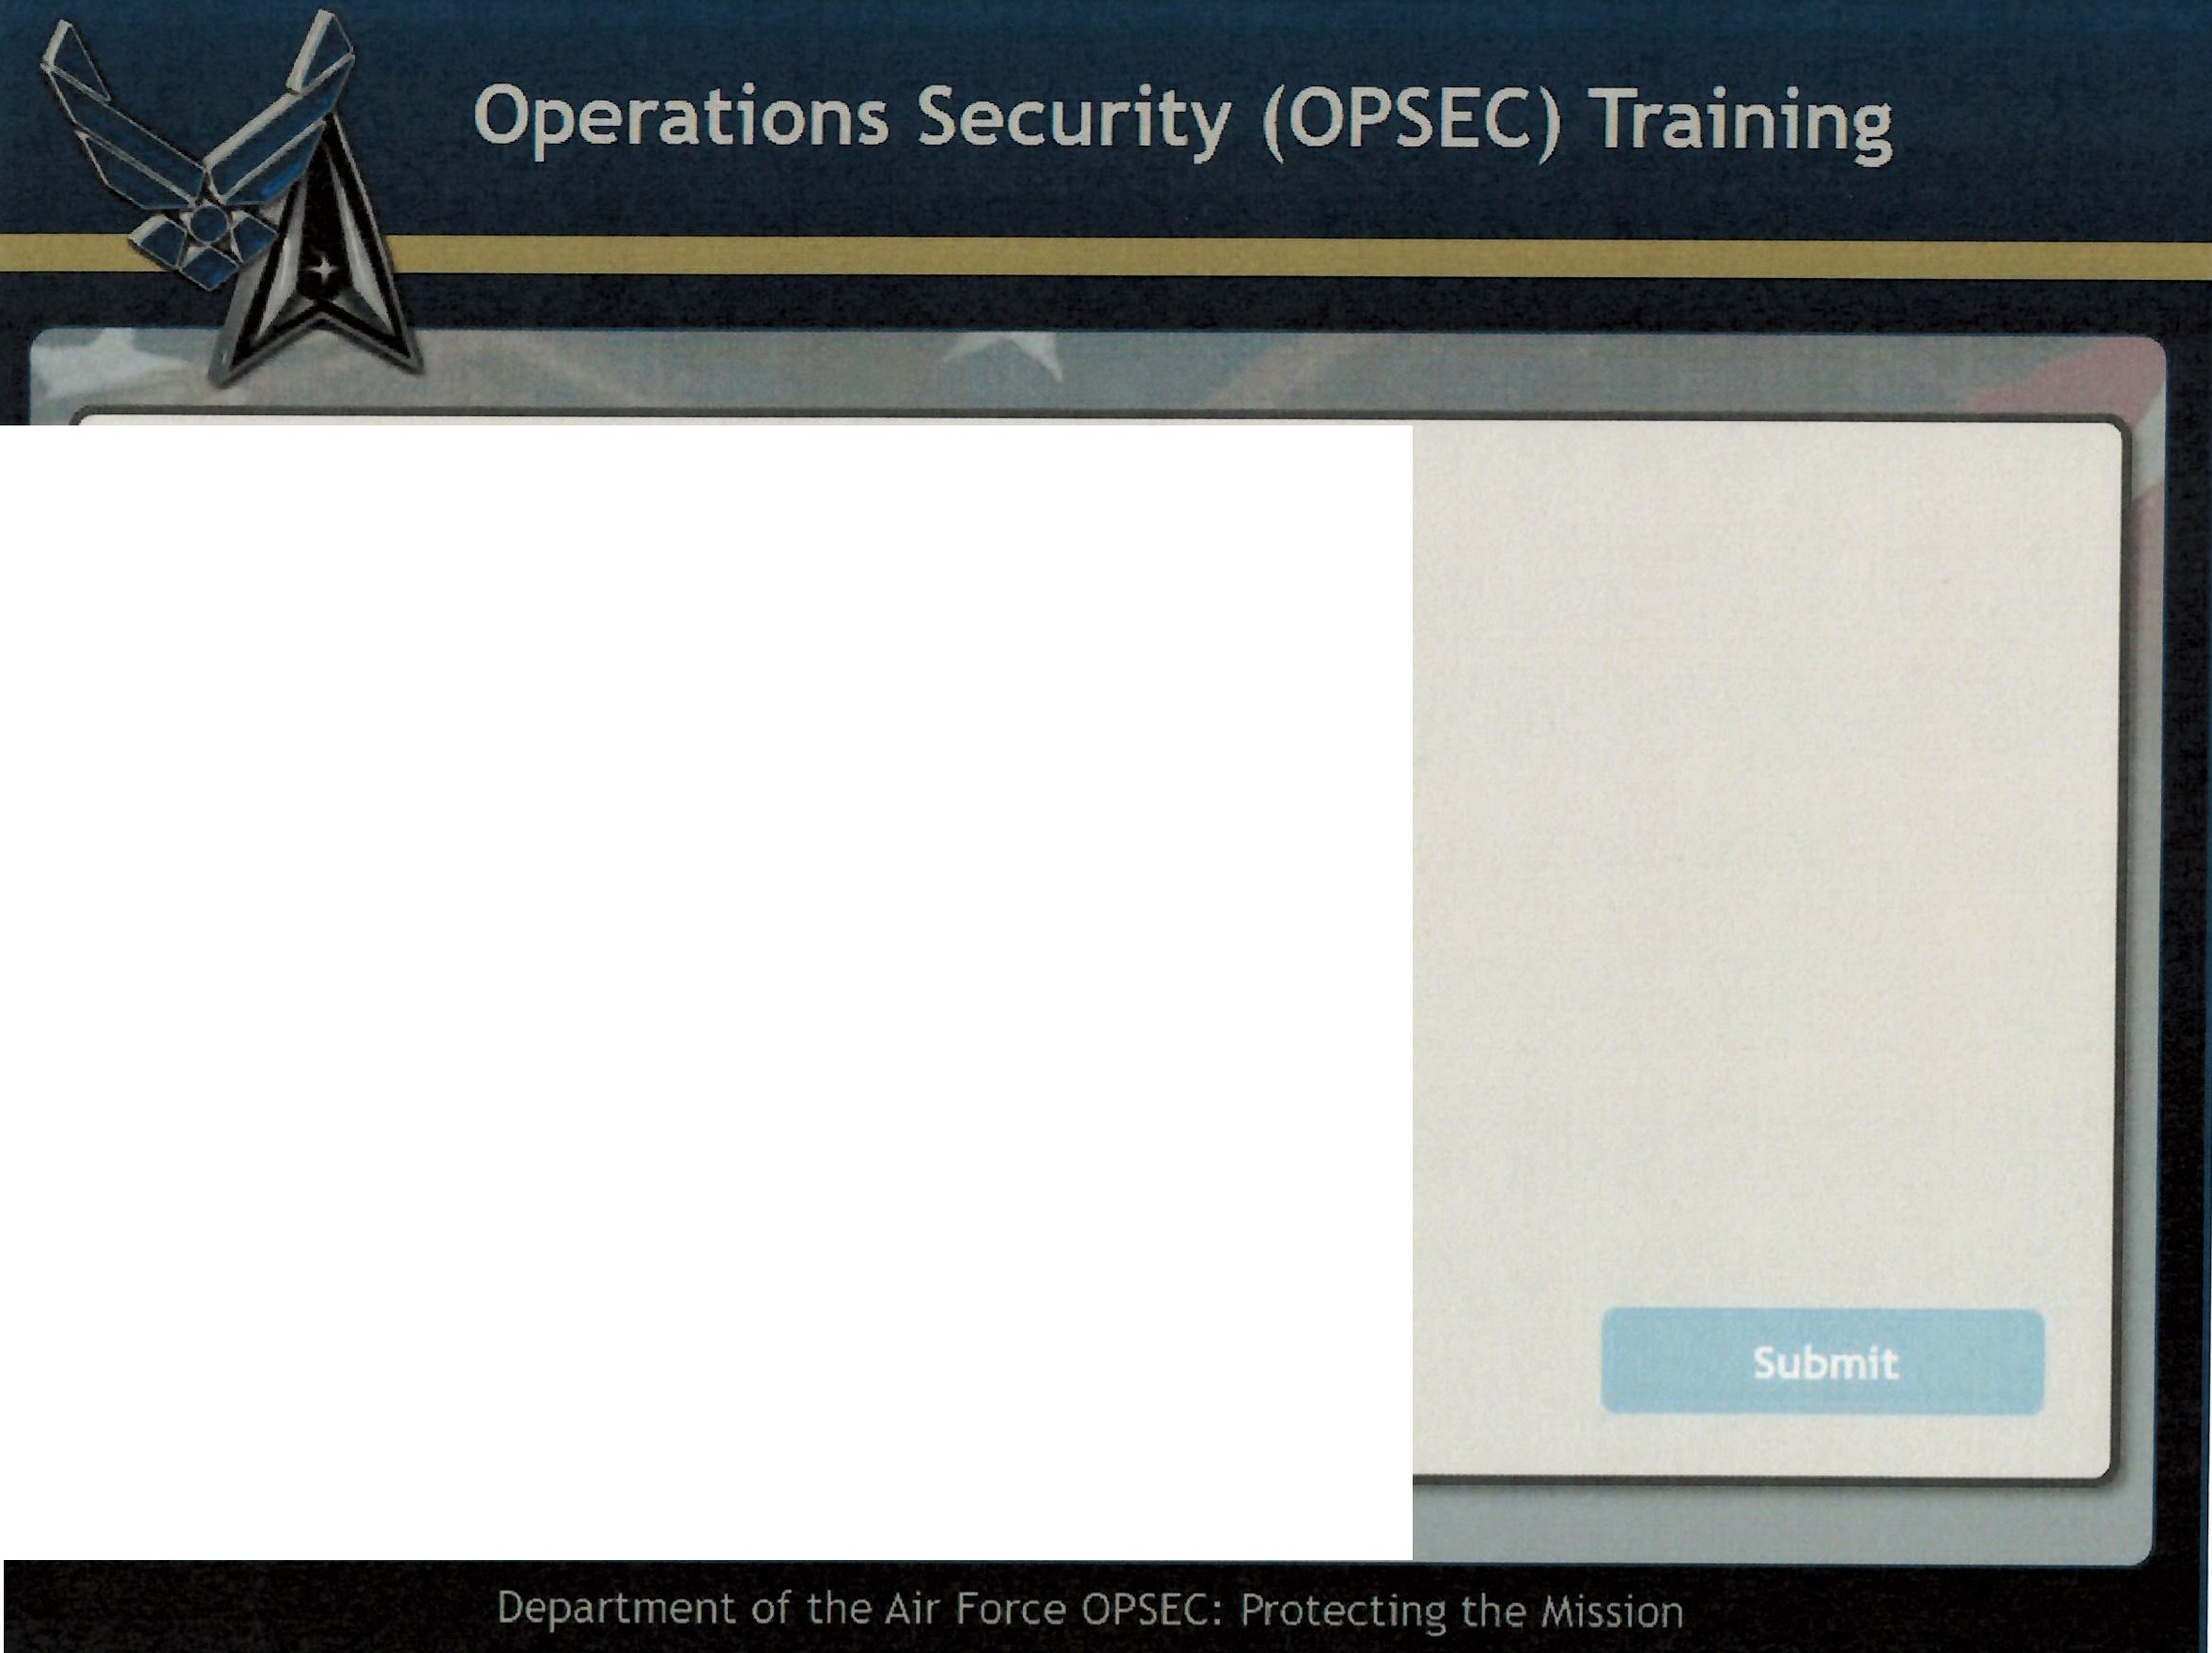
Question 9
Which of the following represents critical information?
Air show dates and locations Deployment dates and locations Ranks and promotions
All of the above

Slide 36
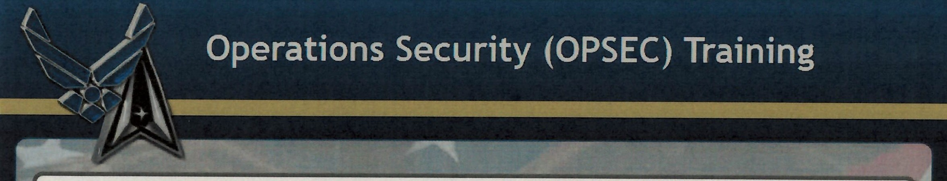
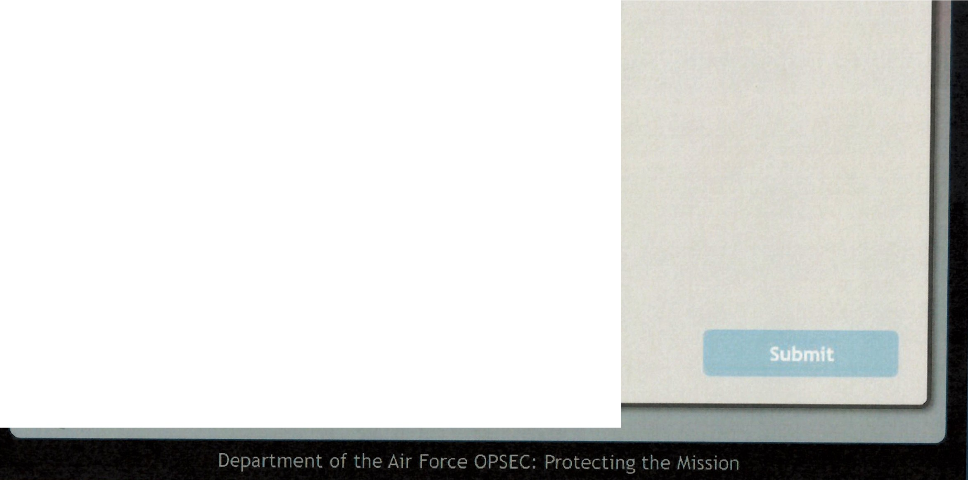
Question 9
Which of the following represents critical information?
Air show dates and Locations
"
Qoeployment dates and locations
- Ranks and promotions
All of the above

Slide 37

Question 10
You are out with friends at a local establishment. A stranger walks up to you and starts to ask about your job and offers to buy you a drink. What should you do?
Deflect them to your friends
Politely decline and change the subject Ask them to the dance floor
Accept the drink and talk

Slide 38

Question 10
You are out with friends at a local establishment. A stranger walks up to you and starts to ask about your job and offers to buy you a drink. What should you do?
--
Deflect them to your friends
(Cy Politely decline and change the subject
Ask them to the dance floor
Accept the drink and talk

