Slide 1

Drug Demand Reduction
(DDR)
75th Air Base Wing
Jeff Hough
Drug Testing Manager

Slide 2
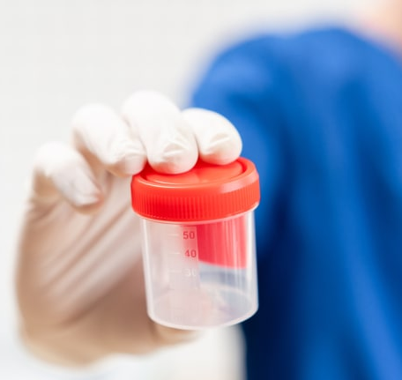
Staff
Program Manager:
  Jeff Hough
  775-5518
Collectors:
  Jen Casperson
  Vaughn Cavender

Slide 3
Location and Hours
Monday – Friday
  0700-1100
  1300-1600
5835 D Ave Bldg 152
  One street east of the BX

Slide 4

Purpose
Overview
The DDR's goals are to enhance mission readiness and foster a drug-free environment through education, prevention, deterrence and community outreach.

Slide 5
References
Operating Guidance:
  AFMAN 44-1977- Military Drug Demand Reduction Program
  AFMAN 44-198- Air Force Civilian Drug Demand Reduction Program
Testing is conducted through the Department of Health and Human Services

Slide 6
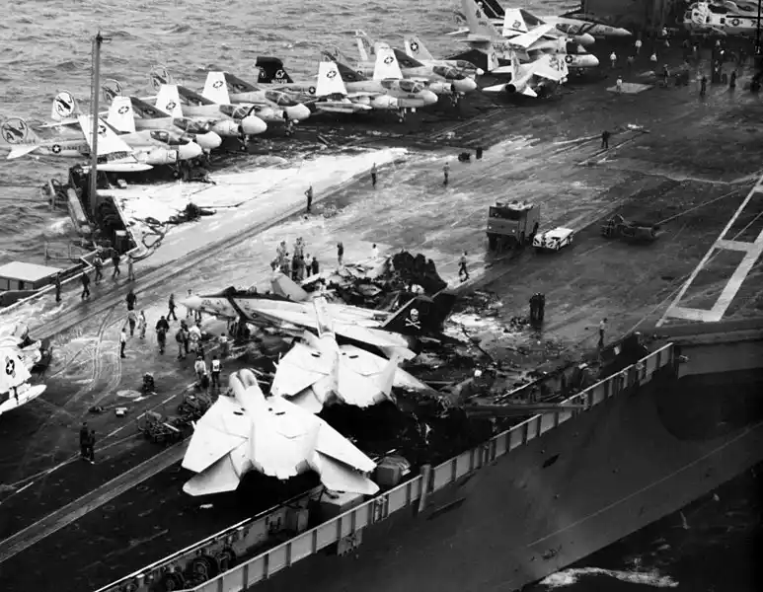
1981 USS Nimitz Aviation Mishap
14 killed, 48 injured, 7 aircraft destroyed, 11 aircraft damaged, $200M in damages ($650M adjusting for inflation)
  Six of the deceased had detectable levels of marijuana in their system. After investigation, it was found that it was the pilot's error that caused the crash.
  President Ronald Reagan implemented the Zero Tolerance Policy because of the incident.
Personnel abusing illicit drugs or prescription medications are a safety hazard resulting in the potential loss of equipment, resources, and lives.

Slide 7
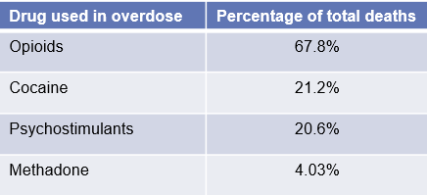
Civilian Drug Testing
Civilian Testing Types
  Random
  Reasonable suspicion
  Consent
  Follow-up
Based on job position
  Must be a Testing Designated Position (TDP)
Currently have just under 4,000 TDPs, out of 10,000 civilian employees.

Slide 8
Notification Process
  Trusted Agents give notice of selection to supervisor
  Only employee’s supervisor can make the notification
  Two hours are given to report for testing
  Three hours are given to produce a sample
  Random tests are not observed

Slide 9
Notification Letter
SUPERVISORS: Put original in employee’s 971 File; give copy to employee to take to testing
MEMORANDUM FOR
FROM: DRUG DEMAND REDUCTION OFFICE
SUBJECT: Notification of Random Drug Testing
You have been randomly selected for urinalysis drug testing. IAW AFI 90-508, all specimens will be tested for marijuana, cocaine, PCP, opiates, and amphetamines. You will have an opportunity to submit medical documentation to the Medical Review Officer to support the legitimate use of any specific medication you may currently be taking.
You must report to 5835 D Ave., Bldg. 152, within 2 hours of date and time below, but no later than the end of testing hours. Testing hours are 0800-1100 Tuesday – Friday and 1300 - 1600 Monday – Friday. Testing starts at 0900 on Mondays. Testing of mid-shift employees will be in the morning at 0700, except for Mondays. Swing shift personnel need to report by 1600.
At the time you check in at the DDR Office, you will be required to present your copy of this signed notification and a photo identification to a DDR staff member. You will also be directed to show the collector all items in your pockets. You may not leave the testing area until a specimen is provided. I acknowledge receipt of this notice and understand that a verified positive drug test or refusal to report or test may result in disciplinary action, which may include removal from federal service.
Employee’s Signature Time/Date Notified
Supervisor’s Printed Name Supervisor’s Signature Supervisor’s Phone #

Slide 10
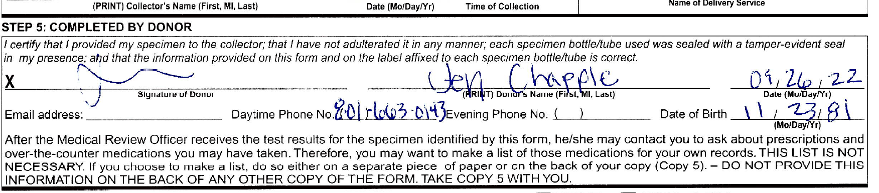
Chain of Custody Document
Write clearly, as the Medical Review Officer uses this information to confirm a positive test has a prescription.
Tests are treated as positive until a valid copy of the prescription is received.
If the Medical Review Officer can’t get ahold of you, they will contact us, and we will inform your supervisor that you need to call them.

Slide 11
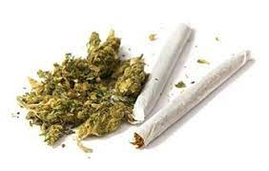
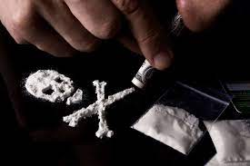
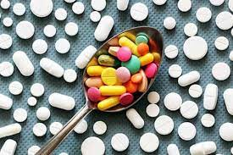
Substances Tested For
THC
  Marijuana, Hashish, Spice
Cocaine
  Morphine
PCP
  Tramadol, Clonazepam
Opioids
  Oxycodone, Morphine, Methadone, Heroin
Amphetamines
  Adderall, Meth, Ecstasy

Slide 12



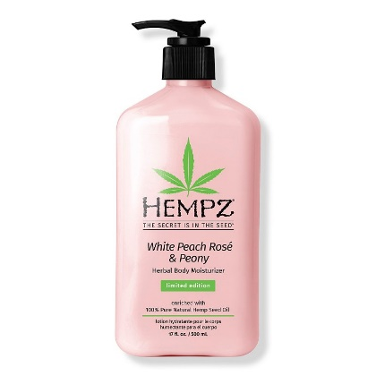
CBD and Hemp
Just Say ‘No’
FDA does not regulate
  May still contain up to 0.3% THC
Lotion, oils, drinks, vape pens

Slide 13
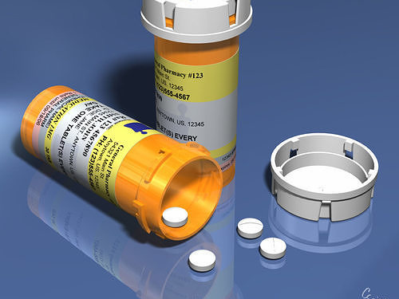
Prescriptions
Prescriptions for controlled substances are only good for 6 months
Even if it was your prescription, you will be positive if you use a prescription after it expires

Slide 14
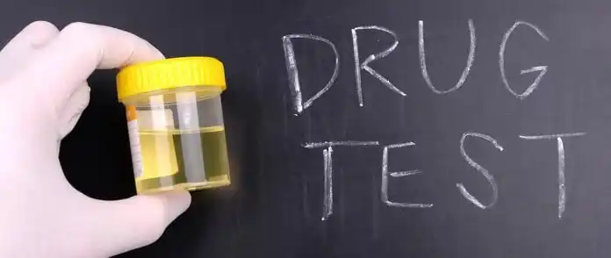
Positive Results
Positive notices are sent to:
  Labor Law
  Civilian Personnel
  Occupational Health
  Squadron Commander/Director
  Supervisor
  Security Forces
  Investigations
  Office of Special Investigations (OSI)
  Security Clearance Office
Other reasons for being reported as positive:
  Violation of Report Time (Everyone is given two hours to report from the time notified)
  Not showing up for your test

Slide 15
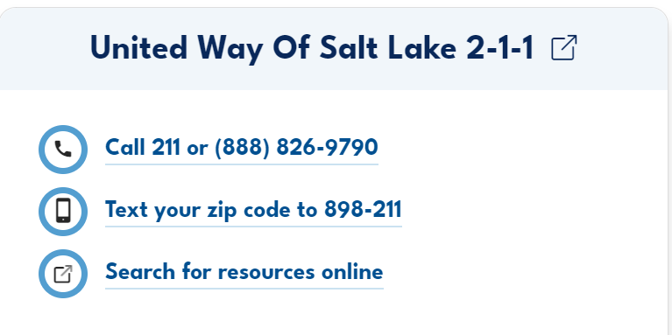

Support
You can voluntarily tell your supervisor you have a substance abuse problem and ask to be put on the Safe Haven program.
You must come forward to a supervisor before you’re discovered as a drug user, or before being directed to report for drug testing.

Slide 16

Questions??

