Slide 1
New Hire Initial Fire Safety and Prevention Training
Hill Fire & Emergency Services
Fire Prevention
777-0236

Slide 2
Overview
Purpose
Additional Hazards
Escape Route
Evacuation
Hazard Trends
Notification
Mass Notification Systems
Hill AFB Bottom Line

Slide 3
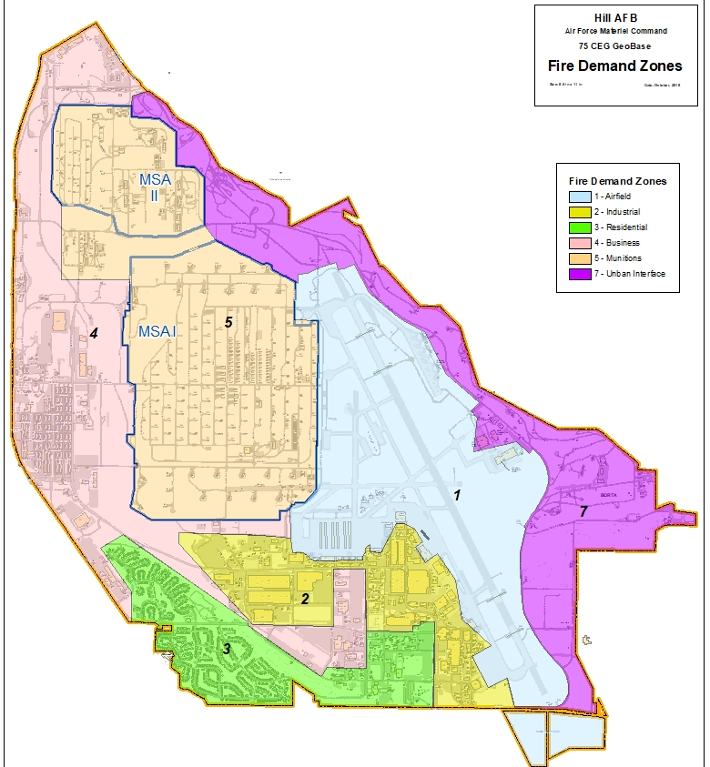
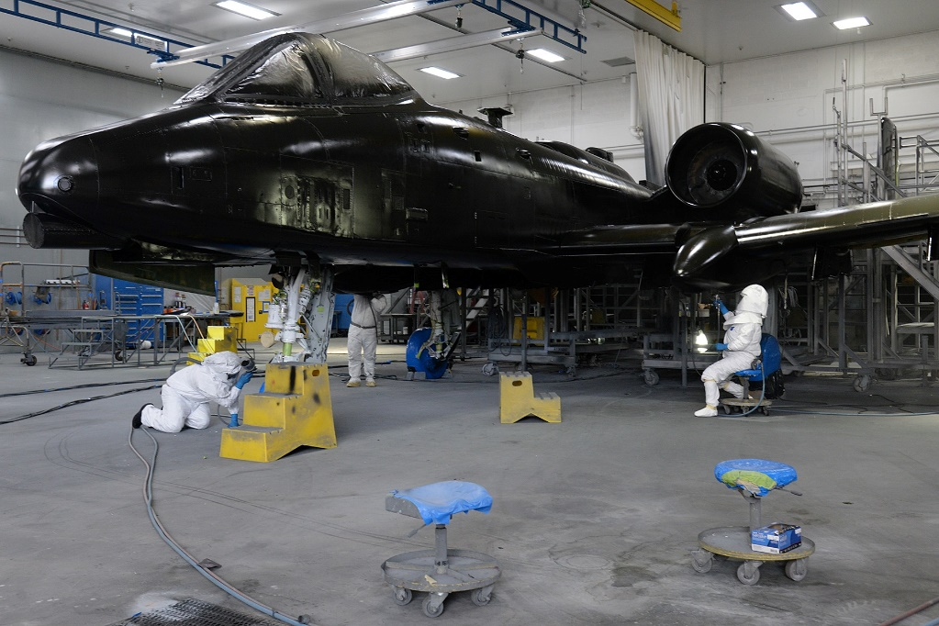
Purpose
Industrial Complex
Notes:
Notes:
Safety – Discuss Initial briefing required by OSHA and Yearly SF 55 updates by supervisor
Discuss Map and how industrial is a major part of our base production and hazards.
Not everyone works directly in an industrial area, but we are all affected by the industrial processes on base.

Slide 4
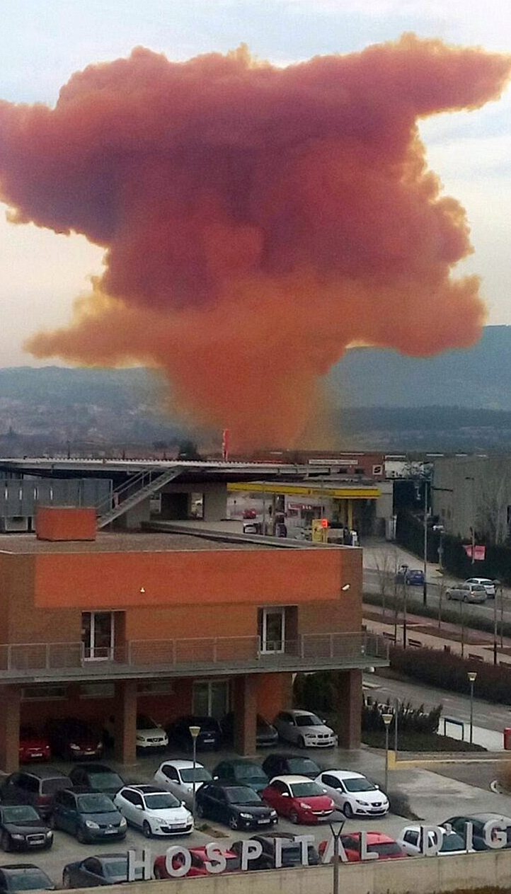
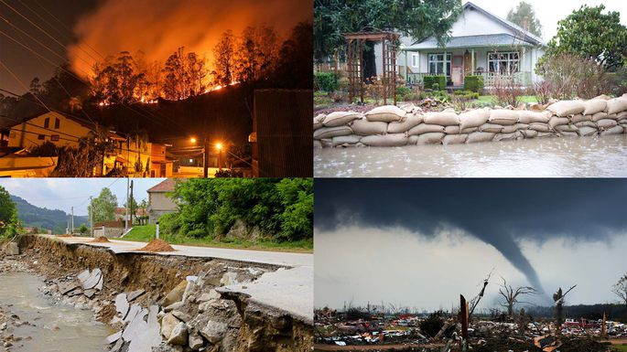
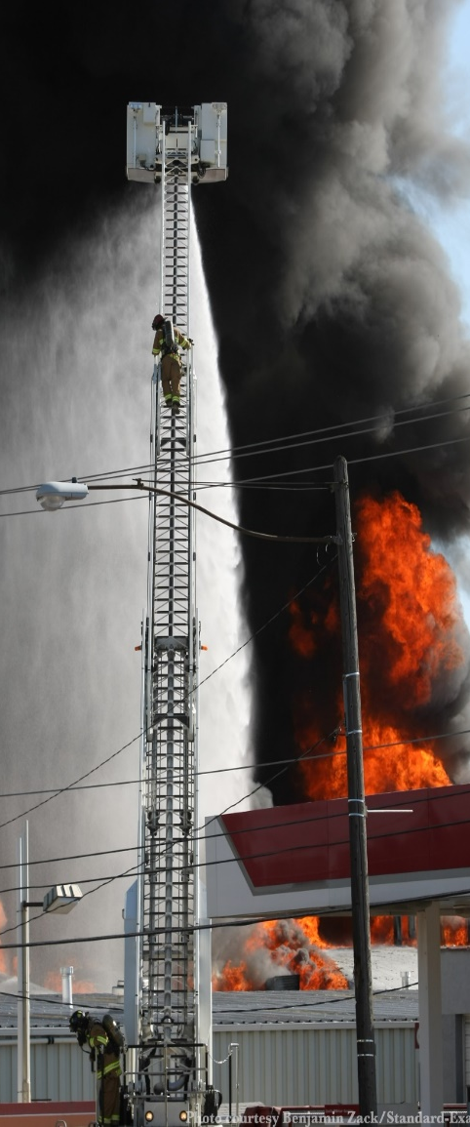
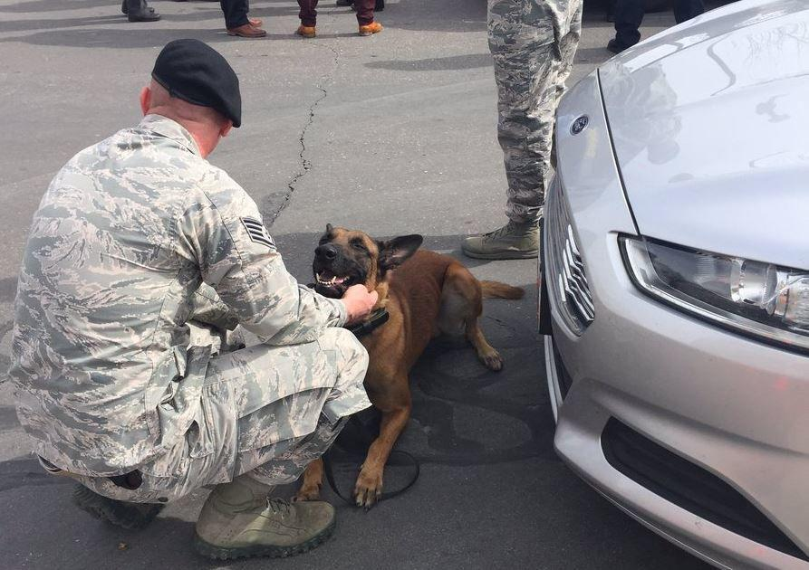
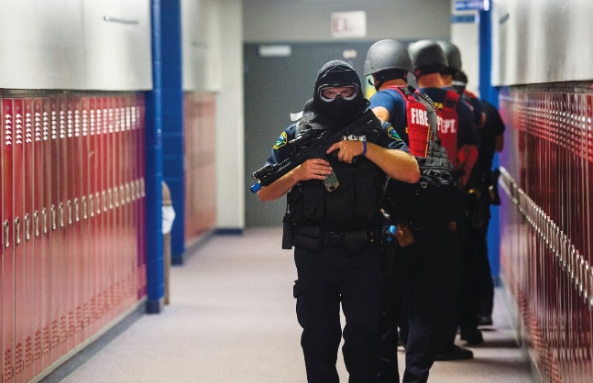
Additional Hazards
Notes:
Note: There are several hazards other than Fire Safety to be concerned with: Toxic Vapors, Explosions, Flooding, Weather, Bomb Threats, and Active Shooter.
Regardless of the threat, ALWAYS know the escape routes from your work area and use them!

Slide 5
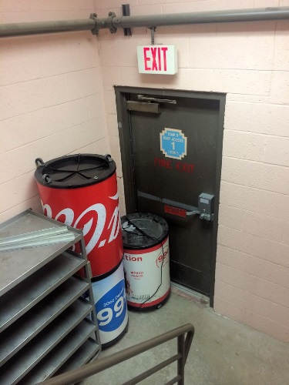
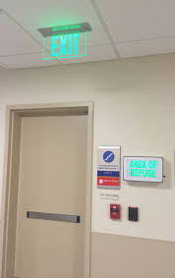
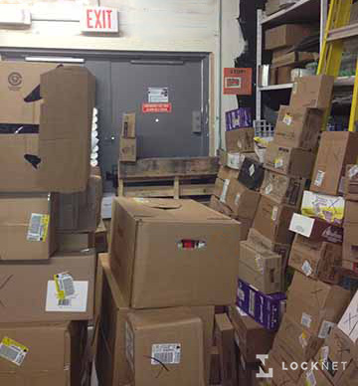
Escape Routes
What are they?
Where are they?
Are they clear?
Are they accessible?
Notes:
Notes: An escape Route is YOUR way of getting out of a building in an emergency.
Familiarize yourself with all the ways out of your work area and building.
Express that it is the new employees responsibility to be the new set of eyes to make changes to existing hazards. If it looks wrong, it probably is.

Slide 6


Evacuation
Notes:
Notes: engage with the audience about 4 things that went wrong with the evacuation drill?

Slide 7

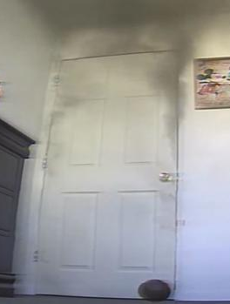
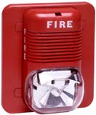
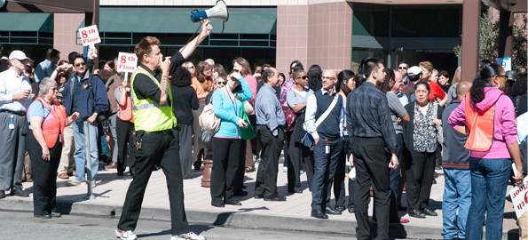


Evacuation
Get out every time:
Notes:
Notes: Evacuate when they see smoke or fire, smell burning and when an alarm sounds. Treat every alarm as an actual emergency.
Explain that dialing 9-1-1 from a cell phone goes off base.
Employee must understand their roll during an emergency. Talk to supervisor for further clarification

Slide 8

Why Evacuate?

Slide 9
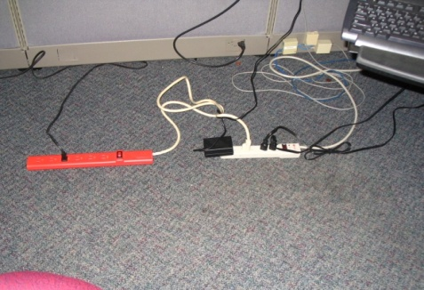
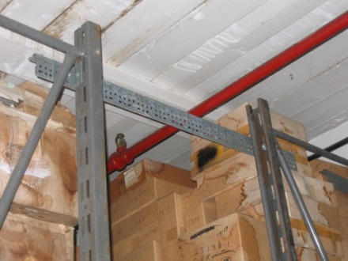
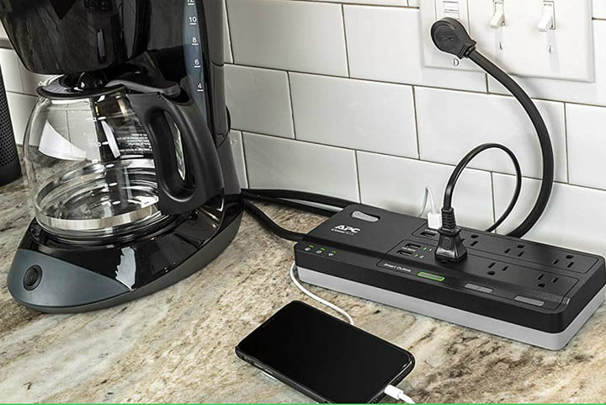
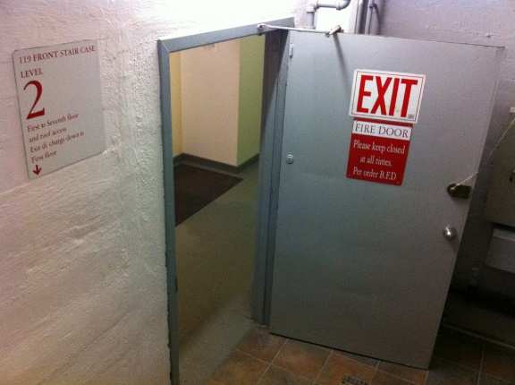
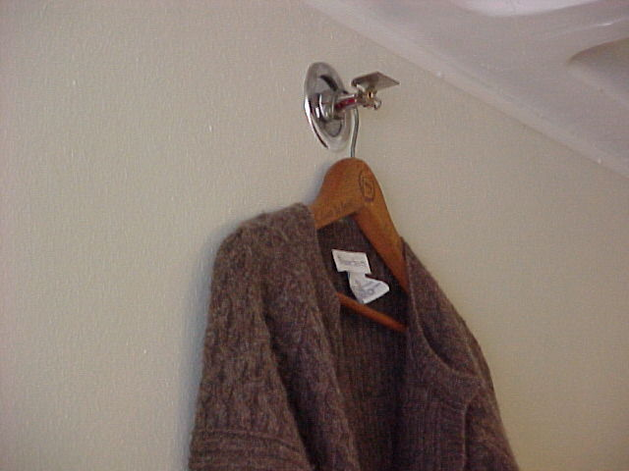

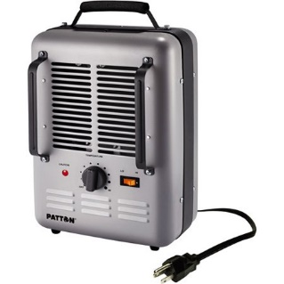
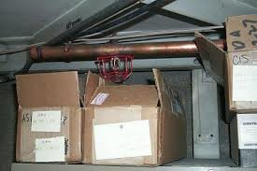
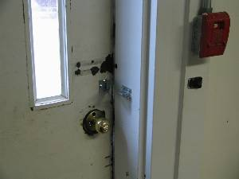
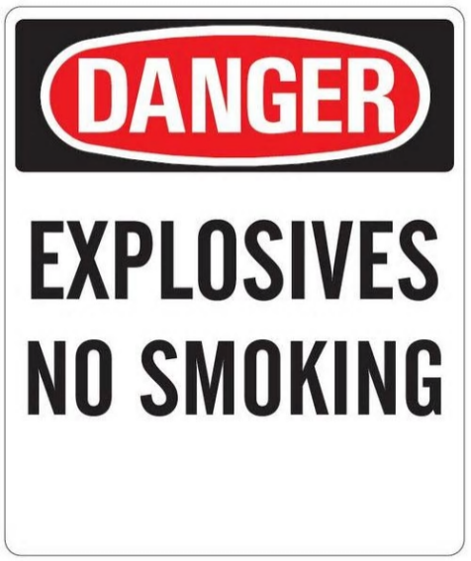
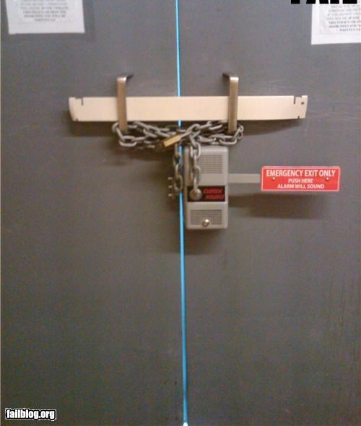
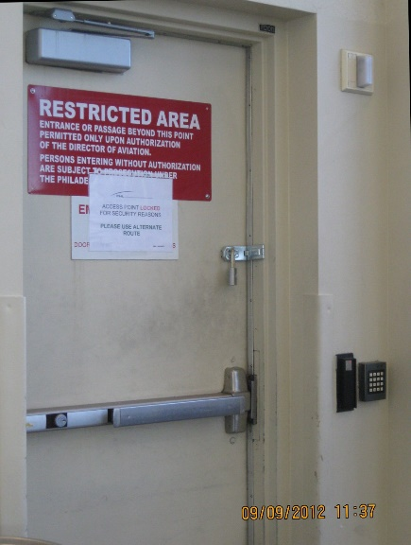
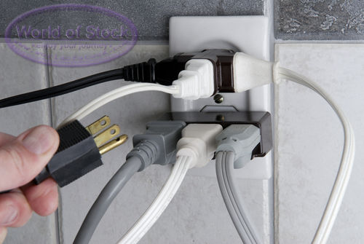
Hazard Trends
Notes:
Notes: Engage the group to discuss 4 of the hazards

Slide 10


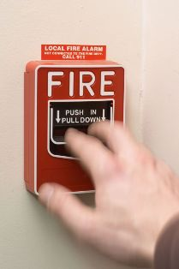

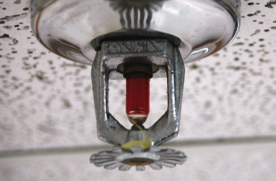

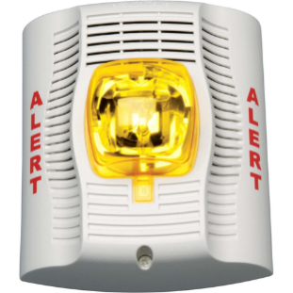
Notification
Landline 9-1-1
Cellphone 9-1-1
Fire alarm pull station
Device Activation
Mass Notification System
Notes:
Notes: Reiterate calling from a cell phone will go to an off base dispatch center.
Pull stations should be activated while exiting the building
MNS is becoming common on base

Slide 11
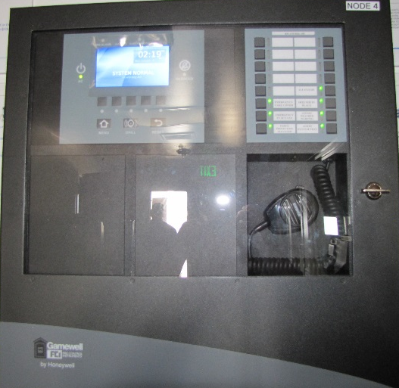
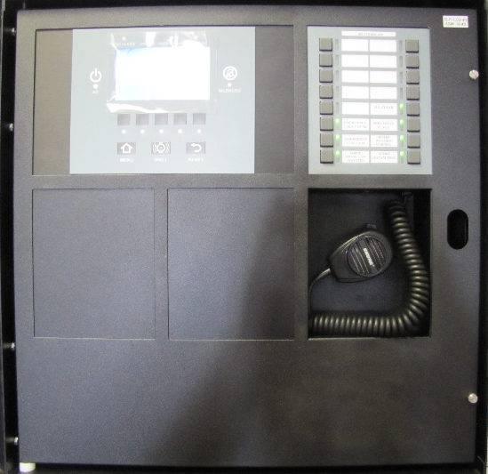
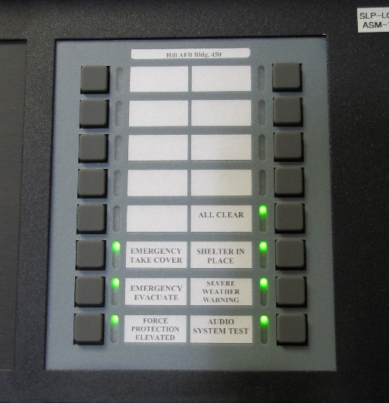
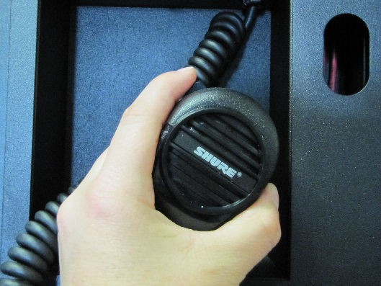
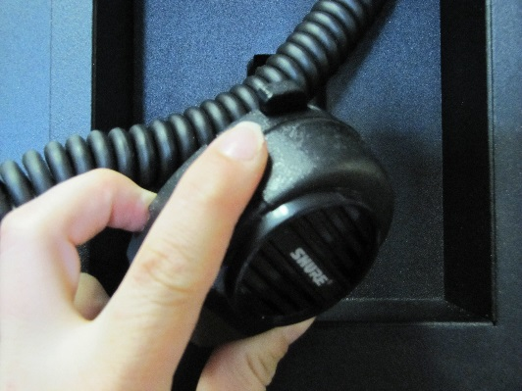
Mass Notification System
Locate the MNS Panel (Usually Main entry point)
Select pre recorded Emergency Notification button
Or
Key microphone and make PA announcement

Slide 12
The Bottom Line
Shout “FIRE – FIRE – FIRE”
Until you can better notify occupants
Evacuate safely to the nearest exit
Initiate Pull Station or Emergency Notification System
Meet at your designated rally point
Call 911 and tell them “I am on Hill AFB”
Give location and any additional information
Ie: where fire is located, what is on fire
Stay at rally point until released
DO NOT REENTER THE BUILDING
Notes:
Notes: This is the most important slide. Put emphasis on notifying building and calling 9-1-1.

Slide 13
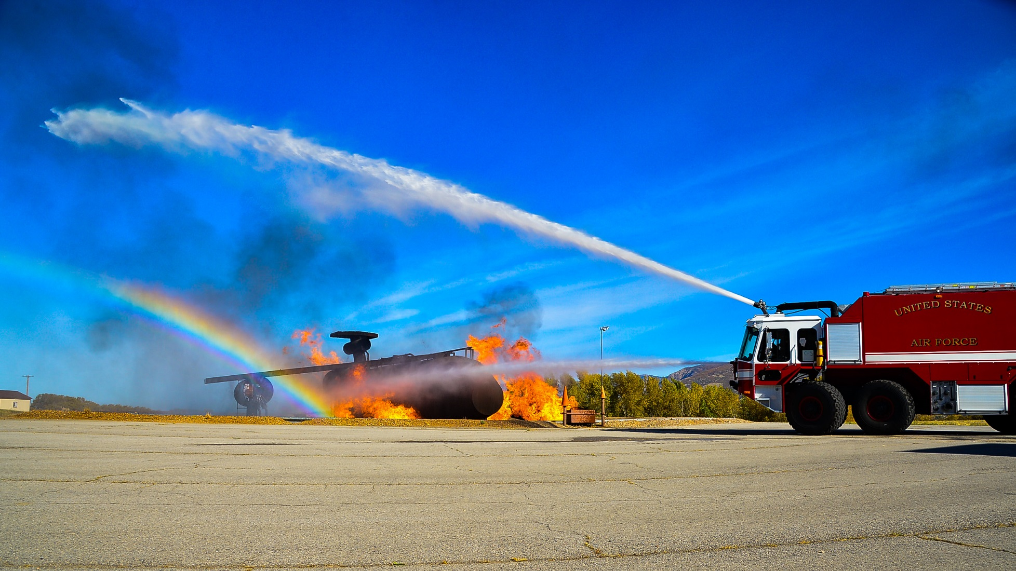
Questions?
Hill AFB Fire Prevention Office 801-777-0236
Hill AFB Fire Department 801-777-3021
Thank You and Have a Great Air Force Day!
Facebook @HillFD

